Slide 1

Integrative Approaches to Psychology and Christianity – 4th ed.
Chapter 11
Allies as Subjects
of One Sovereign
David N. Entwistle, PsyD
These slides are designed to accompany Integrative Approaches to Psychology and Christianity, 4th ed.
Material protected by copy write. Users are welcome to make changes to the presentations and to use them for educational purposes, provided that the original acknowledgement is maintained and any changes to the presentation clearly identified.

Slide 2

PowerPoint Slides to Accompany
Integrative Approaches to Psychology and Christianity, 4th Edition
Chapter 11
Allies as Subjects of One Sovereign

Slide 3
The Allies as Subjects of One Sovereign model recognizes that:
We are subjects of God – we should serve God in every area of our life
Psychology and Theology are both “subjects” (disciplines) over which God is sovereign
Integration itself is subject to God’s sovereignty and should serve godly ends

Slide 4

Earth’s crammed with heaven,
And every common bush afire with God;
But only he who sees, takes off his shoes,
The rest sit round it and pluck blackberries,
And daub their natural faces unaware.
—Elizabeth Barrett Browning

Slide 5
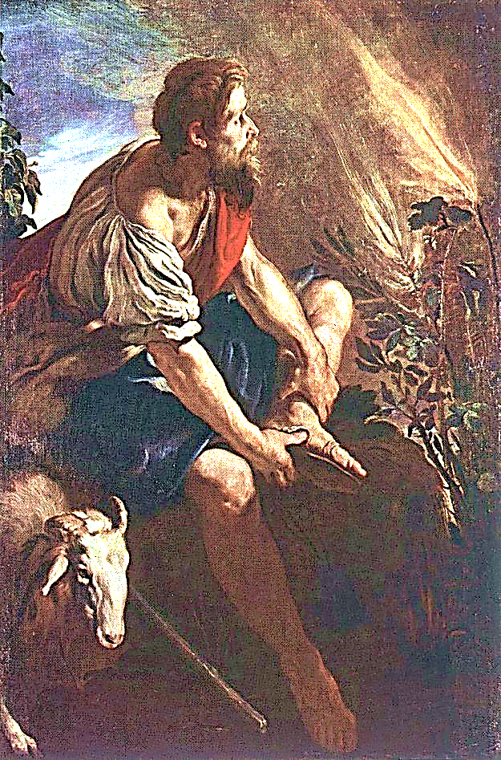
Give us eyes to see…
In Exodus 3, Moses is on Mt. Horeb when “the angel of the Lord appeared to him in flames of fire from within a bush” and “though the bush was on fire it did not burn up” (3:2, NIV). This event led to an encounter with God.
Is it any less of a divine encounter when we recognize the unseen hand of God which gives us beauty or food from a common blackberry bush?
Moses before the Burning Bush
Domenico Fetti, 1613-14
Kunsthistorisches Museum Vienna, Austria
Public Domain

Slide 6
Starting points
The starting point of the Allies model is the assertion that God’s sovereignty reigns over all of life. God created and sustains all things; All truth is God’s truth.
We are to serve Him in all that we do, including our work in academia and in our professions.

Slide 7
Starting points
Every academic discipline asks three basic questions:
Where are we?
Where are we trying to go?
How do I get there?

Slide 8
Starting points
What do Christians believe?
Scripture
Creeds (apostles, Nicene)
The narrative of creation, fall, redemption, consummation
The Trinity and the centrality of the death and resurrection of Jesus Christ

Slide 9
All of life is sacred
The basic Judeo-Christian affirmation that all of life is sacred can be seen in the blessing given before one eats; there is an intimate connection between God’s blessing and human activity.
“Barukh ata Adonai Eloheinu, melekh ha'olam, hamotzi lehem min ha'aretz” – “Blessed are You, LORD our God, King of the universe, Who brings forth bread from the earth.”

Slide 10

Core Convictions
The most basic formulation of Jewish theology was the Shema: Shema yiśrael adonai eloheynu adonai ehad.
“The Shema is not a prayer . . . but a confession of faith.” It emphasizes “God’s oneness,” the call for Israel “to love him and obey his commandments.”

Slide 11
Core Convictions
“In Hebrew thought the essence of true godliness is tied primarily to a relationship, not to a creed . . . For the Hebrews, personal or individual relationship has always been far more expressive of the heart of religious faith than mere intellectual assent to abstract statements or religious ideas.”

Slide 12
Core Convictions
When asked about the most important commandment, Jesus affirmed the Shema and immediately proceeded to focus on the duty to love God and others (Matt 22:36–40). Jesus affirmed the importance of correct doctrine and the actions that should be impelled by belief (Mark 12:29–31).

Slide 13
Core Convictions
The most basic doctrines of the Christian faith are held by Catholic, Orthodox, and Protestants at all times and places, but distinctions between Christian movements are clearly evident.
Orthodoxy (right belief) must exist hand in hand with orthopraxy (right action).

Slide 14
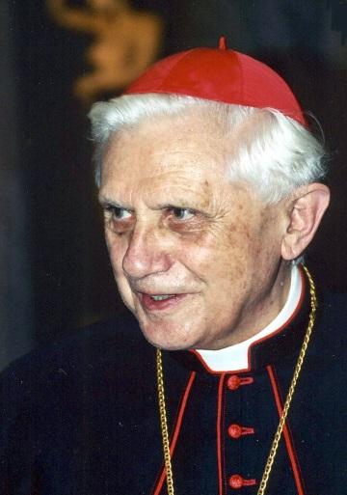
A Christian Framework for Psychology
“Without God man neither knows which way to go, nor even understands who he is.”
– Pope Benedict XVI
What it means to be human lies at the core of psychology, but a Christian view of humanity is sometimes startlingly different from the philosophical anthropologies offered by rival worldviews which partly shape contemporary psychology.
Photo Credit: Joseph Kardinal Ratzinger, 12 May, 2001: Manfredo Ferrari, Public Domain.

Slide 15
“We see nature, persons, society, and the arts and sciences in proper relationship to their divine Creator and Lord.” (Holmes)

Slide 16
The Allies Model affirms that – acknowledged or not – all forms of knowledge rest on God’s Sovereignty
“Therefore the lands belong to none of you,
The borders will not hold, the Law will never serve the lawless.
To every people the land is given on condition.
Perceived or not, there is a Covenant….”
—Leonard Cohen

Slide 17
A Christian Framework for Psychology
The discipline of psychology studies humanity through the light of reason, which, whether or not we recognize it, is a quality given to us by God.
Applied psychology can be a means through which God’s healing grace are expressed, whether or not we recognize God’s involvement.

Slide 18
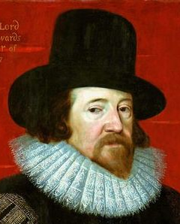
Basic Assumptions of the Allies Model
“To conclude, therefore, let no man … think or maintain that a man can search too far or be too well studied in the book of God’s word, or in the book of God’s works; divinity or philosophy; but rather let men endeavor an endless progress or proficience in both.”
The Allies model is premised on the belief that God’s truths are revealed in the book of God’s Word (Scripture) and the book of God’s Works (creation).
Portrait of Francis Bacon, Paul van Somer, 1617, Palace on the Water, Warsaw, Poland. Public domain.

Slide 19
Historical context
“I propose [that we should] maximize the dialogue between theology and the natural disciplines. According to this model, the natural disciplines and theology, by definition, depend upon one another for completing their respective tasks of exploring God and His world in order to provide the fullest possible picture of them.” (Hasker)

Slide 20
Starting points
Disciplinary Distinctives and Sources
Psychology is primarily concerned with understanding human beings within the context of the book of God’s Works
Theology is primarily concerned with understanding human beings within the context of the book of God’s Word

Slide 21
Basic Assumptions of the Allies Model
The Allies model recognizes that psychology is a unique discipline and affirms that people working in this field – whether in theory, research, or praxis – have unique insights with which we must be fully conversant if we are to engage the discipline as it exists today.
The Allies model does caution, however, that we must be vigilant about ways that secular assumptions often shape the discipline of psychology in ways that may require critique from a Christian perspective.

Slide 22
Given their diverse methods, source materials, and goals, theology and psychology emphasize different things.
Theological reflection typically focuses on God’s workings in the world;
Psychological reflection typically focuses on the workings of God’s world.
Note in the diagram on the following page that this model recognizes that – even apart from divine revelation – secular disciplines have access to truth through common grace, though it also recognizes a variety of limitations including the noetic effects of sin.

Slide 23
Common / Prevenient Grace
General Revelation
Special Grace
Special Revelation
God as Creator and Sustainer
Restraint of sin
(through civil authority, etc.)
Moral sense
Blessings given to all humankind (e.g., the ability to obtain knowledge)
Direct revelation of God
Redemption of all things
Filtered through culture, worldview, personal experience, methodologies, noetic effects of sin, etc.
Academic Disciplines Christian Theology

Slide 24
Procedures
Disciplinary segregation
Observing effects of religious belief and practice
Rejecting errant psychological or theological interpretations.
Modifying errant psychological or theological interpretations.
Observation of parallels
Bringing psychology and theology into a dynamic, consonant relationship

Slide 25
Procedures and Parallels
Disciplinary segregation is necessary for methodological purposes; psychology will always rely on the philosophical and historical underpinnings and empirical and non-empirical research methods unique to the discipline; Christian theology will utilize hermeneutics, history, critical reflection, and so forth in studying God’s Word.
Even at the disciplinary level, we cannot claim to be agnostic—we take our basic beliefs with us and they inform the questions that we ask, the methods that we use, and the ends that we seek.

Slide 26
Procedures and Parallels
The Allies model allows us to observe psychological effects of religious belief and practice.
As we explore human nature, guided by basic Christian presuppositions and utilizing the methods of psychology and theology, we will sometimes need to reject or modify our views as the clarity of one book or the other helps us to identify our misinterpretations.
The observation of parallels between psychology and Christian theology can be a first step toward integration, and an integrative view can lead to the search for such parallels.

Slide 27



Integration of what?
Christianity and Psychology?
Christian Theology and Psychology?
“Christian Counseling” (psychotherapy and principles of biblical counseling)?
Development of a uniquely Christian Psychology?

Slide 28
Integration:
Integration in the context of
  merger or wholeness,
  a whole number (not a fraction),
  a complex whole composed of various parts,
  equality vs. segregation

Slide 29
So what is integration?
The integration of psychology and Christianity is a multifaceted attempt to discern the underlying truths about the nature and functioning of human beings from the unique vantage points of psychology (in its various sub-disciplines, utilizing diverse methodologies) and Christianity (in theology, faith, and practice).

Slide 30
Levels of Integration
Worldview integration – integration begins with basic Christian assumptions (creation, incarnation, reconciliation), and embraces a telos of faithful stewardship to God.
Christian scholarship must be cognizant of our beginning points and our goals.

Slide 31
Levels of Integration
Foundational Integration – developing an understanding of the historical and philosophical foundations of psychology and Christian theology as distinct disciplines.

Slide 32
Levels of Integration
Disciplinary and Scholarly Integration – developing a more complete picture of a common subject by exploring psychological and theological perspectives.
  Intradisciplinary – consistency of praxis and theory
  Interdisciplinary – critique of theology by psychology, and critique of psychology by theology

Slide 33
Levels of Integration
Applied integration asks how Christianity and psychology ought to be applied to concrete situations such as Alzheimer’s disease, marital conflict, despair, and racism.
At this level, we explore how psychology and Christian theology can aid us in confronting personal and social issues that are within the scope of their mutual concern.

Slide 34
Levels of Integration
Public and Personal Integration – integration is done by people, and importantly, by people who live and work in community. It is a social enterprise in which dialogue, critique, and support are found. The integrative task is too large for any individual to accomplish effectively; it must be a shared responsibility.
Integration is also intensely personal – integration is quest for personal wholeness.

Slide 35
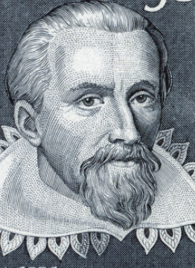
Reflection Point
Image adapted from 1971 stamp printed in Germany.
Public domain.
“Then I think, since in relation to the book of nature, we astronomers are priests of Almighty God, we should not consider the glory of our intellects, but the glory of God . . . I am content with the honour of standing guard with my discovery at the door of the shrine at whose high altar Copernicus performs divine service.”
Johannes Kepler, 1598
How might Kepler’s sentiment apply to all of us who study the book of God’s Works?
How can we heed Kepler’s warning to “not consider the glory of our intellects, but the glory of God” in our academic and disciplinary pursuits?

Slide 36
Reflection Point
What are some of the advantages and disadvantages of the Allies perspective?
What are some of the implications of the recognition that integration takes place at different levels (worldview, foundational, disciplinary and scholarly, applied, personal and public)?

Slide 37






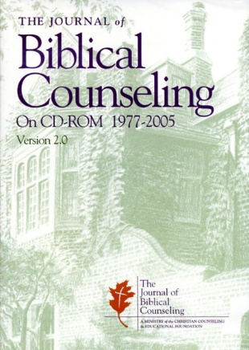
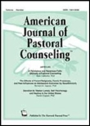
Practical differences
Christian Counseling Today
J. of Biblical Counseling
J. of Pastoral Counseling
J. of the Psychology of Religion
J. of Psychology and Theology
J. of Psychology and Christianity

