Slide 1

Integrative Approaches to Psychology and Christianity – 4th ed.
Chapter 10:
Intermediate Models
Spies, Colonialists, Rebuilders, and Neutral Parties
David N. Entwistle, PsyD
These slides are designed to accompany Integrative Approaches to Psychology and Christianity, 4th ed.
Material protected by copy write. Users are welcome to make changes to the presentations and to use them for educational purposes, provided that the original acknowledgement is maintained and any changes to the presentation clearly identified.

Slide 2

PowerPoint Slides to Accompany
Integrative Approaches to Psychology and Christianity, 4th Edition
Chapter 10:
Intermediate Models
Spies, Colonialists, Rebuilders, and Neutral Parties

Slide 3
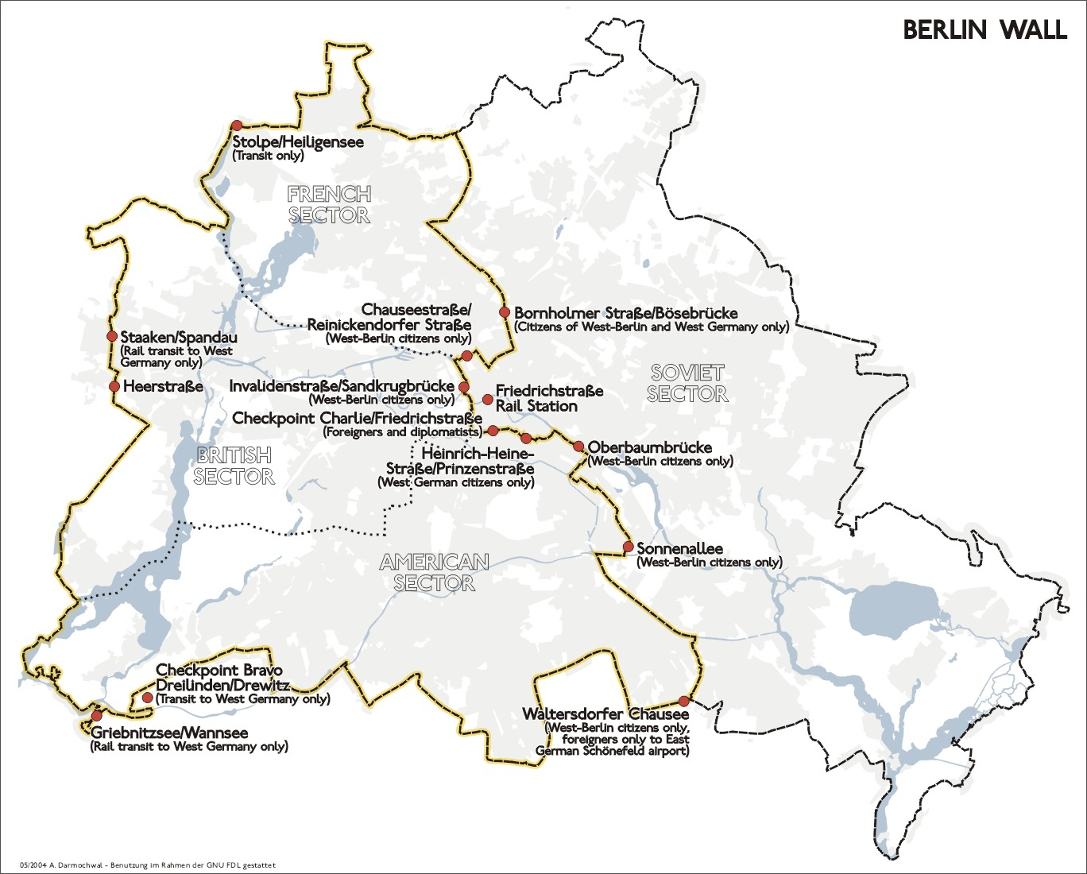
Photo credit: Berlin wall and checkpoints. de:Benutzer:Sansculotte (2004). Usage granted under the conditions of the GNU FDL and the CCBYSA 2.0

Slide 4
At the time that the author visited Checkpoint Charlie, East and West Germany were enemies, with walls and barbed wire between them, and different military alliances behind them (the Warsaw Pact and NATO).
How is that situation similar to the Enemies model of psychology and religion? (Think about the history, barriers, and forces that create and maintain a hostile state of affairs.)

Slide 5

October 27-28, 1961
US and USSR forces faced off with armed tanks at Checkpoint Charlie when the Soviet Union refused to allow US military personnel to have access to East Germany.
Photo Credit: USAMHI, public domain

Slide 6

West German citizens gather at a newly created opening in the Berlin Wall at Potsdamer Platz in November 1989. Photo credit: US DoD photo, public domain.

Slide 7

East Germans drive their vehicles through Checkpoint Charlie, 14 November 1989.
US Department of Defense photo: DFST9101398. Public Domain

Slide 8

Checkpoint Charlie Memorial, now with unfettered access between parts of a unified Berlin and a unified Germany
Photocredit: Pixabay
https://pixabay.com/en/checkpoint-charlie-barrack-250594
Public domain

Slide 9
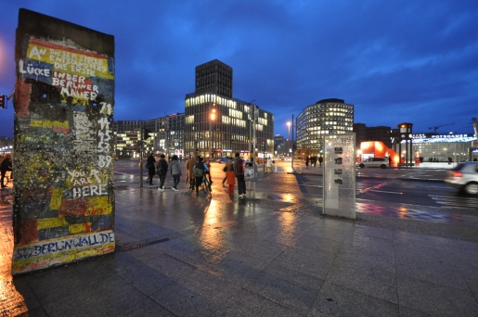
Short section of the Berlin Wall at Potsdamer Platz (Berlin, Germany). The white painted text in the upper third of the section reads: “At this place, the first crevice/hole in the Berlin Wall was created". Photo Credit: Jorge Lascar (2009), Public Domain.

Slide 10
Reflection Point
The Berlin Wall was erected by governmental decree in 1961 and torn down by common people in 1989. Over time, enemies can change their relationship.
What factors bring about a change in relationships between nations? Between people?
Are there any parallels to how this has taken place between psychology and religion (and Christianity in particular)?

Slide 11
People rarely go straight from being enemies to being allies (unless a common enemy emerges!) Many nations adopt patterns that are somewhere between outright enemies and close allies. Describe the fundamental characteristics, advantages, and disadvantages of each of these forms of international relations:
Spies
Colonialists
Rebuilders
Neutral Parties

Slide 12
Espionage
  Foreign Spies are analogous to psychologists who want to study the psychological effects of religious belief or non-belief. This is essentially the same as the psychology of religion, a venerable and useful part of psychology.

Slide 13
Reflection Point
  Foreign spies (psychology of religion)
  Develop a list of three solid empirical questions about religious and spiritual belief (or non-belief) and practices that could be interesting from a research standpoint, or potentially useful from a clinical viewpoint.

Slide 14
Espionage
  Domestic Spies are individuals who do not believe in the literal story of the religion that they profess. They see the stories, rituals, and relationships of religion as useful. As such, these people (whether pastors or laypersons) are interested in how religious beliefs or practices can help people cope with the problems of life and thrive as persons.

Slide 15
Reflection Point
  Imagine that you are a domestic spy (that is, a pastor who is interested in helping others but who does not hold orthodox theological positions and who does not take much of your religion literally). Describe how you can use your ministry to meet the tangible and psychological needs of your flock.

Slide 16
Reflection Point
Espionage – Domestic and foreign spies
What are the advantages of the Spies model
What are the disadvantages or dangers of this model?
In what ways are the initial assumptions of domestic spies and foreign spies similar and different?
How are the goals of the domestic spies and foreign spies similar and different?

Slide 17
Colonialism
Maintains a belief in the usefulness of one nation, under the domination of the other nation.
Augustine believed that secular learning was rightly the possession of the Church and compared it to plundering the Egyptians.

Slide 18
The following extended quotation from Augustine, On Christian Doctrine (Book 2, Chapter 40) is the source of the idea of Plundering the Egyptians, a view which is similar to that of the Colonialists.
“Moreover, if those who are called philosophers, and especially the Platonists, have said aught that is true and in harmony with our faith, we are not only not to shrink from it, but to claim it for our own use from those who have unlawful possession of it.

Slide 19
“For, as the Egyptians had not only the idols and heavy burdens which the people of Israel hated and fled from, but also vessels and ornaments of gold and silver…which the same people when going out of Egypt appropriated to themselves, …in the same way all branches of heathen learning have not only false and superstitious fancies and heavy burdens of unnecessary toil… but they contain also liberal instruction which is better adapted to the use of the truth, and some most excellent precepts of morality; and some truths in regard even to the worship of the One God are found among them.

Slide 20
“Now these are, so to speak, their gold and silver, which they did not create themselves, but dug out of the mines of God’s providence which are everywhere scattered abroad, and are perversely and unlawfully prostituting to the worship of devils. These, therefore, the Christian… ought to take away from them, and to devote to their proper use in preaching the gospel.”

Slide 21
Reflection Point
What are the advantages and disadvantages of viewing “secular” knowledge as something that ought to be “taken back” for use by Christians?
Does the analogy of plundering the Egyptians lend itself to deep engagement with “secular” knowledge? Why or why not?

Slide 22
Rhetoric and Reality
In recent years, some people from the nouthetic counseling (or biblical counseling) tradition have claimed that they are not opposed to psychology.
“Nouthetic Counseling is not opposed to the use of psychological data, especially when it is used to illustrate and describer ather than explain.” (Welch, and Powlison, Every common bush afire, 303. )
“A persistent misunderstanding of the biblical counseling view asserts, ‘You don’t believe Christians can learn anything from secular psychology.’ On the contrary, we can learn, should learn, and do learn from anyone and everyone. But we do seek to be aware of the blinkering and distorting effects of faulty assumptions and explanations. . . .” (Powlison, in Johnson, 2010, p. 255).

Slide 23
Rhetoric and Reality
Does this view lead to deep engagement?
David Myers critique of the biblical counseling approach is that it urges us to “spurn today’s psychological science for a faith that, with its own implicit psychology, has little need for science.”
(Myers, A levels of explanation response, in Johnson, Psychology and Christianity, 274.)

Slide 24
Rhetoric and Reality
Does this view lead to deep engagement?
Stan Jones responded to the biblical counseling movement by noting that despite the claim that it is open to engaging modern psychology, it seems to stop at criticizing it, deconstrucinting it, and generally taking “a stance that effectively undercuts any attempt at genuine learning from psychology.”
(Jones, An integration response, in Johnson, 278. )

Slide 25
Rhetoric and Reality
Does this sound like openness to psychology?
“The problems of people are increasingly defined in secular categories and treated with atheistic therapies and superficial medical interventions. We face a crucial need to recover a biblical vision of the power of Christ to restore troubled people weighed down with spiritual issues that require counseling.”
– Heath Lambert, Executive Director, Assoc. of Certified Biblical Counselors (formerly National Association of Nouthetic Counselors), https://biblicalcounseling.com/resource-library/articles/from-nanc-to-acbc

Slide 26
Rhetoric and Reality
How does this work out in the practice of nouthetic or biblical counseling of things like depression, OCD, eating disorders?
The typical formula is to turn to scripture and identify patterns of sin.
Rarely does this model lead to drawing on psychological research or methods.
Referral is uncommon, since biblical counseling and nouthetic counseling see Scripture as “sufficient” to meet all our needs.

Slide 27
Reflection Point
How are colonialists similar to and different from domestic spies?
What do you appreciate in this model?
What do you see as disadvantages in this model?

Slide 28
Rebuilders
Like the Domestic Spies and the Colonialists, Rebuilders are Christians who see value in psychology.
Like the Colonialists and the Allies, they tend to have a high regard for Christian teaching.
Like the Neutral Parties and the Allies, they tend to be fairly conversant with both disciplines.

Slide 29

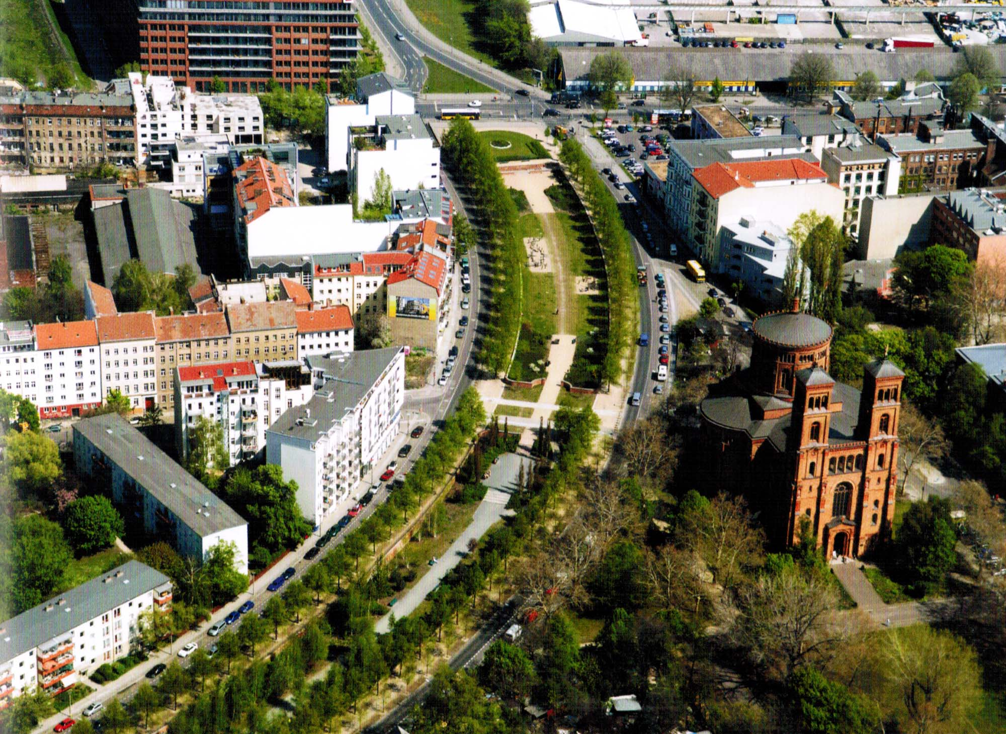
Rebuilders
Rebuilt and Unified, Without a Wall
Photo credit: Thierry Noir, 1986.
Bethaniendamm, Berlin-Kreuzberg. Public Domain.

Slide 30
Rebuilders
Rebuilders assume that the modern definition of psychology (“the science of behavior and mental processes”) and that we should recover the psychology (understanding of persons) embodied in the Christian tradition. Instead, we need to:
Recover the “psychology” of the Bible and of Christian history.
Create a new “Christian psychology” in dialog with modern psychology.

Slide 31
Rebuilders
“Much of the foundational work in Christian psychology will therefore require a careful rereading of Scripture, in the light of some of
the great Christian psychologists of the subsequent past (Augustine, Aquinas, Pascal, Kierkegaard), by people who are familiar with
contemporary psychology and can therefore sniff out a biblical psychology that effectively speaks to current circumstances.”
(Roberts and Watson, A Christian psychology view, in Johnson, Psychology and Christianity: Five views, 155.)

Slide 32
Rebuilders
Begin by developing a plan of what “psychology” SHOULD look like.
Develop a foundation based on Scripture and tradition.
Interact with contemporary psychology.
Build a specifically Christian psychology – a branch of psychology with that has a very carefully constructed view of the person based on Christian premises.

Slide 33
Rebuilders
On the clinical side, counseling or psychotherapy is conceived of as soul care – we must treat the whole person, not just fragmented parts (biological, psychological, social), with a clear understanding of the fundamental spiritual nature of humankind.
Rebuilders are not content to simply relieve suffering; they want to aid people in becoming the kind of people that God desires us to be.

Slide 34
Rebuilders
“Scripture is the normative and formative foundation for what Christian psychologists think and do. God’s view of reality, as presented in the Bible, is the ultimate perspective. Every theory, method, or understanding that is considered important with regard to psychology and soul care is held under the microscope of God’s illuminating Word.”
Vassiliades, Kim, and Kwon, Report, 8

Slide 35


Eric Johnson and SCP
Click icon above for a link to a video of Eric Johnson talking about his vision for Christian Psychology.

Slide 36
Reflection Point
What are the advantages and disadvantages of trying to construct a distinctively Christian psychology, based on a thoroughly Christian view of the person and reality, conversant with modern psychology?

Slide 37
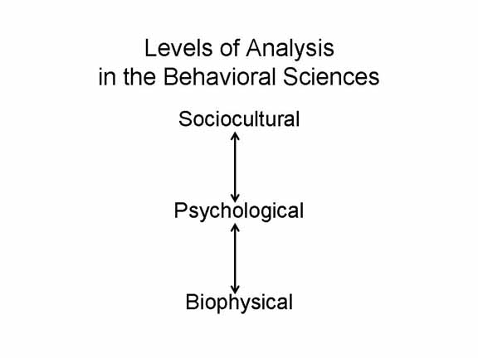
Neutral Parties
Click icon above for a link to a video of Professor Ian Hutchinson – a physicist at MIT – discussing the Levels of Explanation paradigm

Slide 38

Neutral Parties
People who follow this model tend to take faith and psychology seriously.
They want to avoid injecting religious beliefs into psychology, because of the modernist assumption that the scientific method requires “objectivity”.
Psychology and theology offer different levels of explanation.
Psychology and theology are like railroad tracks – parallel, but distinct.

Slide 39
Limited Interaction
“In relating psychological and theological aspects of a topic … the integrity of both disciplines should be respected. Neither discipline should be subordinated or assimilated into the other, nor be allowed to dictate what propositions are permissible in the other discipline. The coming-together of the two disciplines should be on the basis of the two disciplines respecting the autonomy and contribution of the other.” (Watts, F., 2004, p. 4).
BUT is any area of knowledge “autonomous” from any other area of knowledge?

Slide 40
Reflection Point
What are the advantages and disadvantages of trying to maintain a neutral stance between psychology and theology?

