Slide 1

Integrative Approaches to Psychology and Christianity – 4th ed.
Chapter 9
Antagonistic Models:
Enemies
David N. Entwistle, PsyD
These slides are designed to accompany Integrative Approaches to Psychology and Christianity, 4th ed.
Material protected by copy write. Users are welcome to make changes to the presentations and to use them for educational purposes, provided that the original acknowledgement is maintained and any changes to the presentation clearly identified.

Slide 2

PowerPoint Slides to Accompany
Integrative Approaches to Psychology and Christianity, 4th Edition
Chapter 9
Antagonistic Models:
Enemies

Slide 3

“Indeed, it is a strange-disposed time: But men may construe things after their fashion,
Clean from the purpose of the things themselves.”
— William Shakespeare

Slide 4
In Julius Caesar, Shakespeare explores the dynamics that lead to the murder of the character, Julius Caesar. One of the themes is that we don’t see things – including our own dynamics – as accurately as we think we do.
In the line quoted here, Cicero notes that uncommon events are difficult to interpret.
“Indeed, it is a strange-disposed time: But men may construe things after their fashion,
Clean from the purpose of the things themselves.”
— William Shakespeare

Slide 5
“Indeed, it is a strange-disposed time: But men may construe things after their fashion,
Clean from the purpose of the things themselves.”
— William Shakespeare
We often find a similar dynamic in the Enemies model: the combatants sometimes fight against something that they construe quite differently than others do.

Slide 6



Why enemies?
In order to understand why some people see psychology and Christianity as incompatible, we need to understand the history and worldview that led to this conclusion.
Some secularists see religion (in general) or Christianity (in particular) as embodying narrow-minded, judgmental, unhealthy values, and as an obsticle to scientific thinking.
In order to understand why some people see psychology and Christianity as incompatible, we need to understand the history and worldview that led to this conclusion.
Some Christians see psychology (which they often equate only with Freud and secular humanism) as a rival philosophy which holds a perverse view of what humans should be.

Slide 7
Reasons for scientific bias against religion
Claiming that unusual phenomena are the result of supernatural forces can be an impediment to looking for natural explanations.
Religious belief systems can lead to harmful large-scale outcomes, such as tortuous exorcisms, punishment of people accused of being witches, religious crusades, suicide bombings, mistrust of scientific evidence, and the oppression of women and minorities.
Religious systems can be associated with physical and emotional harm.

Slide 8
Reasons for caution
Judging religious beliefs solely by these failings would overlook many of the large-scale benefits of religious systems such as:
  humanitarian reforms in the care of the physically and mentally ill,
  the establishment of hospitals,
  and the provision of aid to refuges and victims of natural disasters.
Additionally, some philosophers argue that some religious beliefs, rather than being antithetical to science, may have aided the rise of science.
So, religion can be associated with both negative and positive effects.

Slide 9
The overlap between psychology and religion
“…from the moment modern psychiatry emerged as a distinct profession, psychiatry and religion have overlapped and at times overtly competed. The reason for this is clear: both seek to heal forms of brokenness that stand on the ambiguous borderline between body and what is variously referred to as ‘psyche’ or ‘spirit.’”
Browning and Evison (1990, p. 3-4).

Slide 10
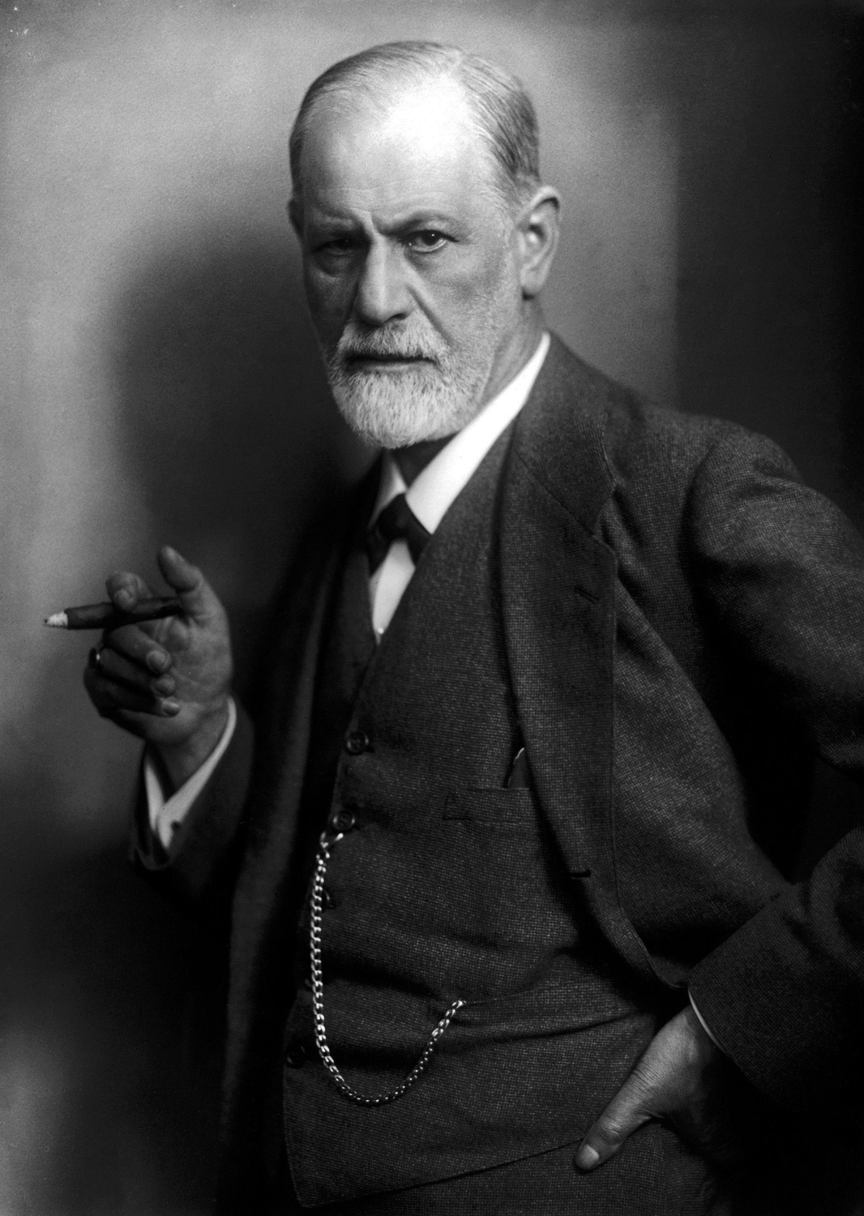
Sigmund Freud
“… one might venture to regard obsessional neurosis as a pathological counterpart of the formation of a religion, and to describe that neurosis as an individual religiosity and religion as a universal obsessional neurosis.”
Freud (1907). Obsessive Actions and Religious Practices.
Photo credit: Public domain, c. 1922; retrieved from Wikimedia commons.

Slide 11
Sigmund Freud
“Religion would thus be the universal obsessional neurosis of humanity; like the obsessional neurosis of children, it arose out of the Oedipus complex, out of the relation to the father. If this view is right, it is to be supposed that a turning-away from religion is bound to occur with the fatal inevitability of a process of growth, and that we find ourselves at this very juncture in the middle of that phase of development.”
Freud, The Future of an Illusion.

Slide 12
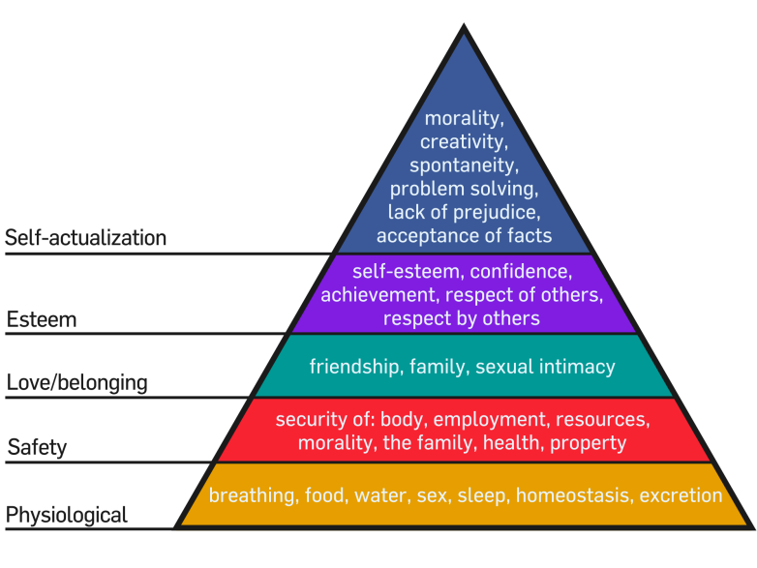
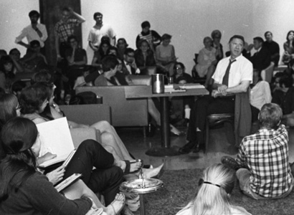
Abraham Maslow
“First time I ever spoke qua atheist in public ... I didn’t dare mention my elitist conception that educated people need “churches” far less than average & low-IQ people. Maybe morons need rules, dogmas, ceremonies, etc., as Eleanor Wembridge claimed long ago—that her feebleminded clients behaved much better and felt better being Catholic and following all the rules.”
Lowry, Journals of Abraham Maslow, 7:710-11, entry of Feb. 25, 1967.
Photo credits: Top: Maslow’s Hierarchy of Needs, Wikicommons. Bottom: Maslow with students at Brandeis University, Brandeis University Archives & Special Collections; retrieved from Wikimedia commons.

Slide 13
Abraham Maslow
“Very ‘successful’ lecture last night before hundreds of Catholics. Left me exhausted & weary. They shouldn’t applaud me – they should attack. If they were fully aware of what I was doing, they would. But maybe not.”
Lowry, Journals of Abraham Maslow, 7:710-11, entry of Feb. 25, 1967.
Photo credits: Top: Maslow’s Hierarchy of Needs, Wikicommons. Bottom: Maslow with students at Brandeis University, Brandeis University Archives & Special Collections; retrieved from Wikimedia commons.

Slide 14
Abraham Maslow
“I think we can save everything
worth saving in religion, everything real and true, without swallowing any of the crap. A new, true religion would certainly change things. Something really good to harness all the good
impulses now wasted on nunneries & churches & Bibles.”
Lowry, Journals of Abraham Maslow, 6, entry of March 12, 1959.

Slide 15
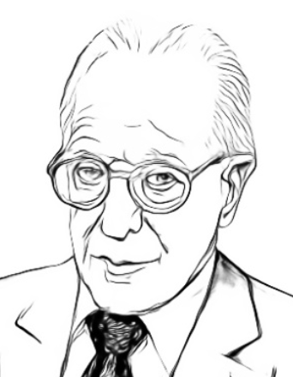
Albert Ellis
“In the final analysis, then, religion is a neurosis….”
“Try to avoid a doctrinal system through which you are dogmatically convinced that you absolutely must devote yourself to the one, only, right, and unerring deity....”
Ellis, A. (1980). The case against religion, 15.
Ellis, A. (2002). No: Dogmatic devotion doesn’t help, 363.

Slide 16


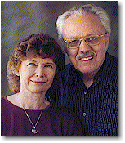
Image above: website header from Psychoheresy Awareness Ministries, www.psychoheresy-aware.org
Image credit: https://realchristianity.com/martin-deidre-bobgan
Fair use for educational use only.

Slide 17
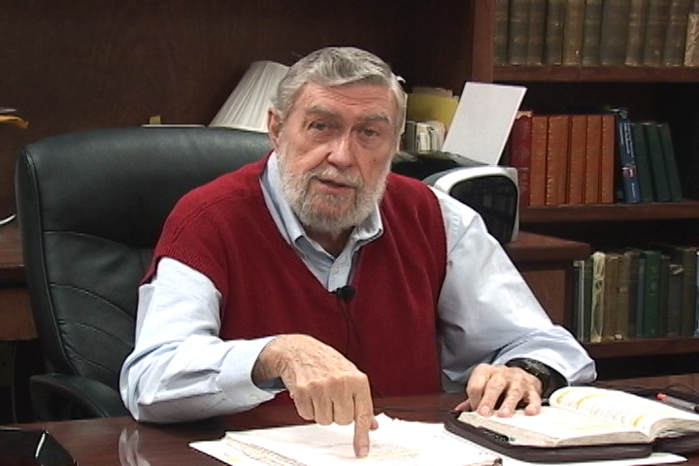
Jay Adams
“The psychiatrist has usurped the work of the physician, but mostly the work of the preacher. And he engages in this work without warrant from God, without the aid of the Scriptures (in almost every case), and without regard to the Holy Spirit…. The work of changing men’s lives belongs to the Christian
ministry in particular and the Christian people in general; not to some self-appointed caste of humanistic priests that has moved into the church’s territory…”
Adams, Jay. (1972). The big umbrella, 8.
Image credit: https://nouthetic.org/about/jay-adams/
Fair use for educational use only.

Slide 18
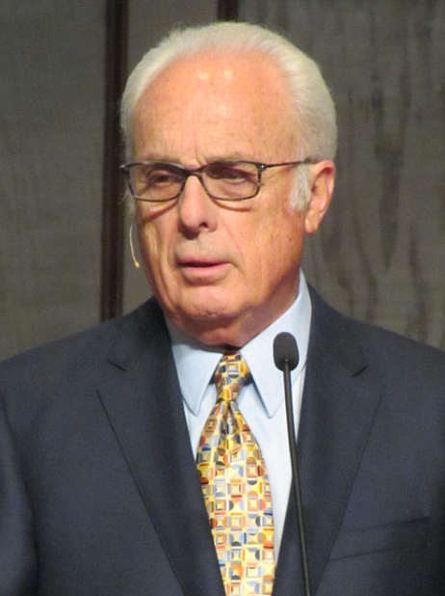

John MacArthur, Jr.
“Scripture itself claims to be a sufficient resource for meeting emotional and spiritual needs.”
“True soul-study cannot be done by unbelievers. After all, only Christians have the resources for comprehending the nature of the human soul and understanding how it can be transformed.”
“Every so-called psychological need that is not traceable to physical causes is, in reality, a spiritual problem, and Scripture does indeed claim to be the only sufficient guide in handling spiritual problems.”
MacArthur, Preaching in biblical counseling, 324.
MacArthur et al., An introduction to biblical counseling, 8.
MacArthur et al., An introduction to biblical counseling, 368.
Click icon for a link to a video in which MacArthur explains “why the Master’s College doesn’t teach psychology.”
John MacArthur
Image credit: R. Huggins. retrieved from Wikimedia commons.

Slide 19
MacArthur on Parenting and ADHD
I can sum up all you need to know about raising your children, all you need to know about parenting in just a couple of sentences. One, teach them the truth about God and His law all the time…. Now that one sentence sums up all kinds of things out of Scripture, but that’s the sum of it…. Second sentence, demand that they obey that law and punish them physically when they don’t…. Those two sentences sum up what the Bible teaches about raising children. Teach them the truth about God and His law all the time. Demand that they obey that law and punish them physically when they don’t.

Slide 20
MacArthur on Parenting and ADHD
[Later in the same sermon, MacArthur transitions to criticisms of ADHD.]
“Professionals base their diagnosis of ADHD on the following guidelines.” And they give a whole bunch of them, there might be twenty of them and they say if any six of these applies to you, you’ve got it. You can pick your six.
“First, pays little attention to details. Makes careless mistakes. Has a short attention span. Doesn’t listen when spoken to. Doesn’t follow instructions. Fails to finish tasks. Has difficulty getting organized. Avoids tasks that require sustained effort. Loses things.”

Slide 21
MacArthur on Parenting and ADHD
“Is easily distracted. Forgets things during the day. Fidgets. Squirms in seat. Leaves seat when remaining seated is expected. Runs about. Climbs excessively. Has difficulty playing quietly. Acts as if driven by a motor. Talks a lot. And blurts out answers before the question is complete.”
You know who they’re describing? All of our children. Don’t kid me, that’s all of my children. That’s all of my grandchildren. That’s me. I don’t have a disease. Every kid is like that if he’s not taught self-control.

Slide 22
MacArthur on Parenting and ADHD
Every report card I got as a little kid in my early years of school said the same thing, “Johnny doesn’t pay attention. Johnny talks too much. Johnny won’t stay in his seat. Johnny fiddles and makes noises with his pencil. Johnny lacks self-control. Johnny doesn’t do his best.” And every time I took home a note like that, I got spanked.
… It’s a sad, sad situation in our society. All these psychologists and psychiatrists running around trying to solve a problem that can only be solved in a home where the Word of God reigns supreme. There’s no other way.
John MacArthur, sermon on Eph 6:1-3, March 31, 1996. https://www.gty.org/library/sermons-library/1949/gods-pattern-for-children-part-2

Slide 23

Nally vs.
Grace Comm. Church
The death by suicide of a young man who had received counseling at Grace Community Church led to a lawsuit against the church and its pastors which raised numerous issues about pastoral counseling liability and freedom of religion. Litigation took place over eight years in several courts. The California Supreme Court ultimately held that “nontherapist counselors have no duty to refer persons to licensed mental health professionals, even if suicide has become a foreseeable risk.”
See: Orr, A. W. (1989). Nontherapist counselors: No duty to refer suicidal patients to licensed psychotherapists—Nally v. Grace Community Church. Law & Psychology Review, 13, 91–102.

Slide 24
Grace CC and COVID
Grace CC has been one of the leading churches opposing mask mandates and limitations on in-person gathering.
LA County sued GCC for its refusal to comply with public health orders.
Grace CC sued LA County for restricting freedom of religion.
In an out of court settlement, LA County dropped its lawsuit against GCC, and agreed to pay GCC $400,000 to settle GCC’s lawsuit, paid out of the LA County Dept. of Health Budget, and the state of California will pay the church an additional $400,000.
reference: Jaclyn Cosgrove (11/9/2021). Why L.A. County paid $400,000 to a church that violated coronavirus rules. Los Angeles Times.
https://www.latimes.com/california/story/2021-09-02/why-l-a-county-paid-400-000-to-a-church-that-violated-coronavirus-rules. See also Alejandra Molina (9/1/2021). John MacArthur’s Church to Receive $800K COVID-19 Settlement,. Christianity Today.
https://www.christianitytoday.com/news/2021/september/john-macarthur-covid-settlement-california-church-grace-com.html

Slide 25
Grace CC and COVID
Some Christians see GCC as providing a model for churches to resist government infringement on religious liberties (in both the Nally and COVID court cases), while others see it as spreading misinformation and anti-scientific views, and as failing to submit to reasonable public health measures.
GCC’s teachings about COVID can be found here: https://www.gracechurch.org/news/posts/2254
For opposition to these teachings, see, for example, Reuter’s Fact Check, (7?26/2021). Fact Check-CDC comorbidity figures presented in sermon do not undermine deadliness of COVID-19. https://www.reuters.com/article/factcheck-sermon/fact-check-cdc-comorbidity-figures-presented-in-sermon-do-not-undermine-deadliness-of-covid-19-idUSL2N2OI1H2

Slide 26
Reflection Point
What points were made by those who are opposed to psychology that you found compelling? What are some legitimate concerns or critiques that we should take to heart?
Were there things that you thought were overstated or wrong? Why?

Slide 27

Biblical Counseling???
“Biblical Counseling” has its roots in Jay Adams’s Nouthetic Counseling. Some biblical counselors claim that it has become less antagonistic to psychology. In contradiction to this claim, reproduced on the following pages are portions of “Counseling God’s Way” from the website of the International Association of Biblical Counselors.¹
1. Retrieved 11/6/2021 from https://www.iabc.net/counseling-gods-way

Slide 28
Biblical Counseling???
“Counseling God's Way is as different from psychological counseling as light is from darkness…. In contrast to psychologically-integrated systems, Biblical counseling seeks to carefully discover those areas in which a Christian may be disobedient to the principles and commands of Scripture and to help him learn how to lovingly submit to God's will.”

Slide 29
Biblical Counseling???
“Psychological counseling… is based on ‘hollow and deceptive philosophy, which depends on human tradition and the basic principles of this world rather than on Christ,’ (Colossians 2:8). That's why Paul warns, ‘See to it that no one takes you captive’ through such empty concepts.”

Slide 30
Biblical Counseling???
“[P]sychological counseling produces… spiritual nearsightedness and blindness and a return to slavery to the very sins God has freed us from. As a result, ‘they are worse off at the end than they were at the beginning,’ (2 Peter 2:20).
Counseling God's Way is totally different, because it relies on the wisdom of God, not on the false precepts of humanistic philosophies and theories.”

Slide 31
Reflection Point
Based on their own words, is it fair to say that the International Association of Biblical Counselors has moved away from Adams’s opposition to psychology, or do they continue it?
As you reflect on the Christian Combatants version of the Enemies model for relating Christianity and psychology, what can you affirm as reasonable and important concerns?
What things in this model do you think may be overstated or wrong? Why?

