Slide 1

Integrative Approaches to Psychology and Christianity – 4th ed.
Chapter 8
Understanding and
Making Models
David N. Entwistle, PsyD
These slides are designed to accompany Integrative Approaches to Psychology and Christianity, 4th ed.
Material protected by copy write. Users are welcome to make changes to the presentations and to use them for educational purposes, provided that the original acknowledgement is maintained and any changes to the presentation clearly identified.

Slide 2
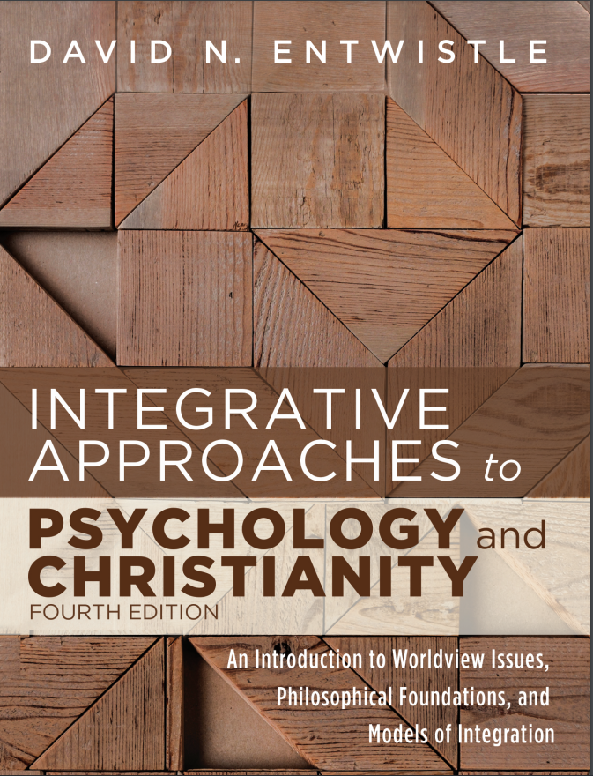
PowerPoint Slides to Accompany
Integrative Approaches to Psychology and Christianity, 4th Edition
Chapter 8
Understanding and
Making Models

Slide 3

The SR-71 Blackbird
How was the author’s model of the SR-71 similar to and different from the real thing?
http://www.youtube.com/watch?v=OiFWdlaNgmo&feature=relmfu
Image credit: US DIMOC, Public Domain; Wikimedia Commons

Slide 4
How realistic can a model be?
On the next slide, there are pictures of a real SR-71 and pictures of models of the SR-71.
Which ones are real, and which are models?
How do you know?
What are the limitations of the different models?

Slide 5





Slide 6

REAL
REAL
MODEL
Image credits: Top : NASA Dryden Flight Research Center (Public Domain).
Models: Builder: Ian Robb; photo credit: John Pearson; used by permission.
MODEL

Slide 7

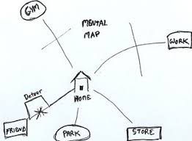
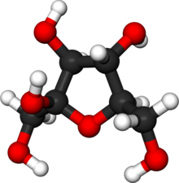
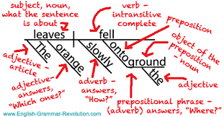
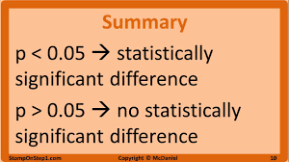

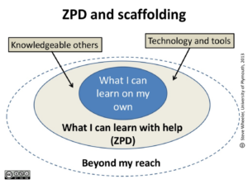
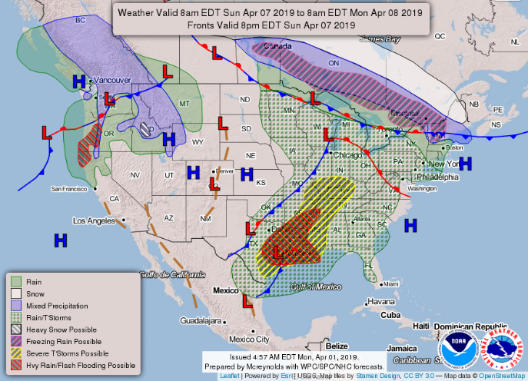
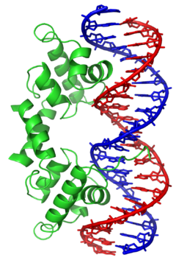
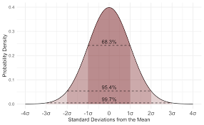

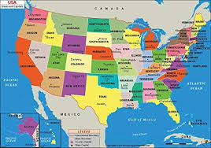
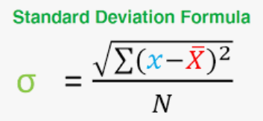
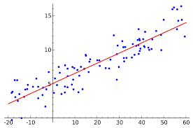
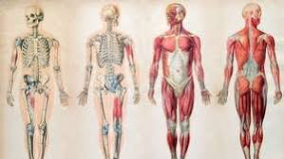
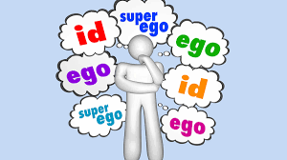
Models

Slide 8
Reflection Point
What kinds of models do you use that shape how you think about and interact with the world?
In what ways are these models helpful?
In what ways can these models be inaccurate, misleading, or harmful?

Slide 9
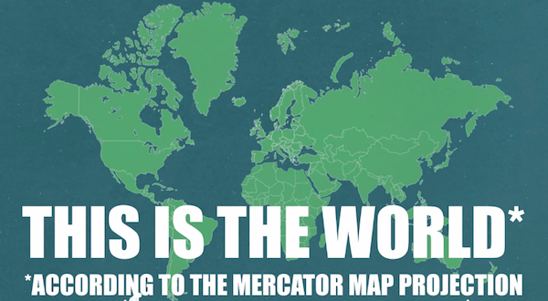
Models
Models help us to simplify and represent the world.
They are enormously helpful.
They are invariably imperfect.
Click on image to see how maps distort reality.

Slide 10
Models
When we look at models for relating psychology and religion (or Christianity or theology), we are looking at models of models, that is, a model of how to relate a model of psychology, and a model of theology (or religion).
SO, when we look at the models for relating psychology and religion, we will discover that the model makers define “psychology” and “religion” in different ways!

Slide 11
Models Shape our Understanding
Models are based on the assumptions that we make, and they are built out of the materials that we have available to us. (Materials can be physical – like a photograph or a model of a kidney – or they can be cognitive construals, such as a mental map or beliefs shaped by culture and education.)

Slide 12
Models Shape our Understanding
Once we have a physical or a mental model of something, it will cause us to see that thing through a set of beliefs and assumptions.
These beliefs and assumptions will, in turn, cause us to ask different questions.

Slide 13
Example
Imagine that you discover a man lying on the floor, unresponsive, covered with blood. What assumptions might you make?
If your “model” of the event was that he was murdered, you will then ask a series of questions flowing from that model.
Suppose that you found out that the man had fainted while watching a surgical procedure. Based on that “model”, what questions would you now ask?

Slide 14
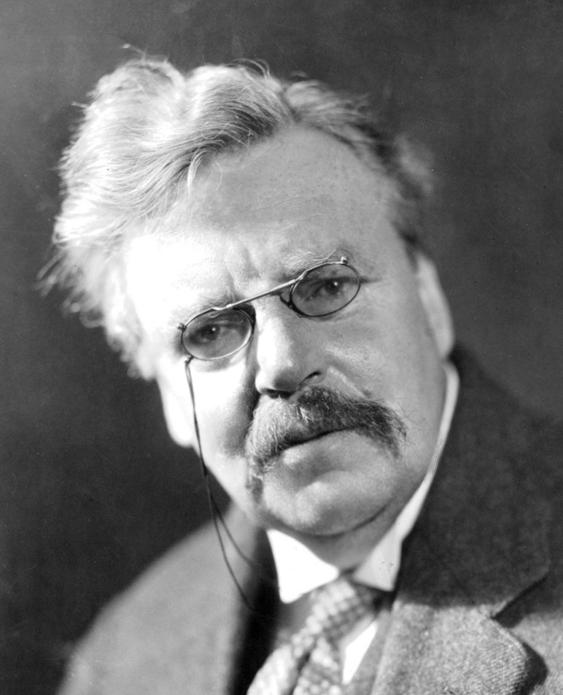
“Once assume the wrong beginning, and you’ll not only give the wrong answer,
but ask the wrong question.”
G. K. Chesterton
The paradoxes of Mr. Pond

Slide 15
Reflection Point
How has the definition (model) of psychology changed over time (pre-1879, 1879-1920, 1920-1960, 1960-present)?
When someone refers to “psychology”, can we be sure that the person is defining psychology in the same way as other people?
When someone refers to “religion”, (or “Christianity” or “evangelicalism”, etc.) can we be sure that the person is defining it in the same way as other people?

Slide 16
Reflection Point
Think about a psychological issue that you have studied. How do different theories (models) of psychology cause you to ask different questions about this phenomenon?
Is this also true of different religions, or even different expressions of any single religion?

Slide 17
Model Assumptions
When thinking about how to relate psychology and religion (or Christianity), model builders make many assumptions.
What is psychology?
What is religion (or Christianity)?
Is psychology a valid science?
Are religious frameworks reliable ways to seek truth? Are they healthy?
And many more!

Slide 18
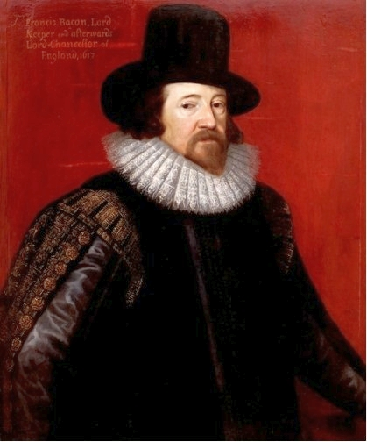
Francis Bacon
Francis Bacon, an influential philosopher and scientist in the early 1600’s, wanted to find a way to assert that knowledge from Scripture and knowledge from reason or observation were both valid.
Portrait of Francis Bacon
Frans Pourbus the Younger, 1617
Palace on the Water, Warsaw, Poland. Public Domain: Wikimedia Commons.

Slide 19
Francis Bacon
“There are two books laid before us to study, to prevent our falling into error; first, the book of God’s Word, which reveals the will of God; and the book of God’s Works, which express His power.”
Portrait of Francis Bacon
Frans Pourbus the Younger, 1617
Palace on the Water, Warsaw, Poland. Public Domain: Wikimedia Commons.

Slide 20
Model Assumptions
The models that we will explore differ in the degree to which they rely on each of the two books (or, indeed, the view that they take of each of the books!).
They also differ in their telos – their ends, purposes, and goals.

Slide 21
A mnemonic device for the models
Enemies
Spies
Colonialists
Rebuilders
Neutral Parties
Allies
Ending
Spurious
Conflict
Requires
New Alternatives
En
Sp
Co
Re
Ne
Al

Slide 22

Enemies
General assumption:
Psychology and Christianity (or religion in general) are fundamentally opposed to and incompatible with each other.

Slide 23
Enemies
Secular Combatants: Psychological health is incompatible with religious practice. Enlightened people cannot believe in religious nonsense.
  Telos—Secular combatants, reflecting their commitment to modernism, reject authority in general, and religious authority in particular. Their aim is to exalt the autonomous exercise of human reason.

Slide 24
Secular Combatant Questions
• Why do religious people have higher rates of mental problems than nonreligious people?
• In an age of reason, how can people still believe in religious myths and superstitions?
• How does a religious upbringing harm children?
• How does religion foster and trap people in unhealthy marriages and abusive relationships?
• How can we help people who have been harmed by the restrictive and repressive sexual mores of religion develop views that are more enlightened?

Slide 25
Enemies
Christian Combatants: Christians who turn to psychology for help are denying the sufficiency of Christ. Only Christians can fully understand the soul and only Scripture can provide the true remedy to the human condition. Psychologists are misleading people and undermining their faith through their theories, methods, and so-called therapies.
Telos—suspicious of all human reason, the Christian Combatants aim to protect religious authority and religious pronouncements against corruption by human reason.

Slide 26
Christian Combatant Questions
• What are the secular, antireligious foundations of modern psychology that make it incompatible with Christian faith and practice?
• Why are Christians embracing a field that is and always has been antithetical to Christianity?
• What sinful actions or beliefs cause people to have personal and interpersonal problems?
• How can the Bible and Christian practices be used to bring people to truth, repentance, reconciliation and restoration?

Slide 27
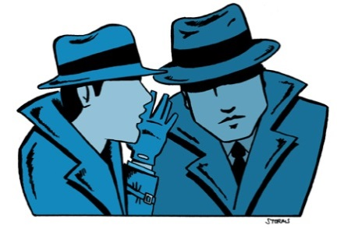
Spies
All religious systems (Christian and non-Christian) are psychological phenomena. The primary emphasis is not on the religious content of a religion as much as it is on its effects on human welfare. Religious systems may be helpful or harmful.
  Telos—Spies have a pragmatic desire to use any means at their disposal to aid human well-being. They may lack deep commitment to a religious system, or they may water down core doctrines as they seek to improve human well-being.
  Domestic Residents and Foreigners differ in whether they are working from within a religious system or are observing it from the outside.

Slide 28
Domestic Spies: Questions
How can the religious beliefs of my tradition help people cope with the problems of life?
How can belief in God’s love be harnessed to help people feel good about themselves, to bring about positive thinking and self-esteem?
How can I affirm the truth of my religious system without taking its teachings (especially about supernatural or miraculous claims) literally? (liberal version).
How can I use the teachings and stories of the Bible to help people find health and happiness in the here and now? (conservative version)
What things in my religious tradition need to be challenged, deemphasized, or rejected so that its positive benefits can flourish?

Slide 29
Foreign Spies: Questions
How can a person’s spirituality exert a positive influence on mental and physical health?
Are particular beliefs, practices, or modes of religious expression associated with detrimental psychological or physical consequences?
What mediating variables can be identified that can help explain the natural mechanisms through which religion and spirituality exert positive and negative influences on health (e.g., affiliation, hope, context for suffering, etc.)?

Slide 30

Colonialists
Christianity embodies the true revelation of God to humankind about the human condition and God’s plan of salvation. Psychology, to the degree that it correctly understands human problems, can be useful to illustrate what Scripture tells us.
  Telos—Colonialists desire to appropriate psychological methods or findings that can illustrate or buttress their theological beliefs. There is usually no deep commitment to, or engagement in, the broader discipline of psychology, and they often prefer to segregate themselves in enclaves with like-minded people.

Slide 31
Colonialists: Questions
How can the Bible be used in counseling as a means of bringing truth, repentance, and reconciliation?
What psychological findings or theories should be rejected based on religious beliefs?
How can some psychological findings or theories be brought into conformity with religious beliefs?
How can statistics about marital satisfaction and its relationship to church attendance be used to illustrate the importance of a Christian understanding of marriage?
How can rates of depression and anxiety highlight our need for relationship with God?

Slide 32

Rebuilders
Rebuilders are critical of the secular foundations of contemporary psychology, and of its neglect of theological and philosophical reflection on the issue of what it means to be human.
Rebuilders believe that the psychological landscape needs to be rebuilt on specifically Christian foundations.
Christian psychology attempts to recover ideas and practices that existed within the pages of Scripture and the teachings of Christians over the past two-thousand years. Drawing on these resources, those who embrace the Christian psychology model contend that we need Christ to be recognized as the Lord of psychology, to discern what God calls each of us to be, and to use transformational processes recovered from Christian tradition to create helpful mechanisms of soul care.

Slide 33
Rebuilders
Telos—Use the insights and practices of Scripture and Christian history and theology to create methods of soul care. They are not simply content to relieve suffering – they want to aid people in becoming the kind of people that God desires us to be.

Slide 34
Rebuilders: Questions
What does Scripture tell us about the origin, nature, and value of persons?
What does Christian tradition tell us about soul care, how to be transformed into the kind of people that God wishes us to be?
In what ways has contemporary psychology rejected foundational assumptions that Christians hold to be true? How can we win a hearing for Christian perspectives within the modern academy?
How can Christians be faithful to their tradition and engage contemporary psychology theory and research?

Slide 35

Neutral Parties
Neutral Parties—Psychology and theology are completely independent disciplines, with their own sources, methodologies, and findings. They need to be carefully segregated to keep either from infecting the other (disciplinary isolationism). However, there may be parallels between the findings of psychology and theology that can be discerned (isolated correlationalism).

Slide 36
Neutral Parties
Telos—people who follow the Neutral Parties approach seek to accumulate knowledge and protect disciplinary sovereignty. They typically acknowledge the influence of worldviews on the pursuit of knowledge, but they also tend to accept the modernist division of knowledge into discrete disciplines that are relatively autonomous. Thus, they are always obligated to follow the sovereignty of whichever discipline they are operating in at a given point in time.

Slide 37
Neutral Parties: Questions
How can I make sure that my religious beliefs do not bias me in my scientific or clinical work?
If psychological and theological teachings appear to conflict, can the differences be explained as simply reflecting the different languages and methodologies of the two disciplines?
How does one determine if a problem is primarily a spiritual issue or a psychological issue?
In what ways do psychology and theology seem to be saying the same thing in different words?

Slide 38

Allies as Subjects of One Sovereign
God is the author of all truth, and all things are “by him, for him” and “hold together” in Him. Although psychology and theology are separate disciplines, with their own sources, methodologies, and findings, they both express truth about human nature and functioning.

Slide 39

Allies as Subjects of One Sovereign
Psychology and theology are both dependent, to some degree, on human thinking, and to the degree that human thinking is errant, our psychological and theological conclusions can be wrong.

Slide 40

Allies as Subjects of One Sovereign
Apparent contradictions between psychology and theology suggest that we need to reconsider our reasoning and data to see if we can identify logical, methodological, interpretive, or other errors in our thinking.

Slide 41
Allies
Telos—Allies strive to be faithful stewards of all that God has entrusted to us, including studying the book of His Works and the book of His Word. Our ultimate goals include serving and praising God with all of our being and fulfilling our call to love our neighbor. At the disciplinary level, the Allies model aims to discern the underlying unity of truth and to use it for godly ends.

Slide 42
Allies: Questions
How can we discern the nature of human beings using both psychology and theology?
How can a Christian worldview help us evaluate fundamental assumptions about our place in the world, especially as they are reflected in academic disciplines?
How can we maintain the disciplinary distinctives of psychology and theology as we seek to understand human nature holistically?
How can psychology and theology help us to minister God’s love to the many needs that people have?
How can all that we do be an expression of love of God and love of our neighbor?

Slide 43
Apparent Conflict
Each of the models will have a different way of handling apparent conflict between Christian theology and psychology.

Slide 44
Handling Conflict
Enemies – one side is right, one side is wrong
Spies – focus only on what supports their assumptions and interests, and ignore or downplay the rest
Colonialists – reform psychology by filtering secular concepts through religious categories

Slide 45
Handling Conflict
Rebuilders – reorient the field of psychology by infusing it with Christian values
Neutral Parties – differences may be due to different levels of explanation
Allies – there can be no fundamental incompatibility (truth is truth, and God is the author of truth), so any apparent conflicts are the result of errant interpretation.

Slide 46
What’s Next?
In this chapter, we have seen how models shape how we understand things and the questions that we generate.
We were introduced to six models for how people think about relating psychology and religion (or theology or Christianity).
In the next several chapters we will explore these models in greater depth.

