Slide 1

Integrative Approaches to Psychology and Christianity – 4th ed.
Chapter 7
Philosophical Anthropology
David N. Entwistle, PsyD
These slides are designed to accompany Integrative Approaches to Psychology and Christianity, 4th ed.
Material protected by copy write. Users are welcome to make changes to the presentations and to use them for educational purposes, provided that the original acknowledgement is maintained and any changes to the presentation clearly identified.

Slide 2

PowerPoint Slides to Accompany
Integrative Approaches to Psychology and Christianity, 4th Edition
Chapter 7
Philosophical Anthropology

Slide 3
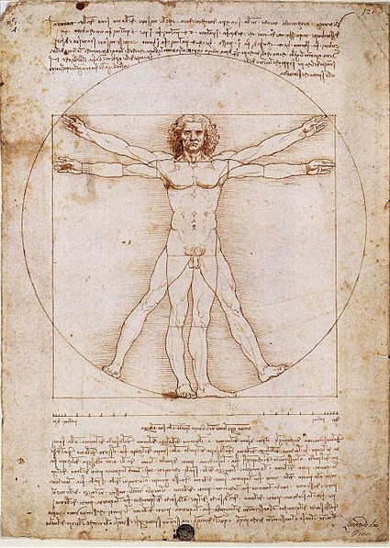
Philosophical Anthropology
The nature of humanity
Vitruvian Man,
Leonardo da Vinci, c. 1490. Photo credit: Luc Viatour / www.Lucnix.be via Wikimedia Commons; Public Domain

Slide 4
Philosophical anthropology (consideration about what it means to be human) builds on epistemology (how we know) and cosmology (what we believe about the nature of the world).

Slide 5
Our place in the universe
On the face of it, it might seem absurd to think that anyone matters in the grand scheme of thing. You are one of 7.4 billion or so human beings alive today. And all of us occupy a tiny speck of the universe.
(See the next slide for a picture of just how small our little corner of the world really is!)

Slide 6

Our place in the universe
Click anywhere on slide to to see “Earth's Location in the Universe”
- Andrew Z. Colvin; Creative Commons. Public Domain

Slide 7
Some possible views
Given the immensity of the universe and the tiny slice of time that we occupy, we really aren’t that important.
The fact that God cares about each of us – made in the very image of God – is amazing and humbling, especially when we consider that everything was created by God and for God!

Slide 8
Do we matter?
“When I consider your heavens,
the work of your fingers,
the moon and the stars,
which you have set in place,
what is mankind that you are mindful of them,
human beings that you care for them?
You have made them a little lower than the angels
and crowned them with glory and honor.”
Psalm 8:3-5, NIV

Slide 9
One of the dividing lines in metaphysics (“Does God exist?”) has implications for how we think about philosophical anthropology
The origin and purpose of human life
The value of human beings
The destiny of human beings
The moral framework for human life
Our relationship to God

Slide 10
While psychology and theology are academic disciplines, every psychologist and every theologian make assumptions that shape their particular psychology and theology.
So, we need to think carefully about the assumptions that are being made, and the implications of those assumptions for how we understand human nature and functioning.

Slide 11
Every psychologist, and every theologian, grounds his or her theology or psychology in a philosophical system, whether or not it is explicitly articulated or carefully considered; every psychology, and every theology, is done from an antecedent worldview perspective.

Slide 12
Some basic questions
Are we the product of chance or design?
Who or what gets to narrate our moral framework?
To what degree is human behavior determined, and by what (genes & environment; biology, socialization, etc.)? How much free will do we really have?
Are we basically good or basically bent towards evil? (And where do our good and evil come from?)
And many others!!!

Slide 13
Diversity and Disciplines
While the disciplines of psychology and theology differ in their methodologies and goals, there is a huge array of diversity in the assumptions made by individuals within these fields.
Thus, there are many different psychological perspectives AND many different theological perspectives.

Slide 14
Psychology
We can use rational reflection and the scientific method to learn about (some aspects of) human behavior.
The world is knowable and predictable.
Methodological naturalism (we learn how things work by experiment).
Humans are biological, psychological, and social beings.

Slide 15
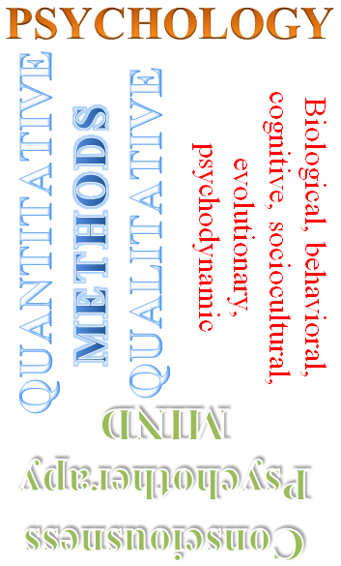
Psychological methods
Empiricism
Rational inquiry
Image credit: David. N. Entwistle

Slide 16
Psychological findings
Competing theories about biological, psychological, and social phenomena, weighed by evidence that supports or disproves the hypotheses generated by theories.
Remember, though, that not all of psychology is “scientific”, and even the parts that employ empirical methods still make philosophical assumptions.

Slide 17
Psychological ideals and goals
Understand how things work (basic science)
Improve life by
  Reducing suffering (e.g., clinical psychology)
  Optimizing ideal conditions (e.g., positive psychology)

Slide 18
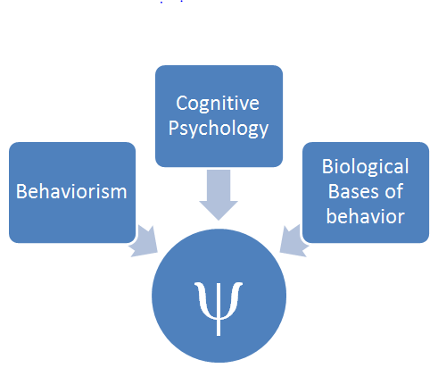
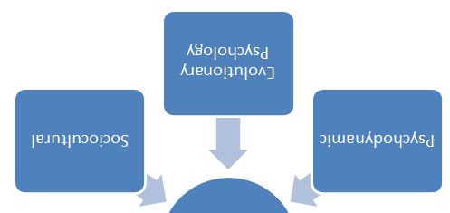
Psychology’s Perspectives
Biological, behavioral, cognitive, sociocultural, evolutionary, and psychodynamic approaches
Image credit: David. N. Entwistle

Slide 19
Psychology’s Perspectives
Biological approaches
The function of nervous system structures
The effects of neurotransmitters and hormones
Behavioral genetics

Slide 20
Psychology’s Perspectives
Behavioral approaches
Classical conditioning
Operant conditioning
Social learning

Slide 21
Psychology’s Perspectives
Cognitive psychology
How information is processed, stored, and retrieved

Slide 22
Psychology’s Perspectives
Sociocultural approaches
How behavior is shaped by social phenomena, such as culture, affiliation, or awareness that one is being observed.

Slide 23
Psychology’s Perspectives
Evolutionary approaches
Attributes and behaviors which lead to an increased probability of survival and having offspring tend to be conserved, while those that do not tend to diminish.
Evolutionary psychology asks how various behaviors, biological processes, and cognitive mechanisms may have been influenced by their survival value.

Slide 24
Psychology’s Perspectives
Psychodynamic approaches
Focus on the role of intrapsychic phenomena such as unconscious conflicts, innate drives, defense mechanisms, and so forth.
Very influential in clinical psychology (many clinical theories either build on or react against this perspective).

Slide 25
Psychology’s Perspectives
Positive psychology “is the scientific study of the strengths that enable individuals and communities to thrive.”

Slide 26
Psychology’s Perspectives
Positive psychology’s three pillars:
  positive subjective experience
  positive traits
  positive institutions
  Some common topics: virtues, gratitude, mindfulness, flow, accomplishment, meaning, positive relationships, positive institutions.

Slide 27
Clinical Psychology
Notice that clinical psychology is not one of the major perspectives of the field. Instead, clinical psychology is an applied discipline which asks how the methods and findings of the major psychological perspectives can help us understand and treat psychological disorders.

Slide 28
What does psychology provide for a philosophical anthropology?
Psychology provides a framework from which to think about the complexity of human nature and functioning. It encompasses theories developed from a variety of perspectives, utilizing diverse epistemic methods, all in an attempt to provide a fuller picture of humans as biological, psychological, and social beings.

Slide 29
Reflection Point
What are some advantages of psychological approaches to understanding human nature and functioning?
For what kinds of questions is a psychological approach well-suited?
What are some of the limitations of this approach?

Slide 30
Theology
As was true of psychology, there are a variety of theological approaches. Common beliefs, though, include the ideas that:
God’s word is a discernible guide for faith and practice (BUT, it must be interpreted).
Natural explanations are usually preferred for most phenomena, but rare occasions may evidence supernatural intervention.
Humans are created in the image of God, finite and fallen, but with a teleological direction shaped by soteriological concerns.

Slide 31
Theological methods
Compatible with empiricism and rational discourse, but its primary focus is theology.
Hermeneutics
Natural Theology
Rational Inquiry
As with psychological methods, these methods are appropriate for answering some types of questions, but not others.

Slide 32
Theological findings
Biblical Theology
Systematic Theology
As with psychology, there are competing interpretive systems.

Slide 33
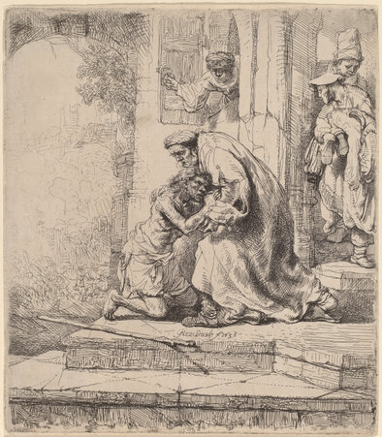
Theological ideals and goals
Understanding
Salvation
Sanctification
Meaning
Stewardship
Worship
Return of the Prodigal Son
Rembrandt van Rijn, 1636
National Gallery of Art, Washington, D.C.
Photo credit: NGA, Open Access;
Public Domain

Slide 34
Some Key Theological Contributions to Philosophical Anthropology
Humans are finite and dependent creatures
Humans are created in the image of God
Humans are fallen
  Sin is both individual and corporate
God loves us and longs to redeem all of creation

Slide 35
Reflection Point
What are some advantages of theological approaches to understanding human nature and functioning?
For what kinds of questions is a theological approach well-suited?
What are some of the limitations of this approach?

Slide 36
What can they contribute?
Psychology
  Empirical and rational methods
  Biopsychosocial perspective (behavioral, biological, cognitive, developmental, evolutionary, social psychodynamic, etc.)
  Psychotherapeutics
Theology
  The derivative nature of humans (hence, relation to God and each other)
  Imago Dei
  Stewardship
  Finite creature
  Fallen
  Redemption / Destiny

Slide 37
Psychology and theology study different variations of the same topic when they look at human nature.
Rather than being antithetical or irrelevant to each other, psychology and Christian theology can be of use to each other. By using both disciplines, we can gain a more complete view of humanity than we can from just one vantage point.

Slide 38
So… they can interact, but how?
Enemies
Spies
Colonialists
Rebuilders (New to the Third Edition!)
Neutral Parties
Allies
The subject of the next several chapters…

