Slide 1

Integrative Approaches to Psychology and Christianity – 4th ed.
Chapter 6:
Metaphysics
David N. Entwistle, PsyD
These slides are designed to accompany Integrative Approaches to Psychology and Christianity, 4th ed.
Material protected by copy write. Users are welcome to make changes to the presentations and to use them for educational purposes, provided that the original acknowledgement is maintained and any changes to the presentation clearly identified.

Slide 2
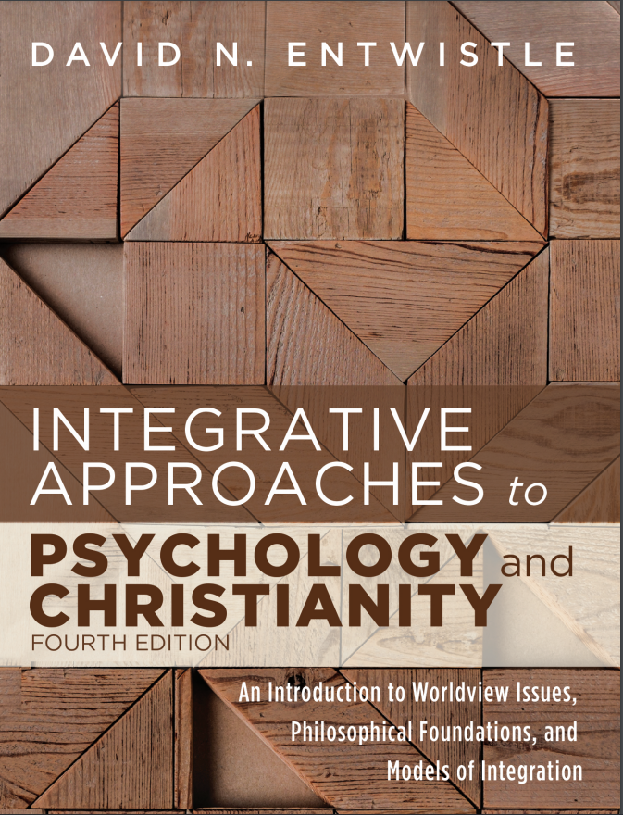
PowerPoint Slides to Accompany
Integrative Approaches to Psychology and Christianity, 4th Edition
Chapter 6:
Metaphysics

Slide 3
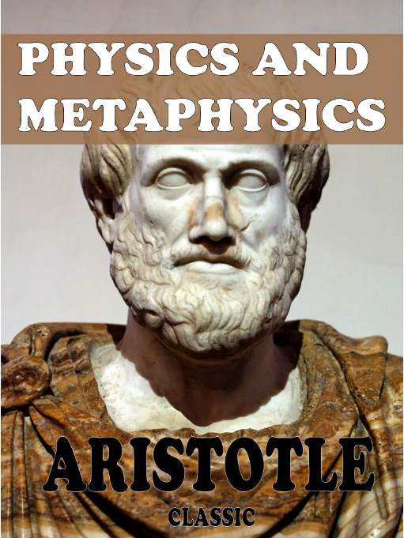
Metaphysics
Metaphysics is not easy to define
The origin of the word means “after” or “beyond” physics.
Used to catalogue the works of Aristotle that came after his earlier works which dealt with the nature of physical objects

Slide 4
Metaphysics
Metaphysics deals with the nature and properties of “being”, and the nature and properties of the world. In popular terms, you might say it deals with questions such as, “What things exist”, “What is there?”, and “What is the world like?”

Slide 5
Metaphysical considerations
Being, existence and reality
Objects and their properties
Cosmology
Determinism and free will
Identity and change
The relationship of mind and matter
Necessity and possibility
Religion and spirituality
The nature of space and time

Slide 6
Cosmology
One of the most basic and important aspects of metaphysics involves the nature of the world.
Is it real or is it an illusion?
Is it self-originating, or did someone or something create it?
These questions are often answered by one’s worldview.

Slide 7
Reflection Point
What are some of your basic assumptions about the origin and nature of the world?
Where did these ideas come from?
What evidence supports (or challenges) your beliefs?

Slide 8
The Physical World
Modern science has allowed us to learn an amazing amount about the physical world. However, science itself cannot answer some of the larger metaphysical questions, such as whether or not anything other than this world exists, or if a being such as God created the world.

Slide 9
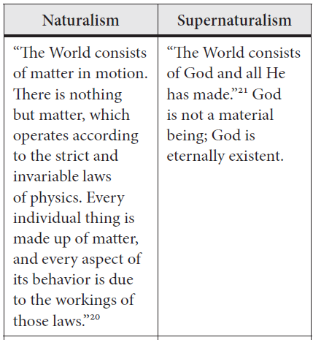
Naturalism and Supernaturalism (adapted from Van Inwagen)

Slide 10
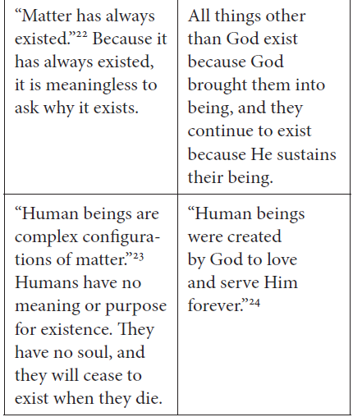
Naturalism and Supernaturalism (adapted from Van Inwagen)

Slide 11
Some Implications of Cosmology
Every worldview contains assumptions which make sense of some parts of our experience, while creating challenges for us in other ways.
Naturalism provides an account of the world which suggests that everything is due to the organization of matter over time through natural selection and chance. It does a very good job explaining the mechanistic working of the world, but it has a hard time explaining why anything should be morally compelling (REALLY right or wrong rather than a mere social construct or an evolutionary adaptation).

Slide 12
Some Implications of Cosmology
Every worldview contains assumptions which make sense of some parts of our experience, while creating challenges for us in other ways.
Supernaturalism provides an account which claims that the world began as the work of a Creator. As such, it has an easy time affirming the value and purpose of human life, that some things are morally compelling, and that God cares about human beings. But it must then struggle with why there is evil and suffering in this world if it’s creator is all good and all powerful.

Slide 13
If God created everything, then
We owe Him our very being, and should respond with gratitude and obedience
He created us, so He knows what is best for us, and has the right to tell us how to live (morality)
When we see His world, it should draw us to awe and worship
When we see what is broken in the world, it should draw us to repentance and to becoming agents of restoration (Shalom)

Slide 14
Supernaturalism and Modern Science
As we saw in Chapter 2, the relationship of Christianity and science is far more consonant than is often assumed.
But, there are still points of potential tension, such as David Hume’s criticism of the Christian belief in miracles.
Can you be scientific and still believe in God and miracles?

Slide 15
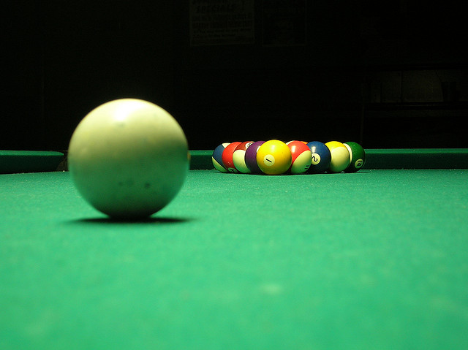
Science and the Supernatural
Photocredit: Clip Art)
Does supernaturalism impede science?
Does a scientific mindset preclude the miraculous?

Slide 16
Science and the Supernatural
Photocredit: Clip Art)
The observable world is much like a billiard table. Science does an excellent job of explaining how the balls move given all the forces involved.
But science can’t tell us if anything exists outside of the table.

Slide 17
Science and the Supernatural
Photocredit: Clip Art)
If a “supernatural” being were to throw a ball on the table, the ball would obey all of the rules once it was on the table. Thus, a miracle is simply something that originates from “outside” which exerts effects within the natural realm.

Slide 18
“If events ever come from beyond Nature altogether, [nature will accommodate them]. The moment it enters her realm it obeys all her laws. Miraculous wine will intoxicate, miraculous conception will lead to pregnancy, inspired books will suffer all the ordinary processes of textual corruption, miraculous bread will be digested. The divine art of miracle is not an art of suspending the pattern to which events conform but of feeding new events into that pattern.” – C. S. Lewis, Miracles

Slide 19
Supernaturalism and Modern Science
So, the Christian belief in God as the creator of the world does not undermine belief in the “normal” workings of the world – it just insists that God set everything in motion and upholds all of it.
The Christian belief in miracles, likewise, simply asserts that – on occasion – God may bring about something within nature that nature could not have brought about herself.
In fact, unless there are normal “rules” we would never perceive something to be a miracle.

Slide 20
But is it really a miracle?
Miracles, because they exist within nature, can be “explained away” if one looks only at the natural effects and ignores the supernatural origins.
On the other hand, we can easily perceive as miraculous things which are explicable by natural means, but which we do not adequately comprehend.

Slide 21
Reflection Point
The author suggested that a difficulty exists in that it is too easy to dismiss miraculous claims by explaining their effects on a purely naturalistic basis, or alternatively, too easy to claim as miraculous things which are statistically uncommon but readily explicable in natural terms.
Which of these extremes is most evident in your own thinking? Do you too readily accept or too readily reject claims of the miraculous? Why?

Slide 22
The problem of
Morality and Ethics
Naturalism can explain moral reasoning based on survival value or social convention, but can it construe anything as morally compelling (actually right or wrong)?
How does the naturalist explain thinking? (If thinking is purely conditioned, then how do we ever know that it is correct?)

Slide 23
The problem of
Morality and Ethics
Christianity can point to specific ethical requirements as having been commanded by God.
BUT, we also have to struggle at times to know which instructions are universal, and which are bound to the specific culture in which they were given.

Slide 24
Christian ethics
“The Christian understanding of goodness is that moral obedience is an obligation, but it also results in well-being. This does not mean that Christians never suffer, but it means that behaving ethically creates optimal conditions for human living.”

Slide 25
Reflection Point
What makes something right or wrong?
Where did your ideas of “rightness” and “wrongness” come from?

Slide 26
Beauty
Aesthetics is the last aspect of metaphysics that we will explore. Rather than ask “what makes something beautiful?”, though, we will explore what kind of person we need to be to appreciate beauty.

Slide 27
Do our responses expose our character? Should certain experiences elicit awe, disgust, etc.?
Positively: Must we be certain kinds of people to have the correct response to events?
Negatively: Is there something wrong or deficient in us if we do not experience the correct response to events?

Slide 28
The Psalms and Beauty
Psalm 19
¹ The heavens declare the glory of God,
and the sky displays what his hands have made.
² One day tells a story to the next.
One night shares knowledge with the next
³ without talking,
without words,
without their voices being heard.
⁴ Yet, their sound has gone out into the entire world,
their message to the ends of the earth.
GOD’S WORD Translation (GW)

Slide 29
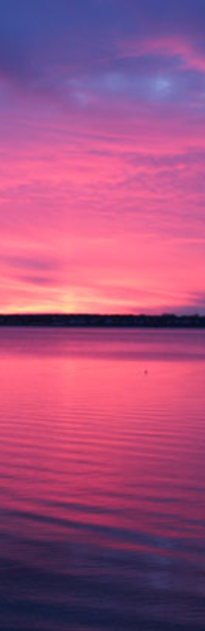
Beauty
“Thin Places”
attributed to Sharlande Sledge
‘Thin places’ the Celts call this space
Both seen and unseen
Where the door
between this world
And the next
is cracked open
for a moment
And the light
is not all
on the other side.
God shaped space.
Holy
Thin Places
Ancient Celtic Christians believed that the veil between this world and the place where God rules is thinner at places, and when we encounter those places, we experience a sense of awe and wonder.

Slide 30
Reflection Point
Describe a time when you felt overwhelmed by amazement and joy. Did it elicit a sense of awe, appreciation, or gratitude?
Was your experience just a behaviorally conditioned response?
Should you feel awe?
In what way might you be “brutal” (a mere animal lacking human insight) or “stupid” (indifferent to the mystery and beauty of the world) if you fail to experience awe?

