Slide 1

Integrative Approaches to Psychology and Christianity – 4th ed.
Chapter 5
The Pursuit of Truth
David N. Entwistle, PsyD
These slides are designed to accompany Integrative Approaches to Psychology and Christianity, 4th ed.
Material protected by copy write. Users are welcome to make changes to the presentations and to use them for educational purposes, provided that the original acknowledgement is maintained and any changes to the presentation clearly identified.

Slide 2

PowerPoint Slides to Accompany
Integrative Approaches to Psychology and Christianity, 4th Edition
Chapter 5
The Pursuit of Truth

Slide 3
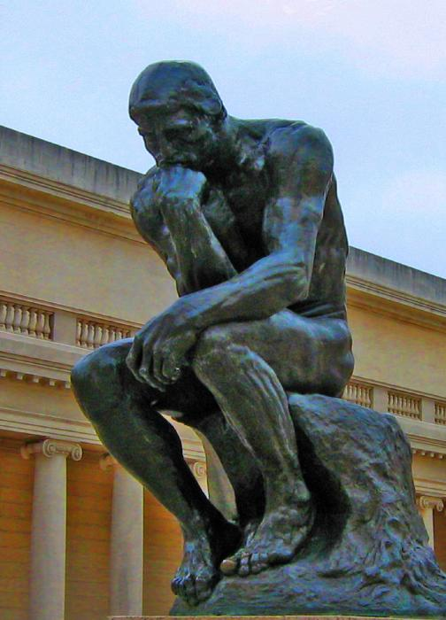
The Thinker
(Le Penseur) is a bronze sculpture on a marble pedestal by Auguste Rodin.
The first cast was made in 1902 and is now in the Musée Rodin in Paris.
28 other casts and numerous copies have been made. This copy is at the Legion of Honor (museum) in San Francisco. Photo credit: Public domain.

Slide 4
Epistemology
Epistemology is the branch of philosophy that deals with the grounds and nature of knowledge.
In short, it seeks to answer the question, How do we know?

Slide 5
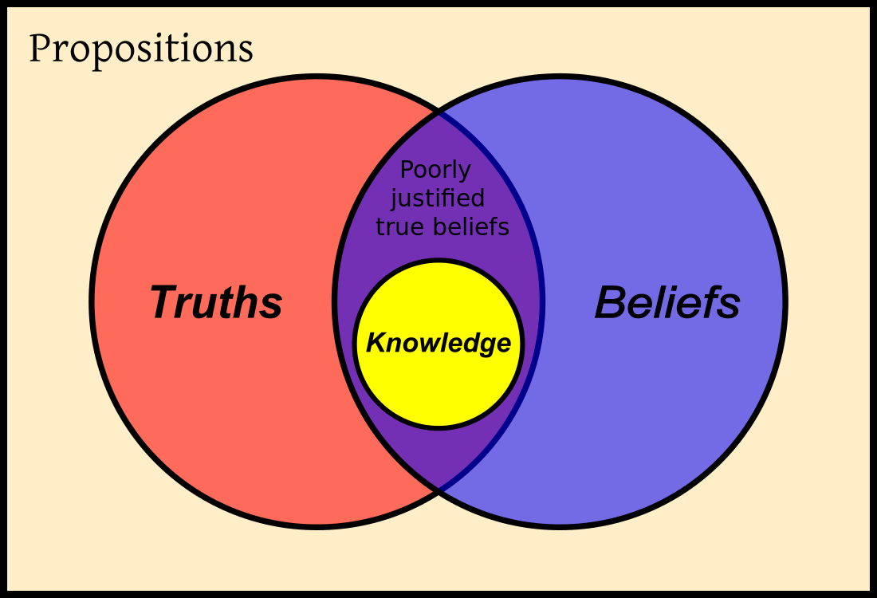
Some of our beliefs are incorrect, despite how tightly we hold and defend them.
Some of our beliefs are correct, but we do not have good justification for believing that they are true.
Some of our beliefs are true and we have very compelling reasons to believe that they are true.
Image Credit: Classical Definition of Knowledge, Krishnavedala; WikiCommons. Public Domain.

Slide 6
So…
We need to think carefully about how to improve the likelihood that our thinking leads to accurate conclusions. This means that we need to look at:
Things that limit the accuracy of our reasoning (human culture, human abilities, human limitations)
Intellectual habits that affect the quality of our reasoning
Epistemic methods that we can employ to help us think well

Slide 7
Part 1:
Human Culture,
Human Abilities,
and
Human Limitations

Slide 8
Our biological systems (sensory and memory systems, for instance) allow us to learn about ourselves and our environment – but they are limited and fallible. We can perceive and misperceive.
Our social contexts allow us to share knowledge and beliefs through socialization processes and language, and to diversify our areas of expertise. But we can share falsehoods as well as truths.

Slide 9
Perception and Reality
How accurately do we perceive reality?
Naïve realists – direct 1:1 correspondence between perception and reality.
Antirealists – there is no necessary correspondence between perception and reality.
Critical realists – assumptions and biases do color our perception, but there is usually a reasonable degree of correspondence and our limited ability to evaluate our assumptions and biases allow us to develop some reasonably accurate ideas aboutreality.

Slide 10
Limitations on Reasoning
The impact of worldviews
As we have already seen, what we see is conditioned in part by what we are predisposed to see based on our assumptions. Worldviews make certain kinds of knowledge possible, and they distort our view of the world.

Slide 11
Human limitations
Frail – our minds don’t always work correctly. Drugs, disease, dementia, and a host of other things can interfere with a healthy brain
Finite – we have limited capacities… and this is a good thing!
Fallen – individual and corporate sin keep us from seeing the world clearly
So… our ability to “know” is limited and imperfect, which means we must be tentative and humble about our truth claims.

Slide 12
The reliability of human thinking
Human thinking itself can be errant
  Cognitive distortions (e.g., Beck)
  Defense mechanisms (e.g., Freud)
  Errors and biases of reasoning
  Memory errors
Noetic effects of sin – sin (both individual and corporate) distorts human thinking
  Some areas of thinking are more affected by sin than others – for example, thinking about moral issues is more adversely affected by sin than mathematics.

Slide 13
Psychological insights on thinking errors
Hindsight bias—overestimating the likelihood that we would have accurately predicted an outcome
The overconfidence phenomenon – being more certain of our knowledge or judgement than is warranted.
The Dunninger-Kruger Effect describes our self-deceived inclination to overestimate our own abilities.
Groupthink – reaching consensus without critical thinking based on shared assumptions
Risky shift – the tendency for groups to make riskier decisions than individuals alone
Group polarization is the tendency for group discussion to move members towards more extreme views.
Confirmation bias – the tendency to overlook disconfirming evidence and to seek out confirming evidence
Echo chambers – environments which repeat and reinforce already held opinions.
The backfire effect – the tendency to become hardened in our views when confronted with disconfirming data.

Slide 14
Reflection Point
Psychologists point out many ways that our thinking can be errant, whether through biological errors (e.g., drugs, diseases), cognitive distortions (e.g., the negative cognitive triad), or the cognitive thinking errors (as highlighted on the previous page).
Identify errors that you have noted in your own thinking or the thinking of others.
How can social media promote errant thinking (e.g., the spread of misinformation, conspiracy theories, and acting as an echo chamber.)

Slide 15
Limitations due to sin
The impact of sin
Sins embedded within a culture make it hard for us to reason clearly when the moral outlook of the culture has been compromised (e.g., racism, sexism, slavery, etc.).
The noetic effects of sin—distortions of human reasoning caused by individual or corporate sin. Classic treatments of this phenomenon assume that sin affects some things less (such as mathematics or chemistry) and others more (such as ethics and theology).

Slide 16
Limitations due to sin
The impact of sin
Personal sin also limits our reasoning. For instance, we may not see ourselves clearly (“it’s not my fault!”) and we use defense mechanisms to evade the truth (e.g., rationalization, displacement, etc.).
The noetic effects of sin—distortions of human reasoning caused by individual or corporate sin. Classic treatments of this phenomenon assume that sin affects some things less (such as mathematics or chemistry) and others more (such as ethics and theology).

Slide 17
Reflection Point
Theologians contend that sin – both individual (personal) and corporate (societal) – can adversely affect the clarity of our thinking (the noetic effects of sin).
How have you observed the noetic effects of sin in your own life (e.g., trying to rationalize that something is okay when you really know it isn’t)?
How have you observed the noetic effects of corporate sin (e.g., sexism, racism, etc.)?
How can we guard against these threats to clear thinking?

Slide 18
Part 2: Epistemic Virtues
In order to seek truth, we need to possess certain abilities and skills (e.g., cognitive capacities) and to understand and employ relevant epistemic methods accurately.
But seeking truth also requires that we be certain kinds of people: those who will seek truth in the right way for the right reasons. This requires the development of intellectual virtues.

Slide 19
Intellectual Virtues
The concept of intellectual virtues can be found in Aristotle and the Medieval Scholastics. The idea is that certain habits of mind are necessary to be the kind of person who seeks truth and who then uses knowledge towards appropriate ends.
Psychology acknowledges the second component by creating ethical guidelines for research and practice.

Slide 20
Intellectual Virtues
A few key intellectual virtues:
Studiositos
Intellectual humility
Intellectual courage
Intellectual caution
Intellectual integrity
Intellectual perseverance

Slide 21
Intellectual Virtues:
Studiositas
The studious person is one who sees opportunities to learn as a gift. She desires to learn about the world and to use her knowledge for the good of others.
In contrast, curiosity is selfish, wanting to own, possess, and keep knowledge for oneself.

Slide 22
Intellectual Virtues:
Intellectual Humility
Intellectual humility involves the ability to judge oneself accurately and to be open to correction and to the insights of others.
Humility, stands in opposition to
the vices of arrogance, conceit, self-righteousness, and selfish ambition.

Slide 23
Intellectual Virtues:
Intellectual Courage & Caution
Intellectual courage calls us to face or overcome fears that ought to be confronted, such as being willing to face criticism when expressing one’s convictions.
Intellectual caution calls us to appropriately recognize dangers that ought to be avoided or carefully negotiated.

Slide 24
Intellectual Virtues:
Intellectual Integrity
Intellectual integrity calls us to be honest with ourselves and with others.
On the one hand, it should cause us to be warry of the potential for self-deception.
On the other hand, it should cause us to be scrupulous in presenting material to others. (Don’t fudge the data!)

Slide 25
Intellectual Virtues:
Intellectual Perseverance
Seeking knowledge is hard work; it requires effort and diligence. Intellectual perseverance requires that we engage the struggle of learning by rigorously keeping at the tasks required of us.
Again, the virtue is a hedge against vices, in this case, against things such as sloth, laziness, and indifference.

Slide 26
Reflection Point
We have identified six intellectual virtues (studiositos, intellectual humility, intellectual courage, intellectual caution, intellectual integrity, and intellectual perseverance).
Why do we need to develop and exercise these virtues? Why don’t they just come about naturally?
Think about times that your quest for knowledge has been ineffective. In what ways might lack of intellectual virtue be involved in those cases?

Slide 27
Part 3:
Of madness and methodologies
  The successful quest for knowledge requires some minimal conditions , such as:
  a reasonably intact mind
  a social context that fosters the transmission of accurate knowledge
  methodologies that allow us to accurately discern truth from falsehood (or at least to make it possible to ferret out the likelihood that something is true).

Slide 28
A few approaches to epistemology
  Skepticism
    Local skepticism – I can’t know SOME things (e.g., morality)
    Cartesian skepticism – I must begin by doubting everything until I can find that there is something indubitable
    Global skepticism; most radical is Nihilism
  Solipsism (you can only know that your own mind exists)
  Intuitionism
  Rationalism (Logic)
  Empiricism
  Authority
  Mystical Experience

Slide 29
Competing Perspectives on the Ability to Know
Realism vs. Constructivism – to what degree can we accurately discern “reality”
  Anti-realists – there is NO necessary relationship between my perception (and knowledge) and the external world
  Naïve realists – there is a 1:1 correspondence between my perception (and knowledge) and the external world
  Critical realists – there is a reasonable degree of correspondence between my perception (and knowledge) and the external world
  Constructivists – because we make so many assumptions, we can never be completely sure about reality, so we should try to understand how people construct meaning or construct their own realities.

Slide 30
Epistemic Methods ¹
Authority
Logic (Rationalism)
  Inductive logic
  Deductive logic
Empiricism
  Scientific method
Revelation
1. Note: This list is not exhaustive and the descriptions of each method are necessarily basic.

Slide 31
Authority
  Most of what we know comes to us by way of authority – parents, teachers, textbooks, etc.
  The pursuit and transmission of knowledge is a social phenomenon. Without socialization, we would be severely handicapped in our ability to obtain knowledge.
  The social distribution of knowledge also allows for the development of expertise – doctors, mechanics, lawyers, and others become expert authorities in a narrowly focused area of knowledge, and the rest of us rely on their expertise.

Slide 32
Authority
  But, of course, authorities can be wrong. To maximize the likelihood that knowledge obtained via appeal to authority is reliable, we need to evaluate four criteria.

Slide 33
Criteria for the Credibility of Knowledge Obtained via Authority
For an authority to be credible, the knowledge base of the authority must be relevant. (Don’t ask your plumber for advice about the best treatment for appendicitis – and don’t trust social media for advice about COVID-19!)
The authority occupies a privileged position from which she accurately discerned the situation. For instance, a doctor went to medical school in order to be able to diagnose and treat medical problems, and she used her knowledge to correctly discern the patient’s problem.

Slide 34
Criteria for the Credibility of Knowledge Obtained via Authority
Character – we need to have sufficient reason to believe that the authority is honestly representing her knowledge and providing it for our benefit and not for personal gain (beneficence).
We need to be reasonably certain that we have accurately understood the information communicated by the authority.

Slide 35
Reflection Point
Carly rushes into the windowless classroom and proclaims that there is a hale storm outside. Without leaving the classroom or using any electronic media, how do you decide whether Carly is a credible authority regarding the weather?

Slide 36
Logic
  Rationalism (or logic) attempts to establish reliably grounds for knowledge claims by exploring the rational consistency of reasoning.
  Deductive logic
  Inductive logic

Slide 37
Logic
  Deductive logic
  The classic “If A = B and B = C, then A = C”. Three parts:
    Premises
    Inferences
    Conclusions

Slide 38
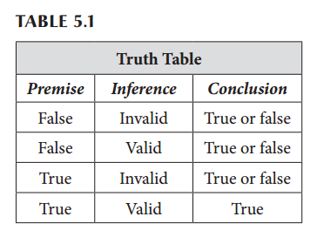
Logic

Slide 39
Logic
  Inductive logic
  Generalizations are made about the way reality is based on select observations.
  This is the basis for theory creation.
  BUT, inductive logic is necessarily probabilistic (remember the old statistical adage, “Correlation does not imply causation”.

Slide 40
Empiricism
  The empirical (or “scientific”) method emerged gradually over hundreds – or even thousands – of years. Today, the most common way of understanding the scientific method is to categorize several steps of scientific reasoning.

Slide 41
Empiricism
Observation
Experiment
Theory
Hypothesis

Slide 42
Empiricism
While the scientific method is a powerful means of learning things about the physical world, we must remember that:
It is affected by our antecedent beliefs – philosophical assumptions, value judgments, personal and cultural biases, etc.
It is ideally suited for exploring replicable phenomena within the physical world, and does not work well for other kinds of phenomena.

Slide 43
Revelation and Interpretation
For those who believe that God reveals things to people through Scripture or other means, we need to distinguish between revelation and interpretation.
Revelation is the source material, such as a vision, a prophetic message, or divinely-inspired writings.
The method of interpretation that we use (our hermeneutics) will shape how we understand the revelatory material.

Slide 44
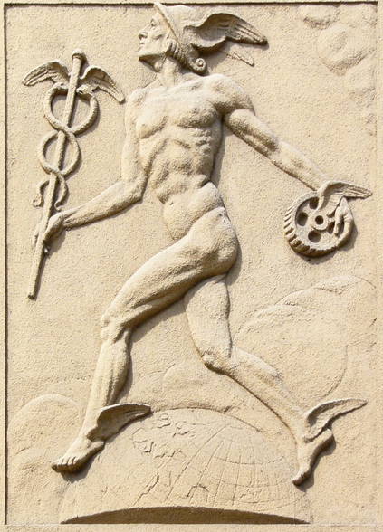
Hermes
In Greek mythology, Hermes was the wing-footed messenger of the gods, delivering messages between the gods – or from gods to people – verbatim. Our word hermeneutics owes its origin to this mythical figure, and reminds us that the purpose of hermeneutics is to faithfully represent and understand the original message.
Photo credit: Michal Maňas – photograph of a relief of Mercury (or of Hermes) at Obchodní akademie building, in Olomouc, Czech Republic. Wikimedia Commons: Public Domain.

Slide 45
Hermeneutical Principles
What did the message mean to the original audience? Look for things such as:
Historical context of the author and audience
Context of the book (purpose)
Genre
Immediate Scriptural context
Confusion due to differences in our own context and language
How does the passage relate to the overall message of Scripture?
How have other reliable sources interpreted the passage?

Slide 46
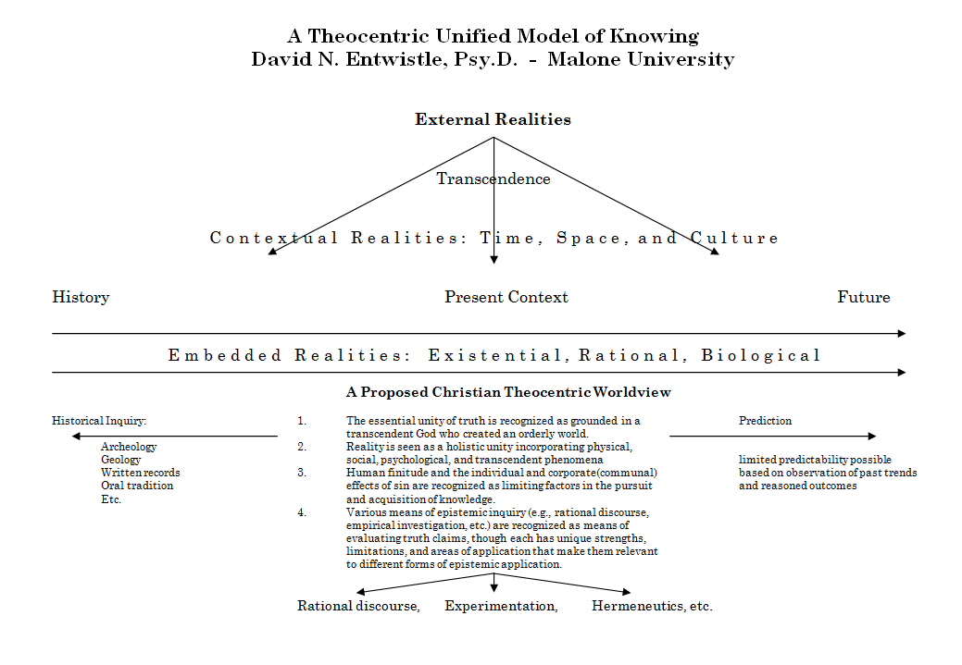

Slide 47
Reflection Point
What epistemic methods (authority, logic, empiricism, hermeneutics) do you rely on most often?
How rigorous are you in making sure that you use relevant epistemic methods carefully?
How can you improve your epistemic competence?

