Slide 1

Integrative Approaches to Psychology and Christianity – 4th ed.
Chapter 4
Windows on the World:
Assumptions and Worldviews
David N. Entwistle, PsyD
These slides are designed to accompany Integrative Approaches to Psychology and Christianity, 4th ed.
Material protected by copy write. Users are welcome to make changes to the presentations and to use them for educational purposes, provided that the original acknowledgement is maintained and any changes to the presentation clearly identified.

Slide 2

PowerPoint Slides to Accompany
Integrative Approaches to Psychology and Christianity, 4th Edition
Chapter 4
Windows on the World:
Assumptions and Worldviews

Slide 3
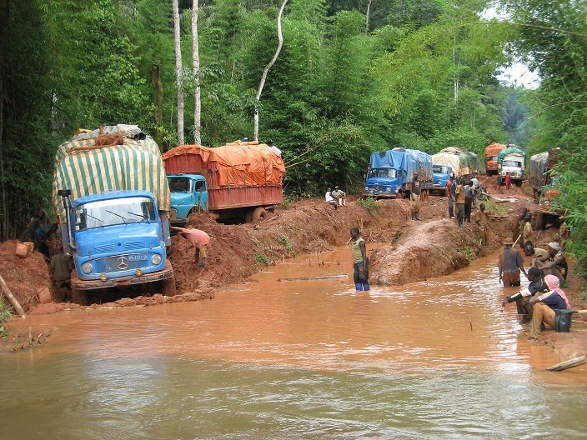
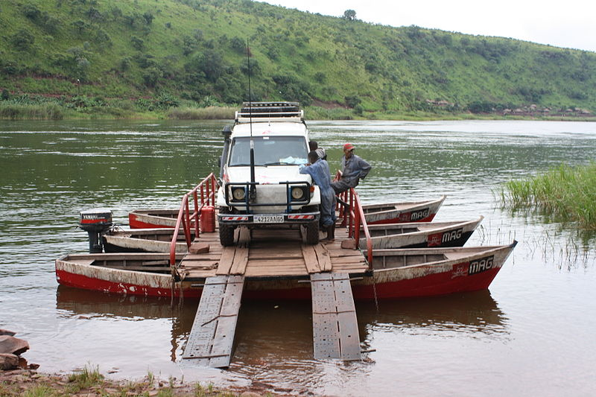
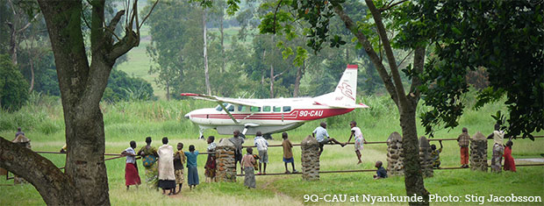
Transportation in the Democratic Republic of Congo Photo credits, clockwise from left: DRC Highway, David Peterson, MAF;
River Crossing, Pweto, Katanga by Tom Skriner, Wikimedia; MAF at Nyankunde, Stig Jacobson. Used by permission.

Slide 4
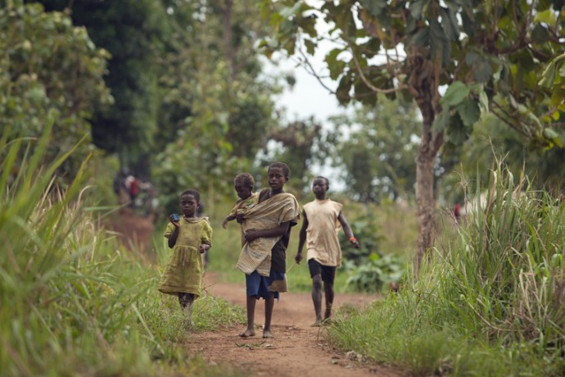
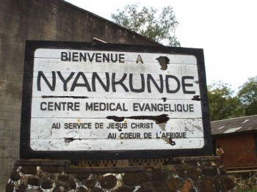
Recall the opening story in which the author talked about his family’s dinnertime conversation and his experiences in Africa. Identify some of the worldview assumptions that framed the way he and others understood the world and their own experiences.

Slide 5
Worldviews
Weltanschauung – “life perspective” or “confessional vision.”
Worldviews are comprised of our basic beliefs and fundamental assumptions that shape how we understand the world.
They are a lot like eyeglasses – they frame and focus what we see, and they obscure and blur things as well.

Slide 6
Worldviews¹
Four basic worldviews questions:
What does it mean to be human?
  What are the characteristics of human nature?
  What is the purpose of human life?
  What duties, obligations, and responsibilities do human beings have?
What is the nature of the world?
  Is the material world real or an illusion?
  Is there anything outside of the material world (spirits, God, gods, etc.)?
  If any thing outside of the observable world exists, how does it relate to the observable world?
  1. Drawn on material from Walsh & Middleton, Transforming vi­sion, 32.

Slide 7
Worldviews
Four basic worldviews questions:
What’s wrong with the world, and why do things go wrong? Why does the world contain suffering and evil?
How can what is wrong with the world, and what is wrong with my life, be fixed? What gives meaning or hope to human existence?

Slide 8
Worldviews
We can – to a limited degree – examine our worldviews.
We usually reflect on our worldviews only when something doesn’t seem to make sense based on our assumptions, or when we encounter people who have different worldviews.
We “inherit” our worldviews from the process of socialization.
  Worldviews are not always internally consistent, and different worldviews can be combined (syncretism).

Slide 9
A Worldview Sampler
Animism – there is a spirit world, composed of spirits of animals, trees, ancestors, or other beings – that can influence the natural world.
Unusual events may be explained by the actions of spirits. The spirits might be able to be placated or, in some cases, implored to harm one’s enemies.

Slide 10
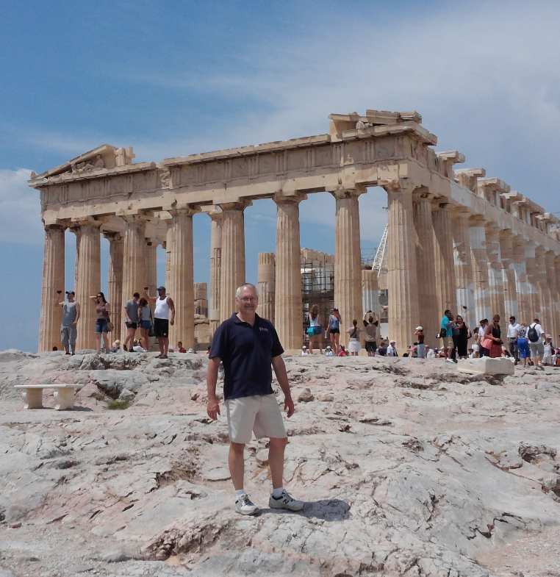
A Worldview Sampler
Polytheism – there is a hierarchy of gods, each of whom is powerful in a limited domain.
Dr. Entwistle at the Parthenon – the Temple to Athena – in Athens, Greece. The larger site, the Acropolis was full of shrines and temples. Nearby was the Areopagus (literally, “large rock”), the place of Paul’s Mars Hill Discourse, where he acknowledged that the Greeks were very religious and worshiped many gods, including “an unknown God” (because they didn’t want to risk leaving one out!)

Slide 11
A Worldview Sampler
Polytheism
The gods can sometimes be played against one another or placated with sacrifice.
A common view in many ancient civilizations, such as the Greeks in New Testament times and the Egyptians and Canaanites in the period of the Old Testament.

Slide 12
A Worldview Sampler
Pantheism – everything that exists is part of a great oneness, the one god that is Everything or is in everything.
In this view, life is cyclical, with an ongoing succession of birth, death, and rebirth.
In many versions of pantheism, reincarnation and assimilation into the grand narrative of the world are the presumed fate of all living objects.
Alternatively, in some Eastern religions, our current existence is seen as an illusion that we may transcend through enlightenment and thereby merge into the oneness of the universe.

Slide 13
A Worldview Sampler
Monotheism – Judaism, Christianity, and Islam are the major monotheistic religions. They share not only a common belief that there is only one God, but they also share elements of religious history and literature (for instance, sacred writings about the creation of Adam and Abraham).

Slide 14
A Worldview Sampler
Monotheism – Judaism, Christianity, and Islam
In all three religions, an all-powerful God is seen as the moving and sustaining force behind the world, and God is without peer.
Nothing is seen as having existence that is not derivative from God or ultimately under God’s control.
While the three monotheistic religions share some broad assumptions about the nature of the world, there are clearly distinctions between and within each of the religions that reflect many other worldview assumptions.

Slide 15
A Worldview Sampler
Atheistic materialism
All that exists is matter in motion over time.
There are no gods, Gods, spirits, or forces that exist outside of the material realm.
Often linked to modernism, and to the expectation of progress through science.

Slide 16
A Worldview Sampler
Modernism and Postmodernism are not worldviews per se, but (as we will see in the next chapter) they do shape how we see the world.
Modernism embodied distrust of authority as an epistemic source and holds optimistic views of human rationality, human objectivity, science, and progress.
Postmodern critiques highlight the potential of individuals and groups who possess political and economic power to install their own views of reality as the “correct” ones and to suppress the voices of the less powerful. Postmodernism reflects a distrust of all claims to knowledge because they are shaped by assumptions and written from a one-sided point of view.

Slide 17
A Christian Worldview
There are a variety of ways that Christians view the world, so we should expect some variation within Christian perspectives. However, there are some guiding narratives that give shape to the basic contours of a Christian view of the world. One influential perspective is provided by the Reformed framework of Creation, Fall, Redemption, and Consummation.

Slide 18
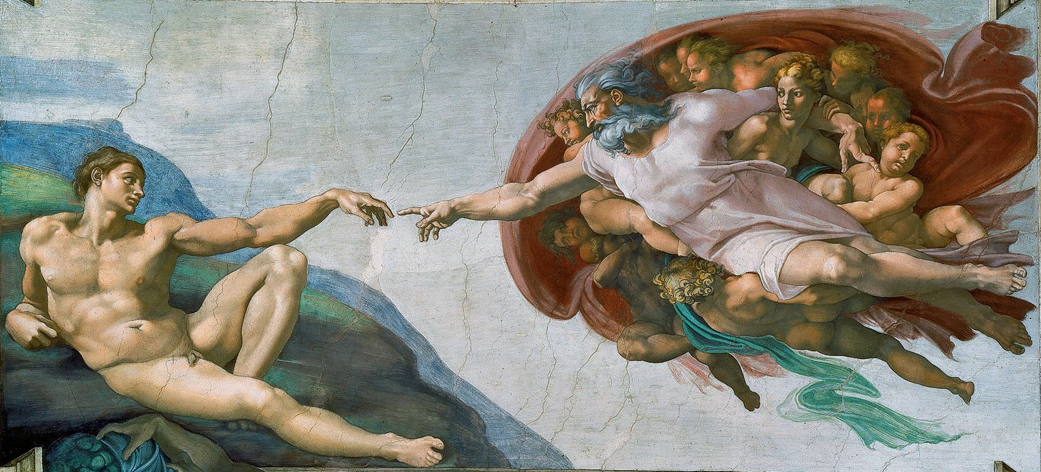
Creation
The Creation of Adam – Michelangelo, c. 1511, The Sistine Chapel
Photo credit: Miguel Ángel, Wikimedia. Public Domain

Slide 19
Creation
The Christian view begins with the statement, “In the beginning God created...”
Genesis 1 – six days of creation, culminating in the creation of humankind, male and female, in the image of God.
The creation is proclaimed to be “very good” and given as a gift for humans to rule over.
God rests on the seventh day (Gen 2:2-3)

Slide 20
Creation
Genesis 2 – God forms Adam out of the dust of the ground, breaths life into him, and places him in a garden to “work it and take care of it.”
In the center of the garden are two trees; Adam is told not to eat from one of the trees, but that he is free to eat from all other trees.
God had formed all of the animals out of the ground, and brings all of the animals to Adam, and Adam names the animals.
With no “suitable helper” having been found for Adam, God causes him to go to sleep, and forms Eve from one of his ribs.

Slide 21
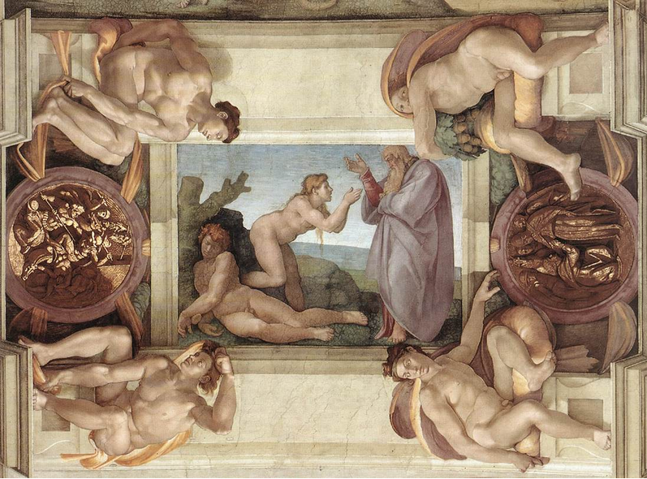
Creation
The Creation of Eve– Michelangelo, c. 1509, The Sistine Chapel
Photo credit: PDArt, Wikimedia. Public Domain

Slide 22
Creation
Some key observations about the Christian account of Creation
God is the Creator; humans are derivative and dependent, yet with incredible “intellectual, creative, affective, social, and caretaking capacities”.
“The creation story holds two truths in tension, first, that humans are part of the created order, and thus, in many ways similar to the other creatures, and second, that they are made in the very image of God and given a caretaking role over the realm to which they belong.”

Slide 23
Creation
“The second biblical account of creation, in particular, highlights the fact that we are social beings, and only in community can we completely reflect the image of God.”
“The biblical account sees creation as infused with potential” - we develop social and cultural life and shape the garden (and the world).
“Creation is pregnant with potential for art, agriculture, education, civil government, science, and literature, waiting to be developed by those who bear the image of God.”

Slide 24
Creation
Humans are given limits, and they are warned that there are consequences of transgressing those limits.
Humans are given all of creation, relationships, work, the ability to develop the potentials of creation… and the wonderful and dangerous gift of free will.

Slide 25
Reflection Point
What are some implications of the Christian doctrine of creation for how we should understand and treat other human beings?

Slide 26
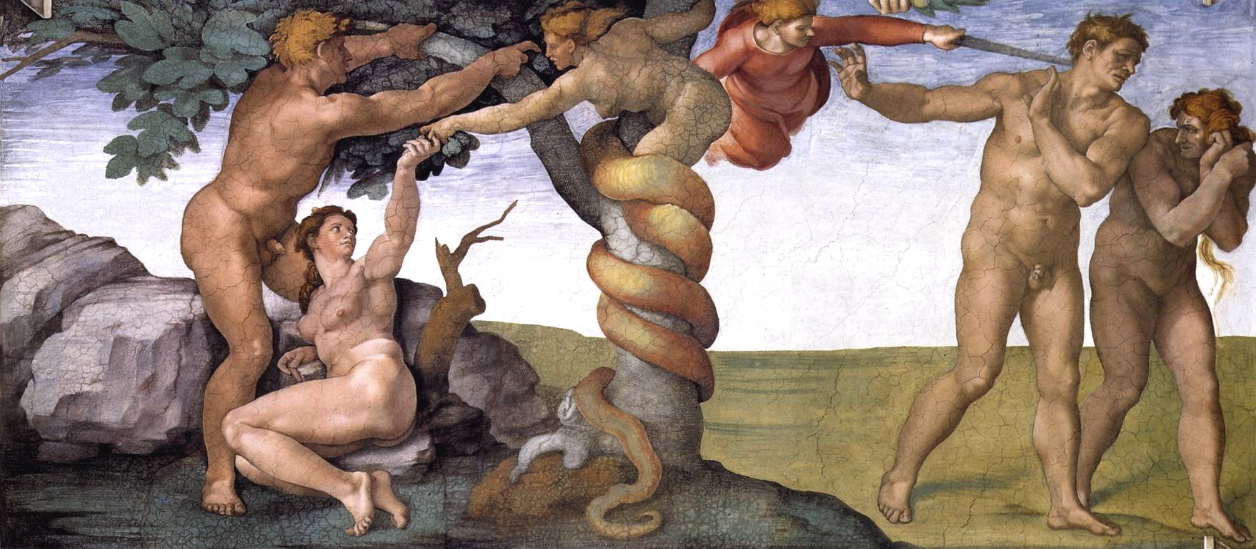
Fall
The Downfall of Adam and Eve and their expulsion from the Garden of Eden
Michelangelo, c. 1511, The Sistine Chapel
Photo credit: PDArt, Wikimedia. Public Domain

Slide 27
Fall
The story of the Fall has been subject to numerous interpretations. The word “Fall” does not occur in the story itself, and is, in fact, an interpretation of the story.
The story has several key components:
  Temptation
  Desire and transgression
  Shame, hiding, and blaming
  Expulsion

Slide 28
Fall
Temptation
  Note that Eve’s response to the serpent is inaccurate, “The woman said to the serpent, “We may eat fruit from the trees in the garden, but God did say, ‘You must not eat fruit from the tree that is in the middle of the garden, and you must not touch it, or you will die.’”
  When temptation takes root: Eve sees that it is good for food, pleasing to the eye, desirable for gaining wisdom.

Slide 29
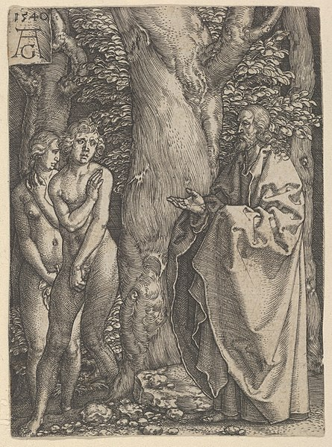
Fall
Consequences:
  Shame
  Covering
  Hiding
Adam and Eve Hide Themselves, from The Story of Adam and Eve
Heinrich Aldegrever, 1540, Engraving
Photo credit: The Metropolitan Museum of Art. Public Domain

Slide 30
Fall
The first grace
  Notice that God comes not with condemnation, but with a question, “Where are you?”
  Notice that instead of answering the question, Adam says he is afraid and hiding
  Another grace, another question: “Did you eat…?”
  BUT, God’s grace is followed by a series of blame-shifting statements

Slide 31
Fall
Curse
  Pain
  Broken relationships (note that the man “ruling over” the woman is a dysfunction, a break of the correct relationship!
  The entire creation is cursed (thorns)
  Work – which was a blessing and a privilege – is now accompanied by toil
  Death
The second grace
  The promise that evil will be defeated
  Expulsion as a protection

Slide 32
Fall
In rapid succession we see
Jealousy
Fratricide
Corporate sin
  The evil of Noah’s generation
  The tower of Babel
So, the biblical story highlights both individual and corporate sin.

Slide 33
Reflection Point
What are some implications of the doctrine of the fall for how we should understand and treat people?
What are some implications of this story for how we should confront transgression?
Why is it so hard for us to respond by saying, “Here I am. I messed up.”

Slide 34
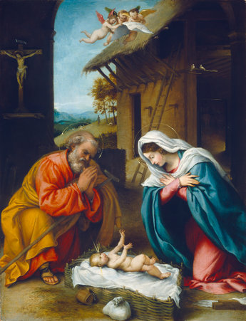
Redemption
Adoration of the Child
Lorenzo Lotto, 1523
National Gallery of Art, Washington, D.C.
Photo credit: NGA, Open Access;
Public Domain

Slide 35
Redemption
There is an unfolding story of redemption
Noah
Abraham
Moses
Ruth and Boaz
Prophets and Kings
Captivity, Remnant, and Return
The Incarnation, Life, Death, and Resurrection of Jesus

Slide 36
Redemption
Note that redemption, too, is multifaceted, addressing
Repentance
Forgiveness for individual transgression
Shalom and restoration of relationships
Our participation in the redemption of the entire created realm (not just nature, but art, agriculture, education, civil government, science, and literature!)

Slide 37
Redemption
The story of redemption culminates in the life of Jesus Christ – his birth, life, teaching, death, and resurrection.
  When the gospel writers proclaim at the beginning of Jesus’s ministry that the Kingdom of God (Mark and Luke) or the Kingdom of Heaven (Matthew) is at hand, they announce the good news that God’s rule has returned… so we ought to repent (to change our ways and live under His rule).

Slide 38
Redemption
The ministry of Jesus as recorded in the gospels is one of teaching and of healing.
It is ultimately out of the greatest tragedy – the death of Jesus – through which Christians proclaim their greatest hope – the resurrection of Jesus and the hope of His rule.

Slide 39
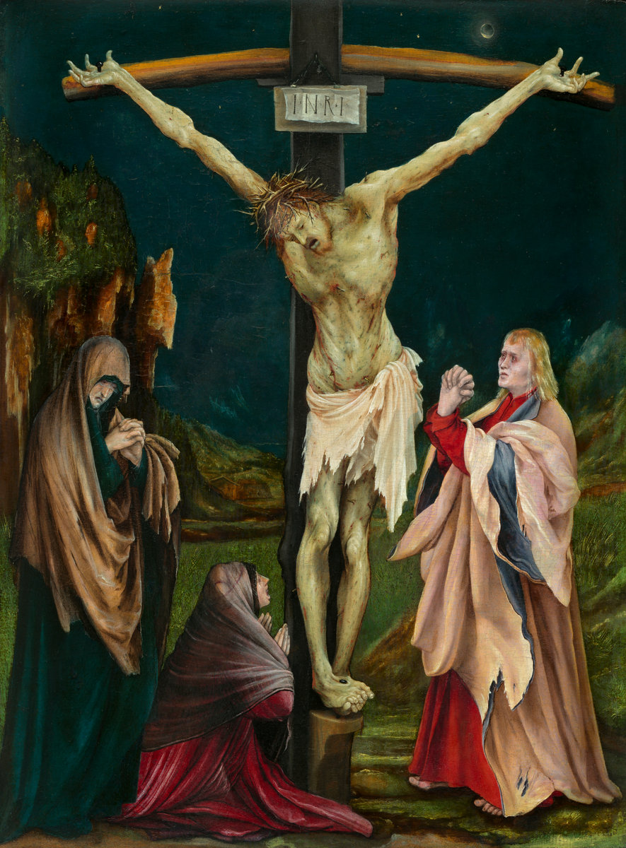
The Small Crucifixion
Matthias Grünewald,
c. 1475/1480 – 1528
National Gallery of Art, Washington, D.C.
Samuel H. Kress Collection
Photo credit: NGA, Open Access; Public Domain

Slide 40
Reflection Point
There is a long and progressive story of redemption in the Bible. How can we be part of the redemptive work of restoring relationships? What are the costs of redemption?
The ultimate work of redemption in the Christian narrative is through Christ’s atoning sacrifice. What are some of the implications of this doctrine for how we understand and treat others?

Slide 41
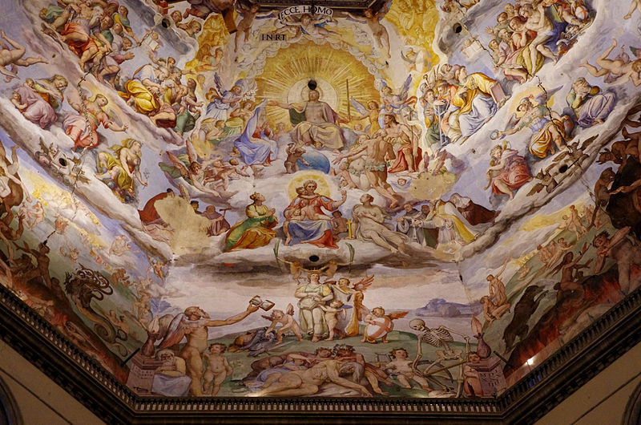
Consummation
The Last Judgment (detail), interior dome of the Florence Cathedral,
Giorgio Vasari and Federico Zuccari, 1568-1579
Photo credit: Paolo Villa, Wikimedia. Public Domain

Slide 42
Consummation
The term consummation refers to the completion of God’s rule over the creation that has been in rebellion against His sovereignty.
The concept of consummation is sometimes framed as recreation—that is, that God restores the creation from its fallen state.
It involves not just individuals saved from personal sin. It is also an image of the people of God living in community where righteousness reigns, thus, it addresses both individual and corporate dimensions of the fall.

Slide 43
Consummation
The biblical view is one in which we participate in the renewal and restoration of creation in the here and now, in the power of the risen Christ, while we await the final and complete restoration of all things yet to come.
It is also the restoration of all things beneath the rule of Christ.
And it is what is depicted in Scripture as the final judgment and the creation of a new heaven and a new earth.

Slide 44
Implications
In our discussion of a Christian worldview, there is an implicit understanding that the narrative of creation, fall, redemption, and consummation has significant implications for how we should live.
  God is the Creator; we are part of the creation.
  Only when we recognize that we owe God our undivided allegiance and live in accordance with God’s design for us can we truly flourish.
If we develop a Christian worldview as we grasp the redemptive flow of history and what God requires of us, then we can begin to answer the all-important question of how we should orient our lives.
This is crucial if we are to have an accurate Christian understanding of what it means to be human and, implicitly and explicitly, it will affect our engagement with the field of psychology, and perhaps, especially, psychotherapy.

