Slide 1

Integrative Approaches to Psychology and Christianity – 4th ed.
Chapter 3
The Soul of Psychology
and the Psyche of the Soul
David N. Entwistle, PsyD
These slides are designed to accompany Integrative Approaches to Psychology and Christianity, 4th ed.
Material protected by copy write. Users are welcome to make changes to the presentations and to use them for educational purposes, provided that the original acknowledgement is maintained and any changes to the presentation clearly identified.

Slide 2

PowerPoint Slides to Accompany
Integrative Approaches to Psychology and Christianity, 4th Edition
Chapter 3
The Soul of Psychology and the
Psyche of the Soul

Slide 3
The Psychology Before Psychology
Psychology, as a modern academic discipline and as a science, is generally dated as beginning in 1879, when Wilhelm Wundt established the Psychologisches Institut in Leipzig, Germany.
Long before then, however, people thought about human behavior. Prior to the Enlightenment, psychology, was a subfield of philosophy.
Religion and biology (especially medicine) were also concerned with human nature.

Slide 4
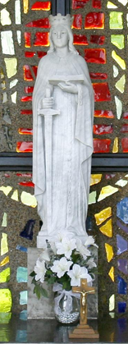
The Psychology Before Psychology
History of Christianity and mental health
Early monasteries cared for the mentally ill, e.g., St. Basil (329–380) in Caesarea, St. Jerome (343–420) in Bethlehem, and St. Benedict (480–543) in Monte Cassino.
The Gheel Shrine in Belgium was founded in 1215 by devout Roman Catholics who implored St. Dymphna for “relief and consolation to all who suffer” from mental illness.
National Shrine of St. Dymphna, Massillon, OH – formerly on the grounds of a State Mental Asylum

Slide 5
The Psychology Before Psychology
History of Christianity and mental health
Christians were often at the forefront of the movement to develop hospitals to care for mentally ill people.
In 1410 a group of concerned citizens in Valencia, Spain, led by Father Juan Gilabert Jofré, a Mercedarian friar, opened the first mental asylum in Europe.
In the late Middle Ages, governments began to create asylums, but most of them were cruel, inhumane prisons where patients were shackled to the walls and floors. Humanitarian reforms were carried out by devout Christians such as Phillipe Pinel in France, and William Tuke, a Quaker, in England.

Slide 6
The Psychology Before Psychology
History of Christianity and mental health
Christian concern for the mentally ill also was evident in the Americas.
Friends Hospital in Philadelphia in 1709.
Friends Asylum, opened in 1812 in Philadelphia, was a Quaker mental hospital modeled after York Retreat; it was the first freestanding treatment facility for the mentally ill in the United States and became a model for other institutions.

Slide 7
Christian Care for the Mentally Ill
History of Christianity and mental health
The Dutch Reformed opened a mental health facility in the Netherlands, and immigrants opened another in Michigan.
Mennonites opened mental health facilities in Russia, Paraguay, and Canada in the early 20th century, and several in the United States following World War II.
Many Roman Catholic hospitals have chapels, pastoral care, social services, and psychiatric services.

Slide 8
Reflection Point
What may have motivated so many Christians to care about the mentally ill?
Many psychology texts tend to ignore the rich Christian heritage of care for the mentally ill, and focus instead on an inaccurate caricature of Christian’s framing mental illness as demon possession. Why might such an inaccurate and one-sided view continue to persist in psychology textbooks?

Slide 9
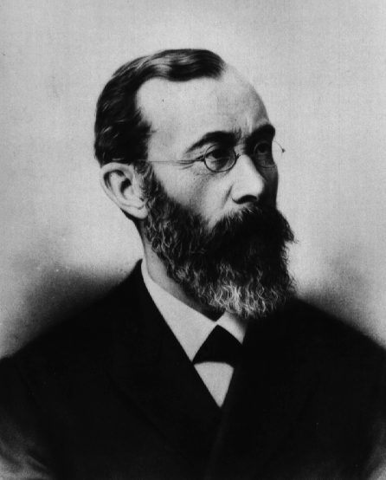
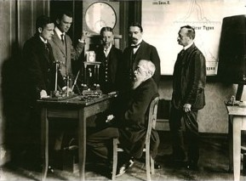
The Beginnings of Modern Psychology
1879 – Wilhelm Wundt
  Gustav Fechner’s Elemente der Psychophysik (1860) proposed the idea that mental and physical events are interrelated
  Wundt took the logical step of applying the scientific method to the study of human behavior, exploring such things as reaction time and introspection.
  Fechner and Wundt were both sons of pastors, and both became atheists in adult life.
Wundt and his students
Public Domain: Wikimedia

Slide 10
The Beginnings of Modern Psychology
1879 – Wilhelm Wundt
  Wundt wanted to apply the scientific method to human behavior – which can be done to some degree.
  He wanted to establish psychology as a science devoid of metaphysical speculation. Is this possible?
  “Psychology functions as a science only so long as it uses the scientific method in application to its subject. As soon as it considers metaphysical questions, it returns to being a philosophical enterprise. Thus it stands on the border of science and philosophy, leaning one way or the other depending on the question at hand and the means by which the question is considered.”

Slide 11
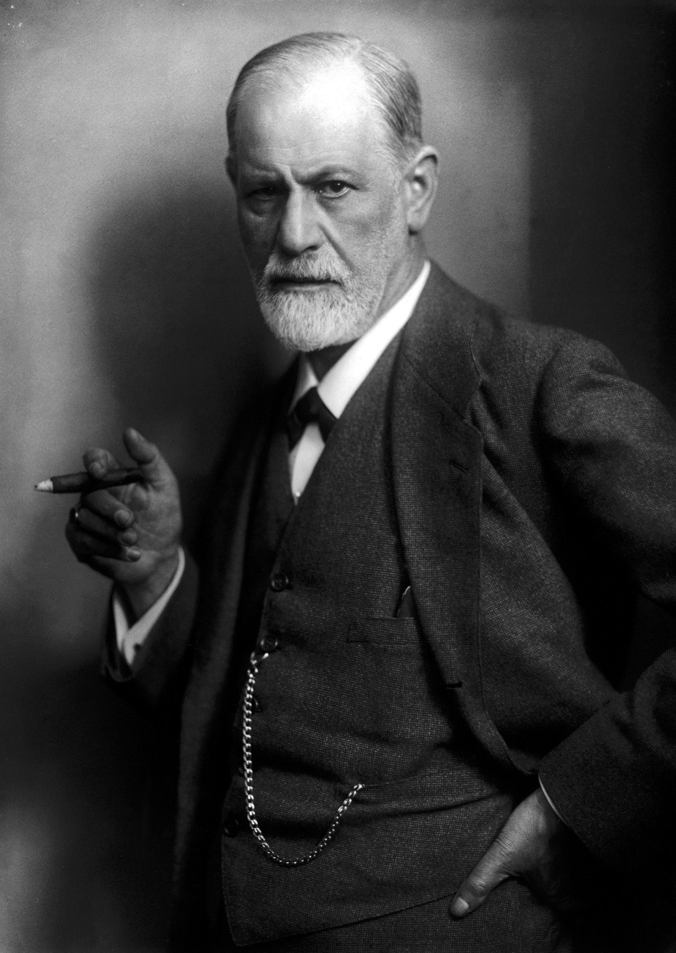
The Beginnings of Modern Psychology
Sigmund Freud
  Jewish, from Vienna
  Trained as a neurologist
  Studied with Jean Charcot in Paris
  1895 marks the public beginnings of psychoanalysis with the publication of Studies on Hysteria, which Freud co-authored with Josef Breuer.
Sigmund Freud
Public Domain: Wikimedia

Slide 12
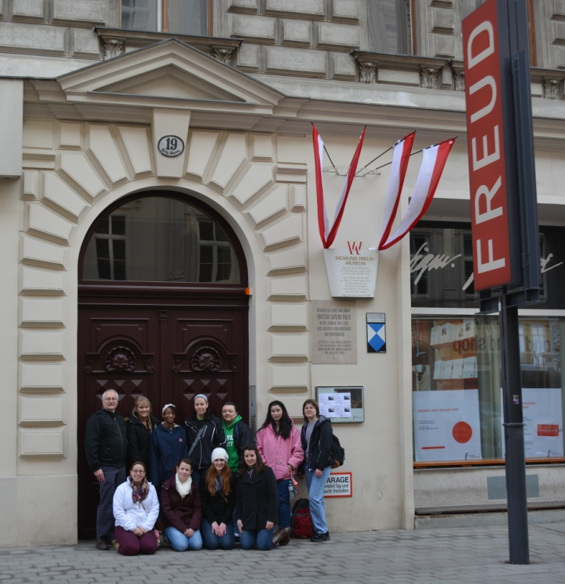
Christianity and Psychology
Early reactions loosely fell along denominational lines:
  Generally, Roman Catholicism was cautious, especially about moral implications
  Liberal Protestants generally embraced psychology
  Conservative Protestants generally reacted against psychology
Dr. Entwistle and a group of Malone University students at Sigmund Freud’s apartments Berggasse 19, Vienna, Austria

Slide 13
Catholicism and Psychology
Early on, Roman Catholicism was somewhat suspicious of psychology. It was concerned about:
  Reductionism
  The often negative portrayal of religion
  Psychology’s incursion into moral discourse
  Psychoanalysis - to the degree that at least one bishop proclaimed that undergoing psychoanalysis was a mortal sin! (What is a mortal sin, and what might have occasioned such a strong reaction?)

Slide 14
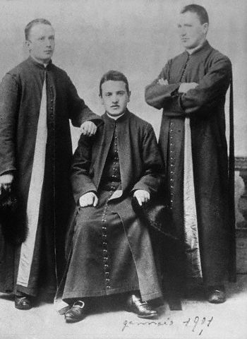
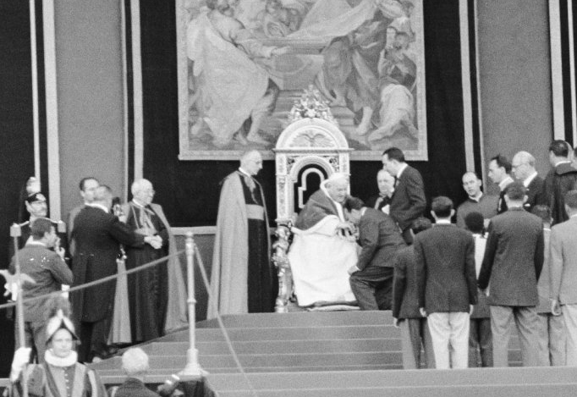
Catholicism and Psychology
Pope John XXIII (Angelo Roncalli) convened the Second Vatican Council.
It sought to “modernize” the Church.
One of the effects was that the Church embraced the use of the insights of psychology and other fields, while simultaneously putting some constraints on them, especially regarding the authority of the church over moral concerns and the value of human life.
Photo at top: Angelo Roncalli, 1901
Photo at bottom: Pope John XXIII, 1960 Olympics. Public Domain: Wikimedia

Slide 15
Catholicism and Psychology
“Although the Church has contributed much to the development of culture, experience shows that, for circumstantial reasons, it is sometimes difficult to harmonize culture with Christian teaching. These difficulties do not necessarily harm the life of faith, rather they can stimulate the mind to a deeper and more accurate understanding of the faith. The recent studies and findings of science, history and philosophy raise new questions which affect life and which demand new theological investigations . . . In pastoral care, sufficient use must be made not only of theological principles, but also of the findings of the secular sciences, especially of psychology and sociology, so that the faithful may be brought to a more adequate and mature life of faith.”
Gaudium et Spes, section 5, ¶3.

Slide 16
Two Main Groupings of Protestants
Mainline protestants – generally more liberal politically and theologically in the 20th century, with an emphasis on social justice issues. Denominations that are commonly grouped as “mainline” include the UMC, ELCA, PC(USA), UCC, and American Baptists, among others.
Note that not all people who belong to a “mainline” denomination are theologically or politically “liberal”. In many mainline churches, local congregations are often more theologically conservative than the clergy and church hierarchy.
In the 20th century, mainline churches tended to encourage higher education, concern for social issues, and ecumenicalism (such as involvement in the National Council of Churches).

Slide 17

Two Main Groupings of Protestants
Evangelical protestants – generally more conservative politically and theologically in the 20th century, with an emphasis on the authority of scripture, God’s activity in history as recorded in Scripture, salvation through personal faith, the importance of evangelism and missions, and the importance of a spiritually transformed life (Marsden 1984).
Timothy Smith describes evangelicalism as a kaleidoscope of disconnected pieces – black Pentecostals, charismatics, fundamentalists, Southern Baptists, some Lutheran and Anabaptist groups, many non-denominational churches.
In the early 20th century, evangelical churches tended to encourage Bible school education, concern for personal salvation (evangelism and missions), and theological conformity.
Photo Credit: Patterns generated by a kaleidoscope. Svampen (2009). Wikimedia, Creative Commons.

Slide 18
Precursors to the 20th century situation
Given the description of Mainline and Evangelical Christians in the 20th century, it is easy to see why the one tended to favor psychology, and the other was more suspicious of psychology.
But how did we get here? You would not have predicted these reactions in the 19th century!

Slide 19
Issue: | 19th Century Evangelicals | 19th Century “Civil Religionists”
Social Position | Not usually in power; often lower class | Often yielding political and economic power
Theology | Prophetic call against social evils and personal sin | Protect social position; “the poor put themselves in poverty”
Prisons; asylums for the mentally ill | Point out deplorable conditions | Protect society from degenerates
Working conditions | Support reform, right to strike | Support the status quo, interests of the wealthy
Child labor & Education | Supported restrictions on child labor; Sunday “school” movement | Many supported the status quo, interests of the wealthy
Temperance | Both groups tended to oppose alcohol abuse beginning around 1820 due to its association with personal and social problems.
“Politics” | “Liberal” | “Conservative”

Slide 20
The Great Reversal
In the 19th Century, evangelicals had been active social reformers, politically liberal (e.g., pro worker’s rights, pro child labor laws, etc.).
From the late 1800’s through the mid to late 1900’s they retreated from social concern.
What happened?
Reactions to Darwin and to higher criticism!

Slide 21
Issue: | Early 20th Century American Evangelicals | Early 20th Century American Mainline Churches | Early 20th Century American Roman Catholics
Fundamentalist / Modernist Controversy | Darwin is bad: Anti-social action, anti-intellectual, anti-ecumenical | Darwin is fine: Pro-social action, pro-intellectual, pro-ecumenical | Science is science; the Church speaks on moral issues
Social Position | Some are in positions of power; some are experiencing upheaval | Often in power and wealthy | Mostly immigrants (e.g., Irish Potato famine); mostly hardworking poor.
Theology of sin | Prophetic call against personal sin | Prophetic call to reform society | Social and personal
Theology | Evangelism, revivalism, dispensationalism | Social gospel | Often from places where Church had profound influence on State, now living in a dominantly Protestant country.
Social focus | Fear of change; escapism; personal responsibility | Create the kingdom on earth | Social responsibility; tight communities
Social condition | “Flight to the suburbs” | “Dying” inner city churches with social outreach | Often among the poor who were discriminated against
Politics | “Conservative” – “From Prohibition to Blue Laws”. (1970’s “Moral Majority”) | “Liberal” – focus on meeting social needs | “Conservative” personal morality; “Liberal” social policies

Slide 22
Framing the mid 20th century Context
1960’s
Culture (Vietnam and Woodstock)
Civil rights movement
Breakdown of the family
Psychology as a reflection of cultural values
Psychology as a means of helping people

Slide 23
Protestants and Psychology
Mainline Protestants
“The response of the mainline Protestant churches to the emergence of psychiatry in the United States has been basically favorable.” (Browning)
A two-way street, with mainline theologians exploring psychological themes, and psychologists who were open to religion exploring connections between psychology and religion.
Some people contend that mainline pastoral care lost its focus on Christian formation and opted, at times, for an uncritical acceptance of the therapeutic culture.
  Pastoral care went “from salvation to self-realization” in some cases

Slide 24
Protestants and Psychology
Fundamentalist Protestants
Rejected psychology, much as they had rejected Darwin in the fundamentalist-modernist controversies (anti-ecumenical, anti-social action, anti-intellectual)
Evangelical Protestants
Some, like Jay Adams, rejected psychology
Some, like Gary Collins and Clyde Narramore, saw psychology as a way of helping people, but wanted to be careful to protect biblical perspectives and values, not unlike the Roman Catholic response.

Slide 25
Reversing the Reversal?
In the mid 20th century, evangelicals gradually began to emphasize education
Bible Schools gradually became Christian liberal arts universities
Renewed emphasis on the poor and the needy
BUT, concerns about cultural issues (e.g., divorce) and fear of desegregation led many white, well-to-do Christians to flee to the suburbs and to engage in “culture wars”.
This led to a divided response to social issues and to psychology.

Slide 26
Reflection Point
What are some of the reasons that many Christians were suspicious of psychology in the early twentieth century?
What were some of the benefits that some Christians saw in employing the insights of psychology?
Why did many evangelical Christians disengage from social concerns in the early twentieth century?

Slide 27
The View the Other Way
Some psychologists rejected religion, much as some Christians rejected psychology. This was particularly true among scientific psychologists who advocated positivism and naturalism, and among many humanistic psychologists.
Although, as a group, psychologists are less religious than the culture at large, some psychologists remained open to religious experience, either as a topic of study or even as a personal commitment.

Slide 28
Where Do We Go From Here
Having painted the broad contours of some historical trends in religion, science, and psychology, we can now turn our attention to some of the worldview and philosophical issues that will frame specific models for and issues in relating psychology and religion in general, and Christianity in particular.

