Slide 1

Integrative Approaches to Psychology and Christianity – 4th ed.
Chapter 2
Allies or Enemies: Historical Views on Faith and Science
David N. Entwistle, PsyD
These slides are designed to accompany Integrative Approaches to Psychology and Christianity, 4th ed.
Material protected by copy write. Users are welcome to make changes to the presentations and to use them for educational purposes, provided that the original acknowledgement is maintained and any changes to the presentation clearly identified.

Slide 2

PowerPoint Slides to Accompany
Integrative Approaches to Psychology and Christianity, 4th Edition
Chapter 2: Allies or Enemies: Historical Views on Faith and Science

Slide 3
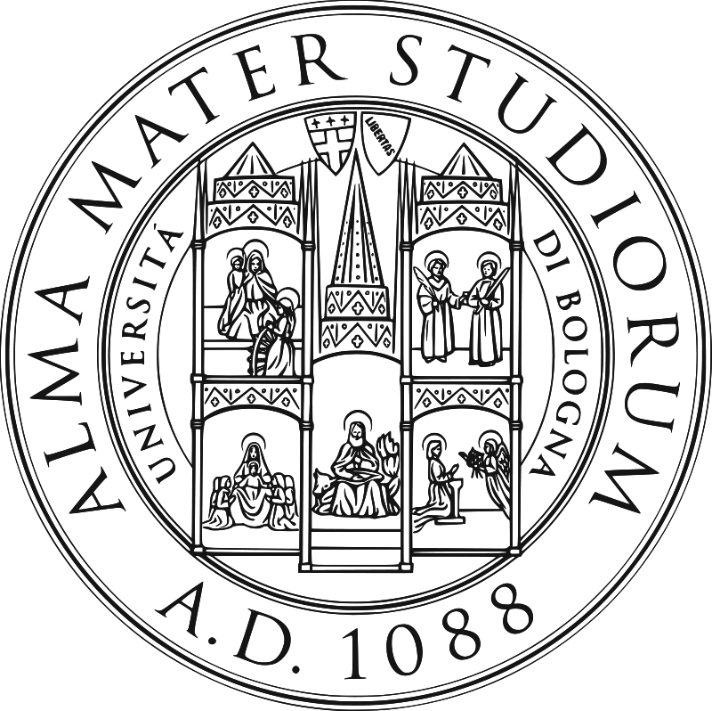
Middle Ages
The Catholic Church was generally supportive of education.
“Perhaps the greatest single contribution to education to emerge from Catholic civilisation was the development of the university system. Early Catholic universities include Bologna (1088); Paris (c 1150); Oxford (1167); Salerno (1173); Vicenza (1204); Cambridge (1209); Salamanca (1218-1219); Padua (1222); Naples (1224) and Vercelli (1228).” – Mark Greeves
Seal of the
University of Bologna;
public domain

Slide 4
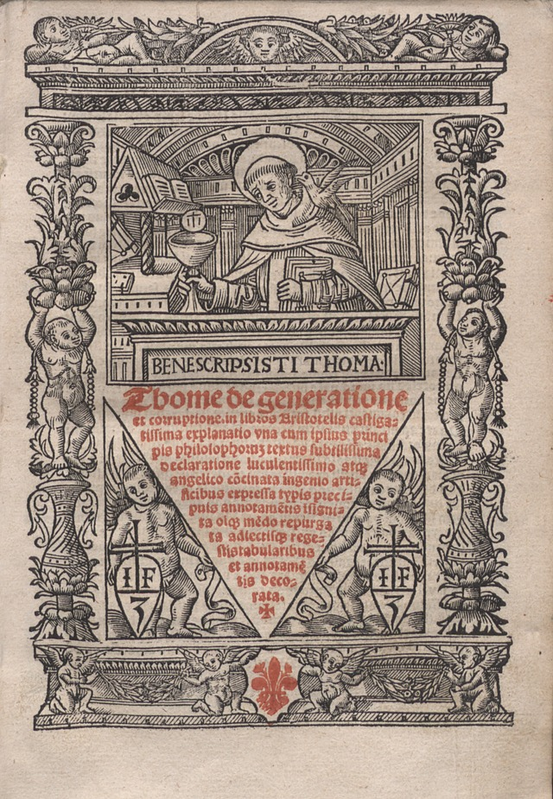
Middle Ages
The most important Church theologians saw God as revealing truth to all people through nature and reason. (Common grace)
“Sacred doctrine makes use even of human reason . . . to make clear other things that are put forward in this doctrine. Since therefore grace does not destroy nature but perfects it, natural reason should minister to faith as the natural bent of the will ministers to charity . . . Hence sacred doctrine makes use also of the authority of philosophers in those questions in which they were able to know the truth by natural reason.” – Thomas Aquinas, Summa Theologica.
Tommaso d'Aquino: Super libros de generatione et corruptione – Public domain; European Library of Information and Culture; Wikimedia Commons

Slide 5
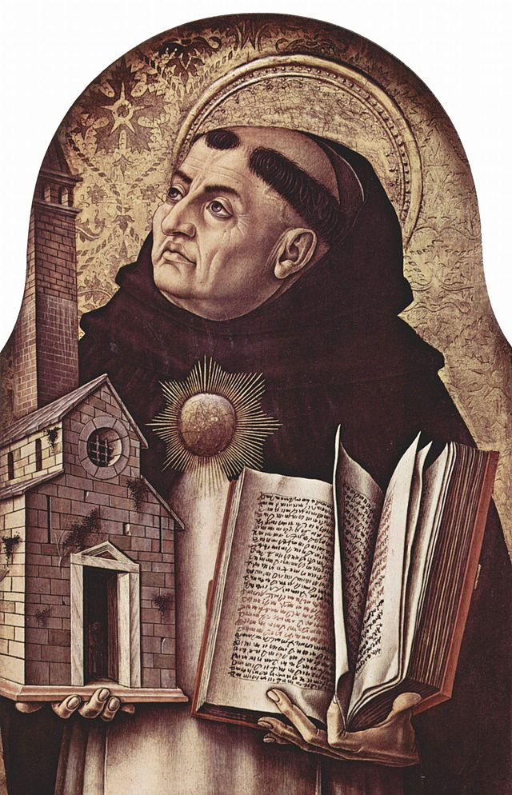
Middle Ages
BUT, theology was seen as being more important and less prone to error than natural reason.
“[Theology] surpasses other speculative sciences . . . because other sciences derive their certitude from the natural light of human reason, which can err; whereas [theology] derives its certitude from the light of divine knowledge, which cannot be misled.” – Thomas Aquinas, Summa Theologica.
Carlo Crivelli (circa 1435)
Altar von San Domenico in Ascoli, Polyptychon, Thomas von Aquin. Public domain, Wikimedia

Slide 6
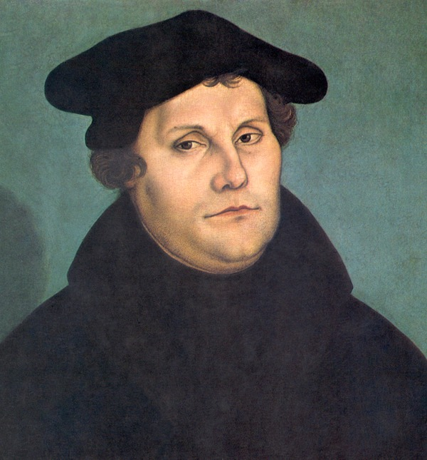
The Challenge of the Reformation
1517 – Martin Luther posted the 95 Theses on the door of Wittenberg Castle church. Some of his main objections included:
  The practice of indulgences
  The Pope’s supposed authority over purgatory
  The belief that the merits of the saints could be transferred to others in need of grace
Martin Luther Cranach – restoration
Public Domain, Wikimedia

Slide 7
The Challenge of the Reformation
Luther’s desire for reforms within the Roman Catholic Church eventually spread far beyond his initial objections, resulting in religious, intellectual, political, and cultural upheaval. A few of its results:
  made the Bible available in native languages
  challenged papal authority
  challenged Roman Catholic power and doctrinal tradition
  splintered Europe politically and religiously
  triggered the Catholic Counter Reformation
Martin Luther Cranach – restoration
Public Domain, Wikimedia

Slide 8
The Roman Catholic
Counter Reformation
The Council of Trent – 1545-1563
Confront breakaway Protestantism
The Council reaffirmed many of the teachings of the church such as:
  the seven sacraments
  the cannon of Scripture, including the Apocrypha
  veneration of saints, relics, and the Virgin Mary
  the doctrine of transubstantiation
  salvation by grace through faith and works

Slide 9
The Roman Catholic
Counter Reformation
The Council of Trent – 1545-1563
Recognizing that some rural parishes had priests that were inadequately educated, the Council sought to restore the Church through such things as making sure that seminaries formed the pastorate in accordance with church doctrine and expansion of religious orders.

Slide 10
The Roman Catholic
Counter Reformation
The Council of Trent – 1545-1563
In order to combat heresy, Pope Paul III established the Roman Inquisition, which had the power to investigate and punish heretics. Penance or punishment could include fines, reciting penitential psalms, public acts of penance, public scourging, fines, confiscation of property, imprisonment, or, in very rare cases, execution by civil authorities.

Slide 11

The Roman Catholic
Counter Reformation
The Council of Trent – 1545-1563
The Index Librorum Prohibitorum (List of Prohibited Books) a list of books that were banned because they were deemed to be heretical, had been developed by Pope Paul IV in 1559. The Council of Trent reformed the banning of books into the Tridentine Index (which continued to be revised until 1948, finally abolished by Pope Paul VI in 1966).
Index Librorum Prohibitorum
Public Domain, Wikimedia

Slide 12
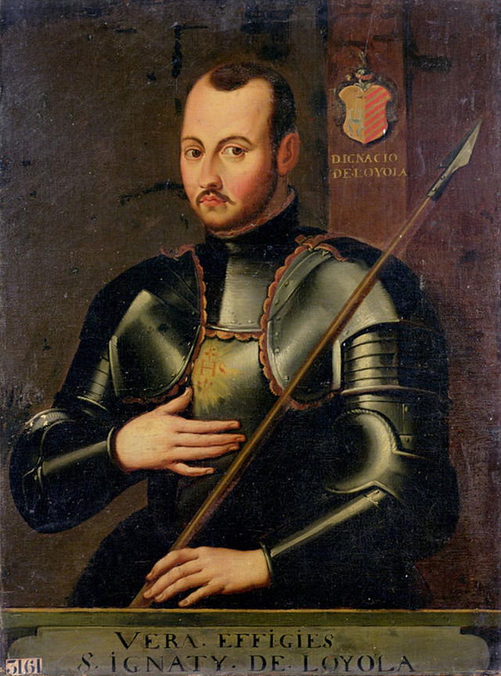
The Roman Catholic
Counter Reformation
The Society of Jesus (Jesuits), founded in 1534 as a monastic teaching order by Ignatius of Loyola.
“Whoever desires to serve as a soldier of God beneath the banner of the Cross in our Society… and to serve the Lord alone and the Church, his spouse, under the Roman Pontiff… should, after a solemn vow of perpetual chastity, poverty and obedience, keep what follows in mind.”
Ignatius in Armor
Public Domain, Wikimedia

Slide 13
The Roman Catholic
Counter Reformation
The Society of Jesus (Jesuits)
Purpose: “defense and propagation of the faith and for the progress of souls in Christian life and doctrine” and “to reconcile the estranged, compassionately assist and serve those who are in prisons or hospitals, and indeed, to perform any other works of charity, according to what will seem expedient for the glory of God and the common good.”
Ignatius in Armor
Public Domain, Wikimedia

Slide 14
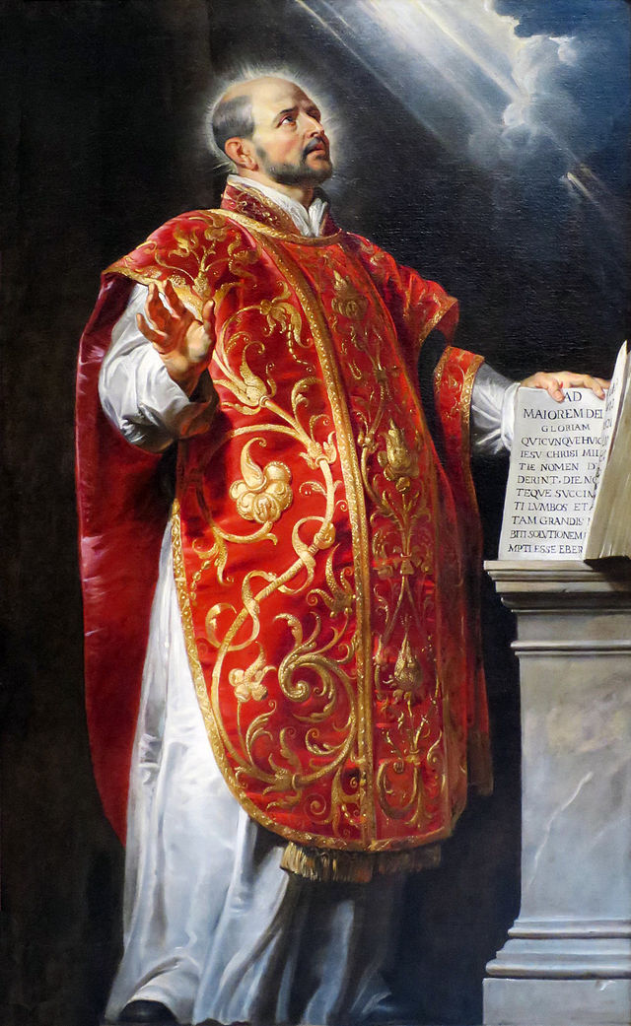
The Roman Catholic
Counter Reformation
Jesuits have had an enormous influence on spiritual formation within the Roman Catholic tradition.
  Ignatian spirituality – "to conquer oneself and to regulate one’s life in such a way that no decision is made under the influence of any inordinate attachment.”
  Undertaken through spiritual exercises and spiritual direction
Ignatius of Loyola
Peter Paul Rubens,
c. 1600’s
Public Domain, Wikimedia

Slide 15
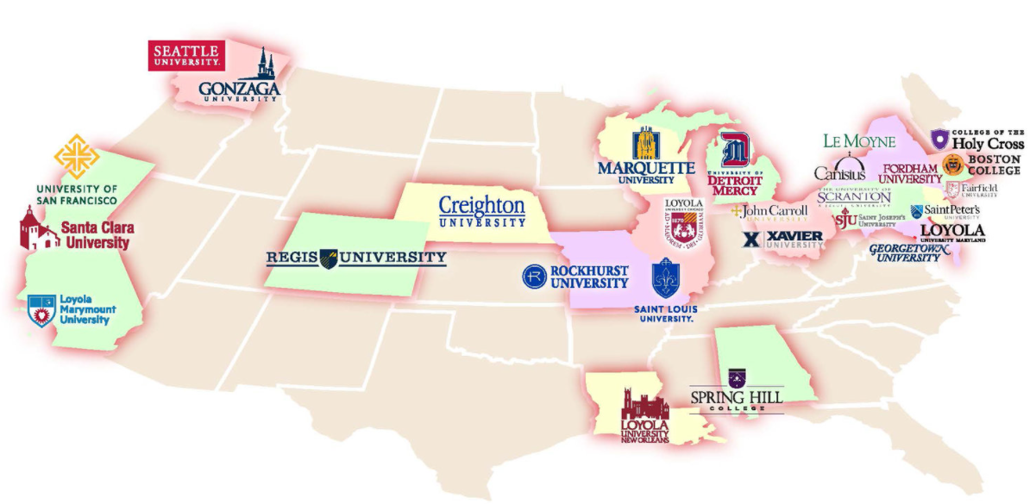
Jesuit influence on education
Many primary and secondary schools, colleges and universities were founded by Jesuits.
  189 colleges and universities worldwide, with 28 universities in the United States including Loyola, Loyola Marymount, Marquette, Santa Clara, Creighton, Fordham, Holy Cross, Boston College, Gonzaga, Xavier, and Georgetown

Slide 16
The Roman Catholic
Counter Reformation
In 1542 Pope Paul III established the Congregation of the Holy Office of the Inquisition, administered by the Jesuits.
Purpose:
  to maintain and defend orthodoxy
  to examine those who were suspected of heresy and to meet out appropriate penalties.

Slide 17
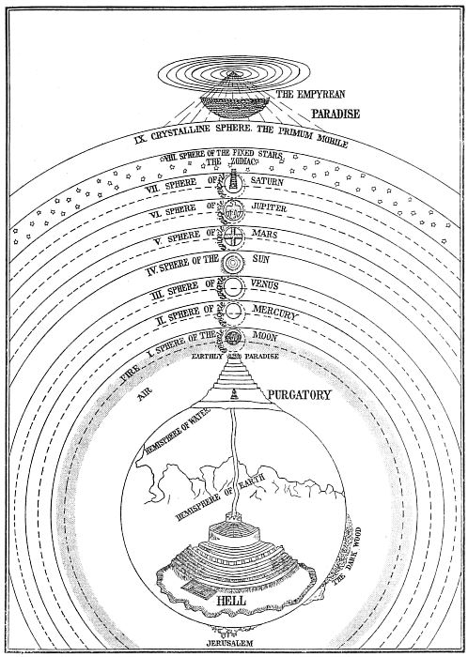
Conflicting Views of the World
The Roman Catholic Church affirmed the Ptolemaic system, developed by Ptolemy and affirmed by Aristotle, that the earth is the center of the universe.
  It was convenient for teaching theology – the corrupted earth was removed from the pristine heavens (whose stars and planets were thought to be pure, unblemished spheres) and only hell (in the depths of the earth) was further removed from God.
Dante’s view of paradise, purgatory, and hell, as illustrated by Michelangelo Caetani (1804-1882), public domain.

Slide 18
Conflicting Views of the World
1543 – Copernicus publishes De Revolutionibus Orbium Coelestium (a defense of the heliocentric view first proposed by Pythagoras).
1610 – Galileo publishes “Siderius Nuncius” (“The Starry Messenger”), a defense of the Copernican view based on his observation of the moons of Jupiter through his telescope.
1616 – Galileo is summoned before the Inquisition and barred from teaching the heliocentric theory as a contravention of church doctrine.
1632 – Galileo publishes Dialogue Concerning the Two Chief World Systems as a discussion between three men about the Aristotelian and Copernican systems.
1633 –The second trial of Galileo focused on whether he had promoted the teaching of the heliocentric view in direct contradiction of the first tribunal. Galileo claimed that his book was simply a theoretical discussion of the topic.

Slide 19
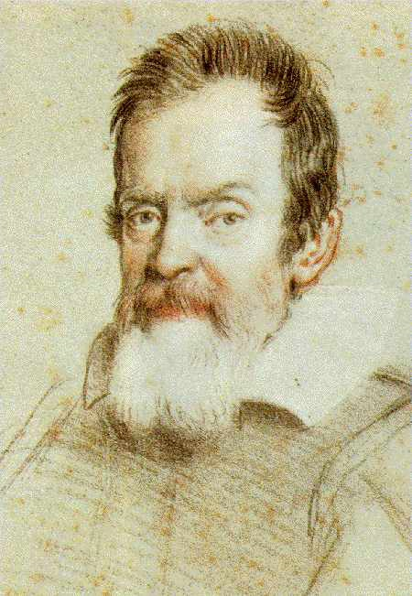
Conflicting Views of the World
Opposition to Galileo began in the academic world! He was, by accounts, an arrogant and condescending man who easily made enemies.
Opposition soon spread to the Church, bringing Galileo to the attention of the Inquisition.
Trial of 1616 – Galileo is told that the heliocentric theory cannot be taught or held to be true, (but perhaps it could be held hypothetically).
Galileo Galilei
Portrait by Ottavio Leoni
Public Domain, Wikimedia

Slide 20
Conflicting Views of the World
After being silent on the issue for nearly 16 years, Galileo published a book called Dialogue Concerning the Two Chief World Systems in 1632, with the approval of the Inquisition and the Pope.
In the book, Galileo sought to abide by the restrictions of the Inquisition of 1616 by writing a story in which three men debated the Ptolemaic and Copernican systems. Sagredo is a neutral party. The Copernican system is advanced by Salviati . The views of the church are advanced by Simplicio (“Simpleton”), defending the Ptolemaic system.
In the book, Simplicio wins the argument… but no one was fooled about Galileo’s real intentions.

Slide 21
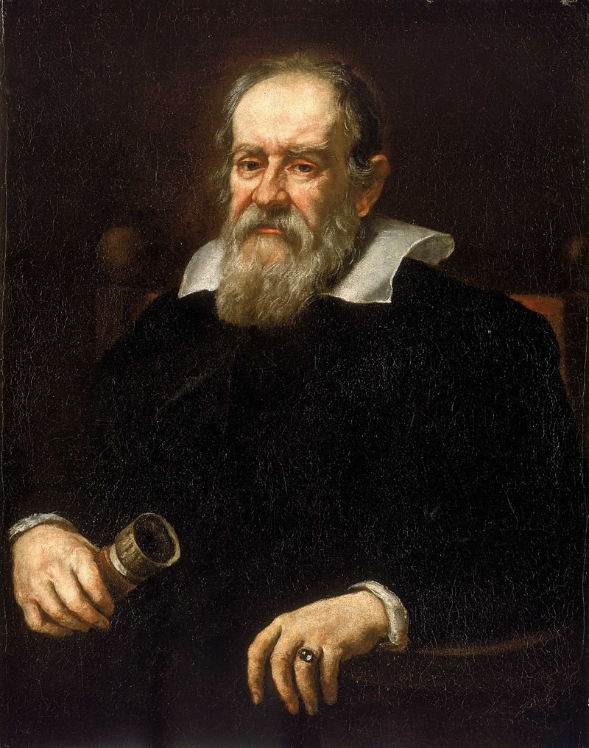
Conflicting Views of the World
Trial of 1632 – the key issue was whether Galileo had violated the prohibition of 1616.
Galileo was found guilty and sentenced to house arrest. His most recent book was added to the Index of Prohibited books.
Portrait of Galileo Galilei by Giusto Sustermans 1636
Public Domain, Wikimedia

Slide 22
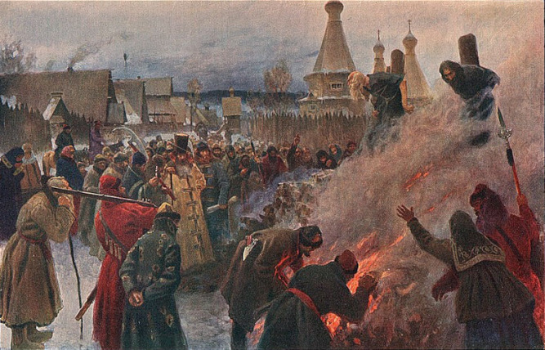
Reflection Point
If you were Galileo Would you have recanted?
Why or why not?
Giordano Brunno, burned alive with a shirt covered in pitch in 1600 for heresy, including denying the deity of Christ, the virginity of Mary, the doctrine of eternal damnation, the doctrine of transubstantiation… and for his belief that distant stars are suns with their own planets and earth is not the center of the universe….

Slide 23
Christianity and Science
Because of the condemnation of Galileo by the Inquisition, it became convenient (if not entirely accurate) to see science and religion as opposed to one another.
Why? How might a “warfare” metaphor have benefited both secular Enlightenment and some religious political ideologies?
Is this the most accurate way to view their relationship?

Slide 24
Christianity and Science
On the other hand, most early scientists identified themselves as Christians, including Galileo, and some were even monks (e.g., Gregor Mendel)
Why might this be so?
Alfred North Whitehead (1861 –1947), a mathematician and philosopher, argued that the Christian view of God’s power and rationality led Christians to look for order in nature, and to use natural theology as a means of demonstrating the existence and nature of God.

Slide 25
Christianity and Science
Many factors were needed for modern science to be established, including economic, educational, and philosophical developments.
So, can we claim that Christianity alone caused the rise of modern empirical science? No, but it was probably one factor among many that propelled its development.
And, lest we forget, while previous civilizations did not have the scientific method, they did have many insights and technologies that we still benefit from today.

Slide 26
Reflection Point
If Christianity was a common backdrop for most early scientific thinking, how did it come to be that many people now think of Christianity as an impediment to the development of science?
If the evidence does not support the view that Christianity impeded the development of science, why is the view so widely held?

Slide 27
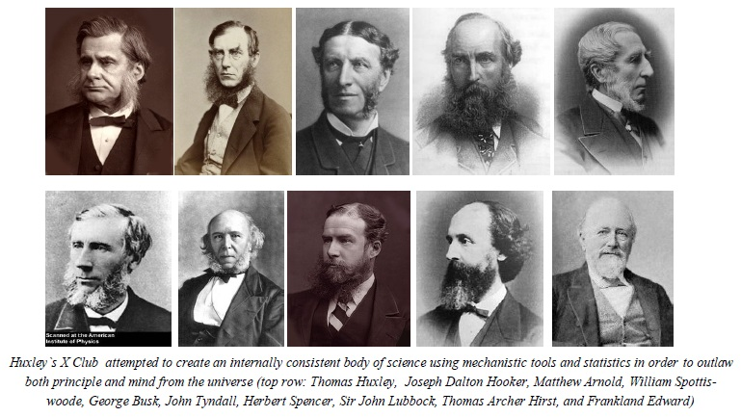
Thomas Huxley and the X-Club
Sought to establish “a scientific status for natural history, to rid the discipline of women, amateurs, and parsons, and to place a secular science into the center of cultural life in Victorian England.”
(“Science” and “Religion”, 2006, p. 87).

Slide 28
Evangelicalism and Science
As we explore evangelical reactions to science, it is important to emphasize that we are using the term evangelical in its historic sense, not in the way that it is sometimes associated with contemporary American politics, (e.g., “the white evangelical voter.”
Historians use the term evangelical to characterize a Christian movement that exists around the world (in fact, roughly one-third of Christians around the world can be described as “evangelical” as classically defined.

Slide 29
Evangelicalism and Science
Evangelicals are a diverse group
Rooted in the Protestant Reformation, Puritanism, and the revivalist movements in Great Britain and the United States.
Typically defined by four theological stances
  Personal conversion
  High view of scripture
  Salvation through Christ alone
  Importance of sharing the “Good news”

Slide 30
Evangelicalism and Science
Early evangelicalism was interested in science:
  first, as a support for “natural theology”, and
  second, for the benefits that it could afford through medical science.
Natural theology was useful to support belief in God and to learn about God’s goodness.
Medical science allowed missionaries to express social concern by establishing hospitals at the same time they shared the gospel. This was an expression of holistic ministry, social and spiritual concern.

Slide 31
Protestants and Science
Some sociological research suggests that there were more Protestants involved in science relative to their numbers in the general population from the mid-1600’s until recently. Why might this have been the case?
  De Candole suggested that part of the reason is that Catholic clergy didn’t have children
  The Protestant work ethic
  Middle class vocational opportunities
  Rediscovery of the idea that God can be worshiped through all forms of inquiry
  Creation of universities in North America by Puritan and other European immigrants

Slide 32
“Normal Science”
Until the mid-1800’s, there was not a significant sense of conflict between scientific and religious viewpoints.
Partly, this was because most of the scientific community operated implicitly from a Christian worldview. In fact, one can easily find works that involve both scientific and theological reflection up until this time.
And, since the time of Galileo, no scientific theory prior to the mid-1800’s had significantly challenged long-held theological views. But that was about to change…

Slide 33
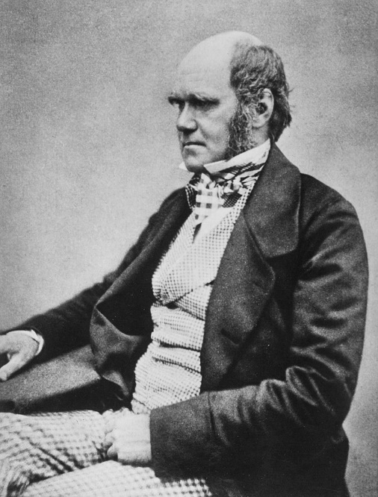
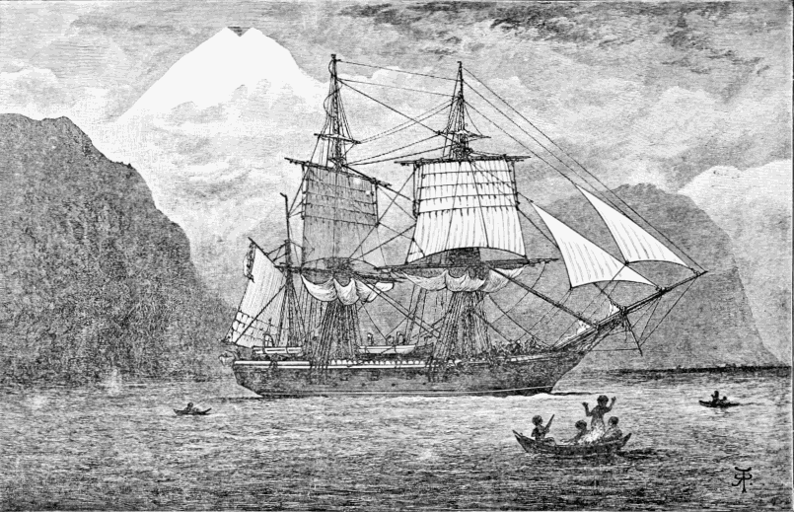
Charles Darwin embarked on a voyage aboard the HMS Beagle on December 27th, 1831. The voyage lasted nearly five years. While traveling as a self-funded naturalist, he observed variations among geographically isolated species, which became the germinating seed of his theory of evolution.
Top: Charles Darwin, c. 1854, (Maull & Fox), Public Domain: Wikimedia.
Below: HMS Beagle in the Straits of Magellan, R. T. Pritchett. Public Domain: Wikimedia.

Slide 34
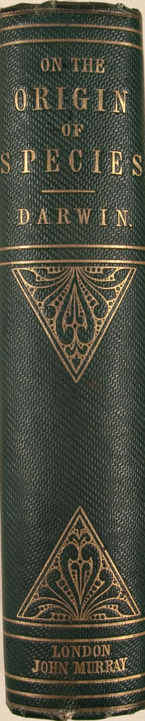
Christianity and Science
Charles Darwin – 1859, On the Origin of Species
Darwin’s view threatened the traditional view of creation. A new form of theological interpretation, higher criticism, also began at about the same time.
Reactions:
  Catholicism – avoid unnecessary conflicts with science
  Liberal / neo-orthodox Protestantism – alter theology to fit science and reason
  Fundamentalism – defend the “fundamentals” of the faith against “errant” views

Slide 35
Christian Reactions
Reactions emerged over time
Roman Catholicism gradually moved towards acceptance of evolutionary theory
Protestantism, reacting both to evolutionary theory and theological revision, underwent the fundamentalist-modernist split.

Slide 36
Fundamentalist-Modernist Split
Liberal groups in the nineteenth century increasingly adopted a view of Scripture that focused on its moral and humane teachings and removed or minimized its authority concerning historical or scientific matters.
Fundamentalists maintained a literal interpretation of Scripture. It rejected Darwinism and higher criticism. Fundamentalists became suspicious of science, seeing it as having been hijacked to promote atheism and humanism. In reaction, fundamentalists tended to alter scientific views to make them fit their theological views.

Slide 37
Fundamentalist-Modernist Split
Liberal groups became pro-ecumenical, pro-social action, and pro-intellectual. (They worked to care for the needs of the poor and disenfranchised with any group who had similar aims, and they valued university education).
Fundamentalists focused on salvation instead of social concern (“What does it matter if we improve your lot in life if you go to hell?”). They became suspicious of other groups who didn’t focus primarily on salvation. And they became suspicious of higher education. They became anti-ecumenical, anti-social action, and anti-intellectual. “Bible Schools” that helped people become missionaries and pastors took the place of “liberal arts” education.

Slide 38
The Contemporary Scene
For most contemporary evangelical, mainline, and Roman Catholic Christians, faith and science are seen as complementary ways of knowing, but with the recognition that areas of tension will occur.

Slide 39
Reflection Point
What experiences do you have of the ways that people from different Christian traditions react to science?
What remnants of the fundamentalist-modernist split can you see in how different Christian groups think about education, social concerns, and cooperating with other religious groups?

