Slide 1

Integrative Approaches to Psychology and Christianity – 4th ed.
Chapter 1
The Question of Necessity: Athens and Jerusalem
David N. Entwistle, PsyD
These slides are designed to accompany Integrative Approaches to Psychology and Christianity, 4th ed.
Material protected by copy write. Users are welcome to make changes to the presentations and to use them for educational purposes, provided that the original acknowledgement is maintained and any changes to the presentation clearly identified.

Slide 2
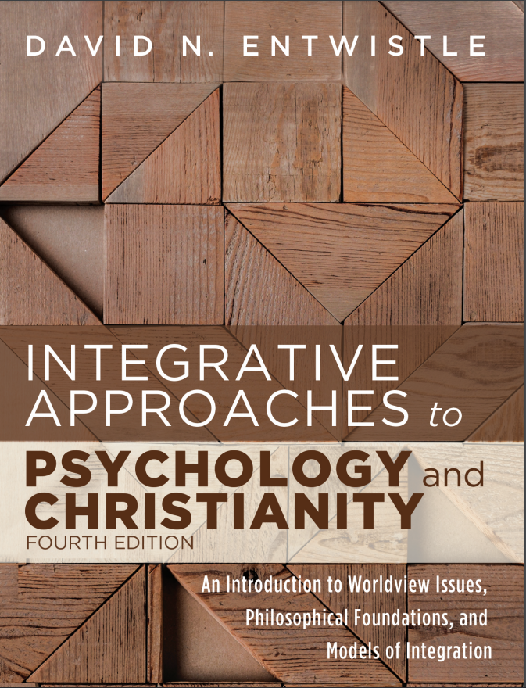
PowerPoint Slides to Accompany
Integrative Approaches to Psychology and Christianity, 4th Edition
Chapter 1
The Question of Necessity: Athens and Jerusalem

Slide 3
Spirit Filled Church of Our Lord Jesus
Recall the story of the people in a church, unknowingly overcome with carbon monoxide.
Why might they have prayed for each other rather than leaving the building?
  Physical evidence: Can you see CO₂?
  Spiritual evidence: Can you see the Spirit of God?
Are there any hints about the culture or theological framework of the church that might help explain why they stayed and prayed?

Slide 4
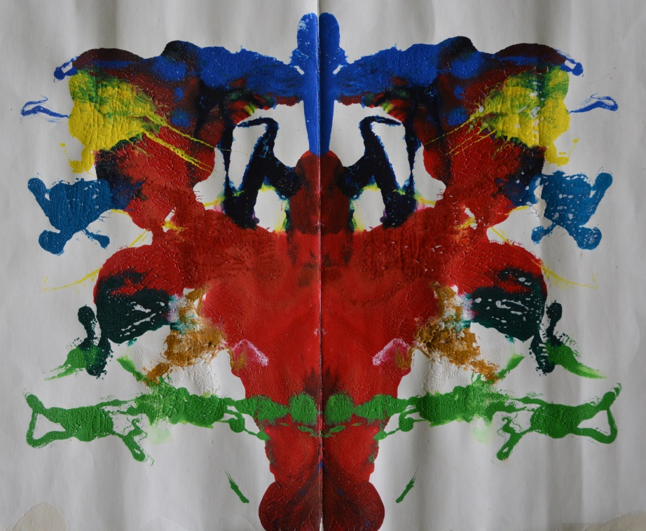
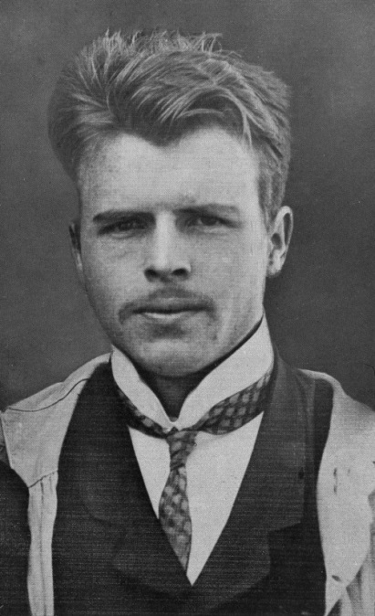
A Metaphysical Rorschach
Hermann Rorschach, a Swiss psychiatrist, enjoyed klecksography - making pictures out of inkblots. He noticed that people saw different things in the inkblots, leading him to create the test that bears his name for clinical and diagnostic purposes.
Image at right: a colorful inkblot made by Dr. Entwistle. What might this be?
Image at left: Hermann Rorschach c. 1921, public domain
photo credit: Wikimedia Commons

Slide 5
A Metaphysical Rorschach
Metaphysics deals with the nature of reality. How one interprets the story of the worshipers at the Spirit Filled Church of our Lord Jesus may tell us quite a bit about the person, such as his or her views about:
religion in general
this specific religious group
the world (could supernatural elements have been at work, such as demon oppression, God causing concerned relatives to call the police, etc.?)
What was your reaction to the story?
What does your reaction reveal about you?

Slide 6
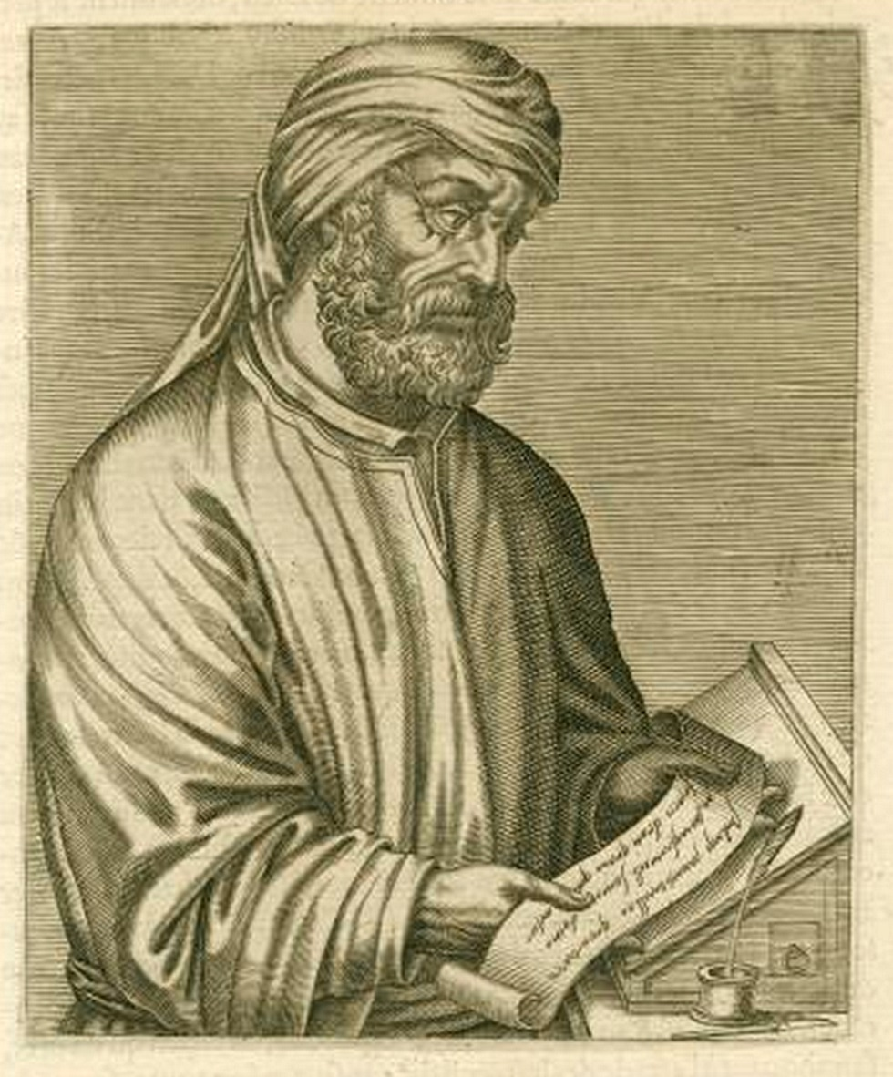
“What indeed has Athens to do with Jerusalem?”
Quintus Septimius Florens Tertullianus
c. 155 – c. 240 AD
Woodcut of Tertullian
Les vrais pourtraits et vies des hommes illustres grecz, latins et payens
by André Thévet, 1584.
public domain
photo credit: Wikimedia Commons

Slide 7
Tertullian and the secular academy
“Whence spring those ‘fables and endless genealogies,’ and ‘unprofitable questions,’ and ‘words which spread like a cancer?’ From all these, when the apostle would restrain us, he expressly names philosophy as that which he would have us be on our guard against. Writing to the Colossians, he says, ‘See that no one beguile you through philosophy and vain deceit, after the tradition of men, and contrary to the wisdom of the Holy Ghost.’ He had been at Athens, and had in his interviews (with its philosophers) become acquainted with that human wisdom which pretends to know the truth, whilst it only corrupts it…. What indeed has Athens to do with Jerusalem? What concord is there between the Academy and the Church? what between heretics and Christians? … With our faith, we desire no further belief.”

Slide 8
Tertullian’s conclusion
Tertullian believed that the Apostle Paul had unequivocally condemned pagan philosophy.
He believed that human reason (Athens) and faith (Jerusalem) are essentially irreconcilable.

Slide 9
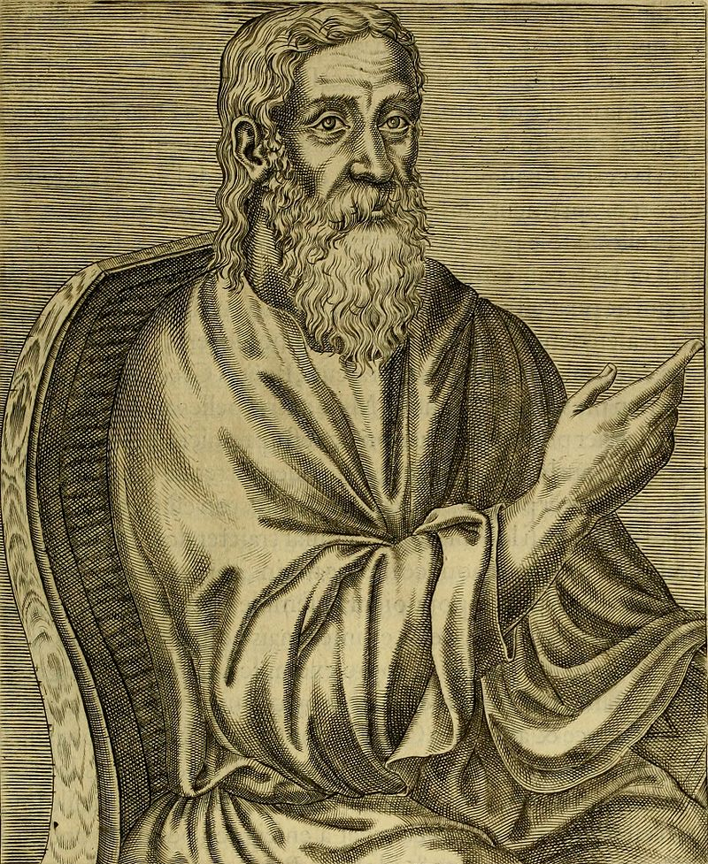
Alternative views
Clement of Alexander
In Clement’s view, there was clearly truth in Greek philosophy, and all that is true comes from God. Thus, Christians could learn from Athenian philosophy, and philosophy could, in fact, pave the way for conversion. In his words, philosophy “was given to the Greeks as a covenant peculiar to them – being, as it is, a steppingstone to the philosophy which is according to Christ.” (Stromata VI,8)
“Clement Alexandrin”
Les vrais pourtraits et vies des hommes illustres grecz, latins et payens by André Thévet, 1584.
public domain
photo credit: Wikimedia Commons

Slide 10
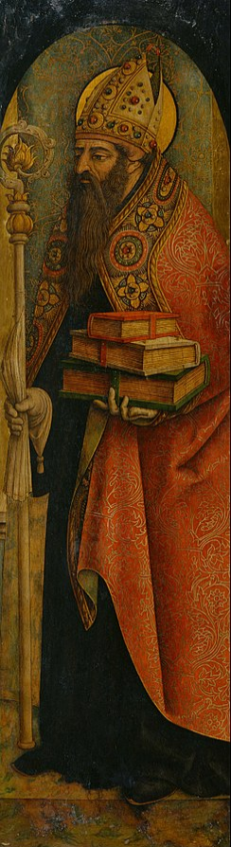
Alternative views
Augustine of Hippo
Augustine saw reason and faith as compatible with one another.
Augustine’s conversion to Christianity took place in stages.
Augustine realized that rhetoric could be about the search for truth rather than just about how to win arguments by reading the Greek philosopher Cicero.
Greek philosophy and reason led Augustine to the doorstep of belief in God, though it was faith that took him across its threshold.
St. Augustine
Carlo Crivelli, c. 1487-88
National Museum of Western Art, Japan
public domain
photo credit: Wikimedia Commons

Slide 11
What has Athens to do with Jerusalem?
An old but relevant question
“We are not the first generation to have thought about this question.”
“The question which you and I as Christian scholars and intellectuals can never be finished with pondering is how to speak and act with Christian integrity within that practice of our common humanity which is scholarship and learning. We do not, or should not, go off into our own corner to think; we participate in the practice of our common humanity. But we are not under the illusion that it is possible to participate as generic human beings; accordingly, we struggle to participate there with Christian integrity.”
– Nicholas Wolterstorff, Tertullian’s Enduring Question

Slide 12
Athens and Jerusalem for Us
Christians need to take seriously that:
Christian Scriptures and Church tradition have a lot to say about human beings.
Contemporary psychology (including both philosophical reflection and empirical inquiry) has a lot to say about human beings.
Some people would – like Tertullian – suggest that these perspectives are opposed to one another, while others – like Clement – would suggest that both sources provide profitable insights and areas of disagreement.

Slide 13
Athens and Jerusalem for Us
As we will see later on, there are modern Tertullians who see the church and modern psychology as enemies. (And there are psychologists who would heartily agree – but they, like ancient pagan philosophers, see religion as errant and unhealthy!)
We will also see that there are many Christians – and some non-Christians – who will propose models that allow varying degrees of interaction between psychology and religion (or Christianity).

Slide 14
Athens and Jerusalem for Us
However, most Christians today probably don’t even think about the possibility of conflicts between Christianity and contemporary psychology or ways that Christianity might frame how we “do” psychology. These are potentially serious blind spots!
To help us in our task, throughout this book we will explore various ways to think about how to structure the relationship between psychology and Christianity.

Slide 15
Athens and Jerusalem for Us
For those of us who want to take Christian faith and our involvement with the discipline of psychology seriously, the key question that we must struggle with is this: how do we participate in contemporary psychology with Christian integrity?

Slide 16
“Christian Thinking”
Harry Blamiers suggested that we distinguish between secular thinking and Christian thinking.
Secular thinking focuses only temporal concerns
Christian thinking recognizes that all things are connected to the Christian narrative
Both forms of thinking can be done well or done poorly, and both are useful if done well!

Slide 17
“Christian Thinking”
Imagine that someone is in charge of a Eucharistic or communion service. There are numerous ways in which “secular thinking” is important and necessary.
How much wine (or grape juice) do we need?
Where can the communion elements be purchased?
What is the budget for the communion elements?
Where are the serving utensils kept, and who is going to prepare the elements and clean up afterwards?
Who is going to distribute the elements?
Should we reduce the spread of illness during flu season by using individual cups or intinction?

Slide 18
“Christian Thinking”
“Secular thinking”, while necessary, will only carry us so far. “Christian thinking” will require us to consider a great many other things, such as:
How should the service be framed? (Do we follow a formal liturgy? Who is welcome to take communion? Is it important to note that the elements are the real body and blood of Christ, or conversely, that they are symbols?)
How should biblical instructions about communion be interpreted?
What mindset do I need to cultivate for communion bring me into a holy encounter of God and to reconciliation with others?

Slide 19
Your Turn
How would “secular thinking” and “Christian thinking” be important in the following situations?
Deciding whether to purchase a car
Deciding where to go to church
Deciding what career to pursue
Deciding whether to pursue a marital relationship
Deciding whether to donate to a charity
Deciding whether to accept an invitation to take on a new responsibility
Setting up client fees, informed consent forms, and employee benefits for a psychology practice

Slide 20
Religious thinking and COVID-19
How do we think about complex issues drawing on BOTH Christian thinking AND secular thinking?
Remember, BOTH forms of thinking can be done well or done poorly.
On the one hand, research shows that religiousity is positively correlated with the use of vaccines (in general) across the world (e.g., MMR, polio, etc.).
On the other hand, research shows that belief in misinformation and mistrust of COVID vaccines are more common among religious people (other than Jewish people!).
E.g., in some Muslim countries, rumors have spread that COVID was created by Jews to target Muslims, and that COVID vaccines were designed to target Muslims.

Slide 21
Religious thinking and COVID-19
How do we think about complex issues drawing on BOTH Christian thinking AND secular thinking?
In a British study, only 52% of Christian and 50% of Muslim respondents agreed with the statement, “My religious or cultural beliefs are compatible with the practice of vaccination.” (Compared to 94% of Jews and atheists, 67% of Buddhists, and 38.5% of Hindus). Siani, A., Driscoll, M., Hurst, T, Coker, T., Grantham, A. G. , & Bunet, A. (2021, April 9). Investigating the determinants of vaccine hesitancy within undergraduate students’ social sphere. Journal of Public Health: From Theory to Practice, 1–9.
Why do you think vaccine hesitancy is positively correlated with (non-Jewish) religiosity?

Slide 22
Religious thinking and COVID-19
To use Blamiers’s terms, how would we engage the BEST secular thinking (how do we engage public health recommendations based on scientific data) and the BEST Christian thinking (how do we think about protecting our own and other people’s health as Christians)?
Authority
Empirical evidence
Scripture and church tradition

Slide 23
What is a Christian Psychologist?
People often use terms like “Christian counseling” or “Christian psychology” without a clear sense of what they are referring to. How might you respond to the following questions?
Are you a Christian psychologist?
Do you teach Christian psychology at this school?
Will a major in psychology help me to become a Christian counselor?

Slide 24
What is a Christian Psychologist?
Entwistle suggests that a better way of framing this issue might be to ask:
  “What tangible difference does it make in one’s life and practice to be a psychologist who is a devoted follower of Christ?”
  What kinds of things would you need to consider as you think about how to answer this question?

Slide 25
What is a Christian Psychologist?
“By bringing a Christian framework and insights into a constructive relationship with contemporary psychology, a variety of approaches to integration are possible… [drawing] on scripture, Christian theology, and contemporary psychological theory and research as we seek to understand human nature and to relieve human suffering.”

Slide 26
What is a Christian Psychologist?
Entwistle argued that the integration of psychology and Christianity involves two key elements.
Identifying key Christian commitments that shape how we understand human beings, their relationship to God and to others, and their potentials and their problems to form a framework from which we study psychology, engage in research, and apply psychotherapeutic interventions.

Slide 27
What is a Christian Psychologist?
Entwistle argued that the integration of psychology and Christianity involves two key elements.
2. Having a firm grasp of the theories, methods, and findings of psychology.
How does this proposal increase the complexity and the possibilities of relating psychology and Christianity?

Slide 28
Integration as a Noun and as a Verb
Integration as a noun - integration is a
priori, a thing that we discover when we
are uncovering the fundamental unity
that God created.
Integration as a verb - integration is something we do as we create ways of thinking about, combining, and applying psychological and theological truths.

Slide 29
So, is Integration Necessary?
“If Christ lays claim to all of life, then the work of integration becomes not just feasible, but imperative….”
What has Athens to do with Jerusalem? A lot!!!
But, as we will see in the rest of the book, integration is not simple because we will need to learn the customs of Athens and the customs of Jerusalem, and to carefully navigate what it means to be Christians working in the field of psychology.

Slide 30
So, is Integration Necessary?
To paraphrase Wolterstorff, we must ponder deeply how to speak and act with Christian integrity as we work within the discipline of psychology.

Slide 31
Some Questions to Ponder
Before now, how much have you thought about what it means for someone to be uniquely and distinctively Christian within your intended profession?
What are some ways that you might need to think carefully about what it means to be from Jerusalem while living, working, and dialoguing with people from Athens?

