Slide 1
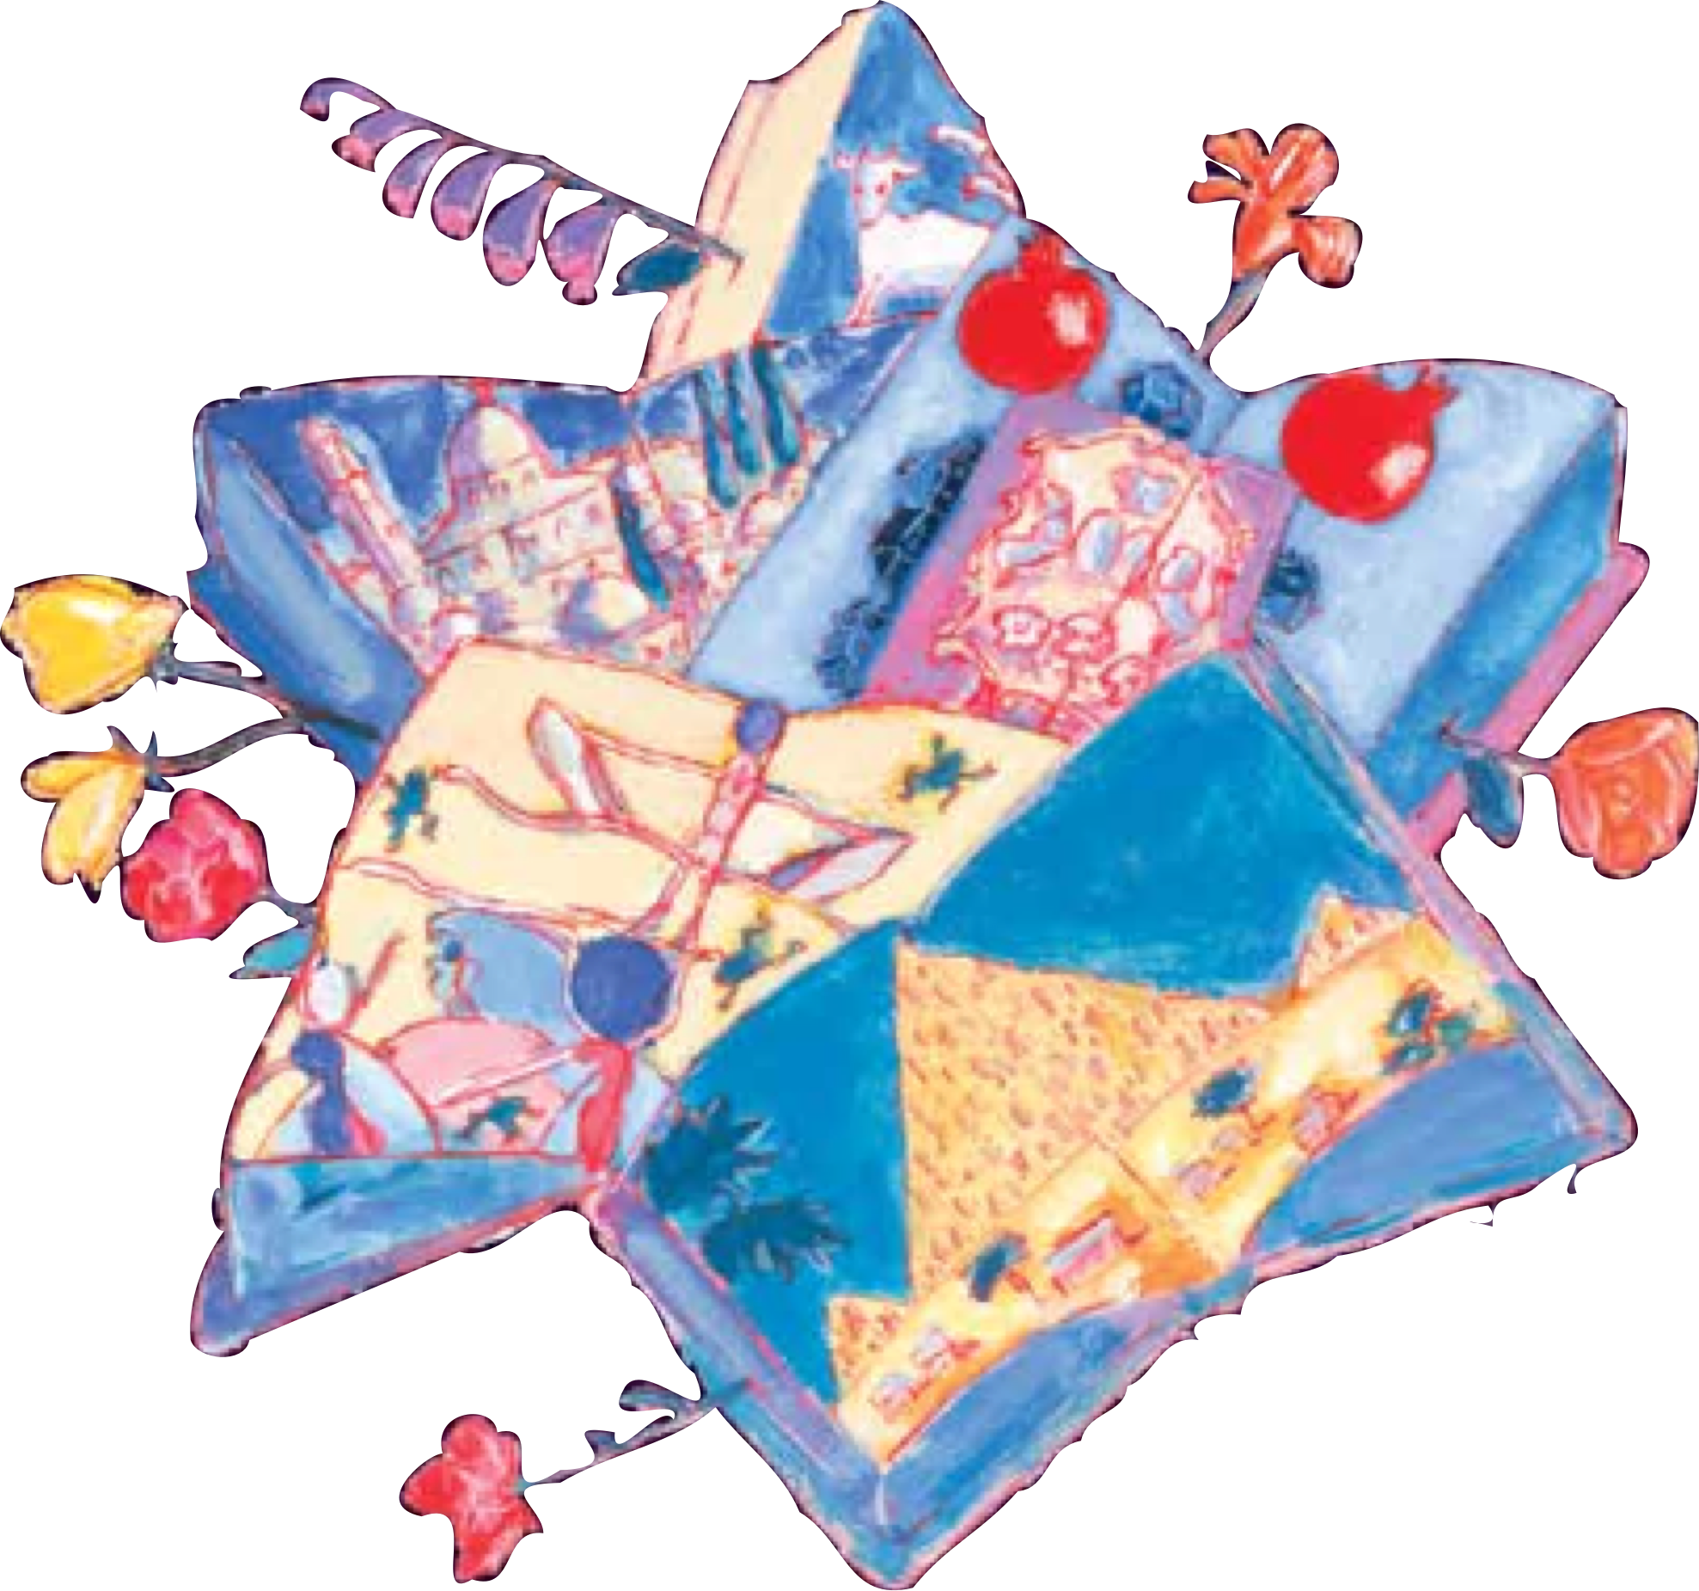
Sharing the
JournEY
The Visual T’filah™ Haggadah
for the Contemporary Family
SAMPLE
Copyright by the Central Conference of American Rabbis.
Written by Alan S. Yoffie
Illustrated by Mark Podwal
Rabbi Mary L. Zamore,
Consulting Editor
Visual T’filah by Rabbi Dan Medwin
Central Conference of American Rabbis

Slide 2

Kiddush: Blessing for the First Cup of Wine
Reader:
The Kiddush cup that holds the wine is our symbol of joy. The wine poured into the cup is our hope for life’s sweetness. Together, poured to the brim, the cup reminds us of the fullness of our days.
During the seder, we will drink four cups of wine. Each cup symbolizes a different aspect of Passover. With the first cup, we remember God’s promise to our ancestors and to every generation:
SAMPLE
Copyright by the Central Conference of American Rabbis.
“I will free you from the labors of the Egyptians.”
V’hotzeiti etchem mitachat sivlot Mitzrayim.
(Exodus 6:6)
21

Slide 3

Kiddush: Blessing for the First Cup of Wine
Reader:
As we drink, we celebrate this promise of freedom from slavery and oppression. From our enslavement in Egypt, we learn that there are times when bitterness is a companion to life’s sweetness. The story of our deliverance teaches us that a life touched by God’s Presence strengthens hope, providing us with the will to overcome the bitter and to rejoice in the sweetness and sanctity of every life.
SAMPLE
Copyright by the Central Conference of American Rabbis.
The Shehecheyanu ( ) is a prayer of gratitude recited at the beginning of special times. We recite it immediately after the blessing for the first cup of wine to give thanks for our opportunity to celebrate this holiday season together.
21

Slide 4
Kiddush: Blessing for the First Cup of Wine
The Reader raises his/her cup of wine.
Reader:
With song and praise, and with the symbols of Passover, let us renew the memories of our past. In love God has given us solemn days of joy and this Festival season of Passover, a remembrance of our departure from Egypt and a celebration of freedom and life.
SAMPLE
Copyright by the Central Conference of American Rabbis.
To continue with the Festival Kiddush, click here to go to page 86. Otherwise, continue onward.
21

Slide 5


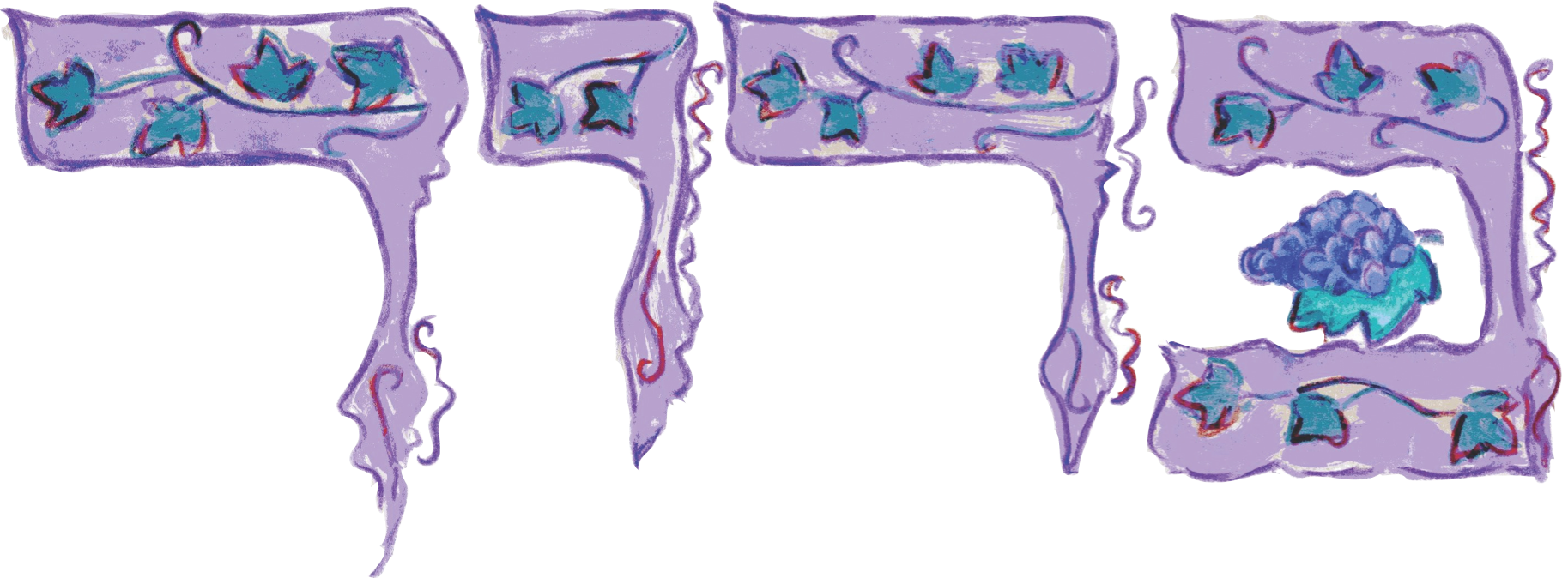
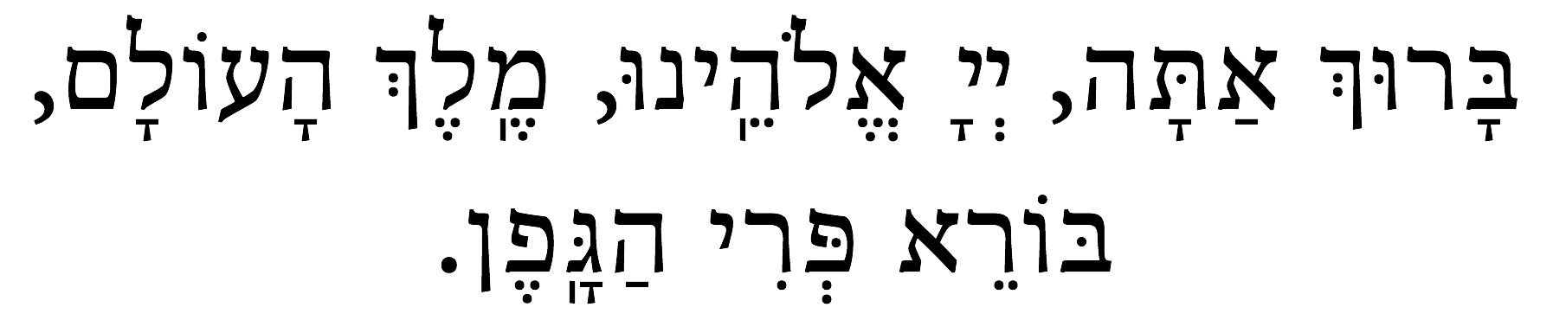
Kiddush: Blessing for the First Cup of Wine
Reader:
Together let us raise the first cup of wine and say:
SAMPLE
Copyright by the Central Conference of American Rabbis.
Baruch atah, Adonai Eloheinu, Melech haolam,
borei p’ri hagafen.
Blessed are You, Eternal our God, Sovereign of the universe,
Creator of the fruit of the vine.
22

Slide 6
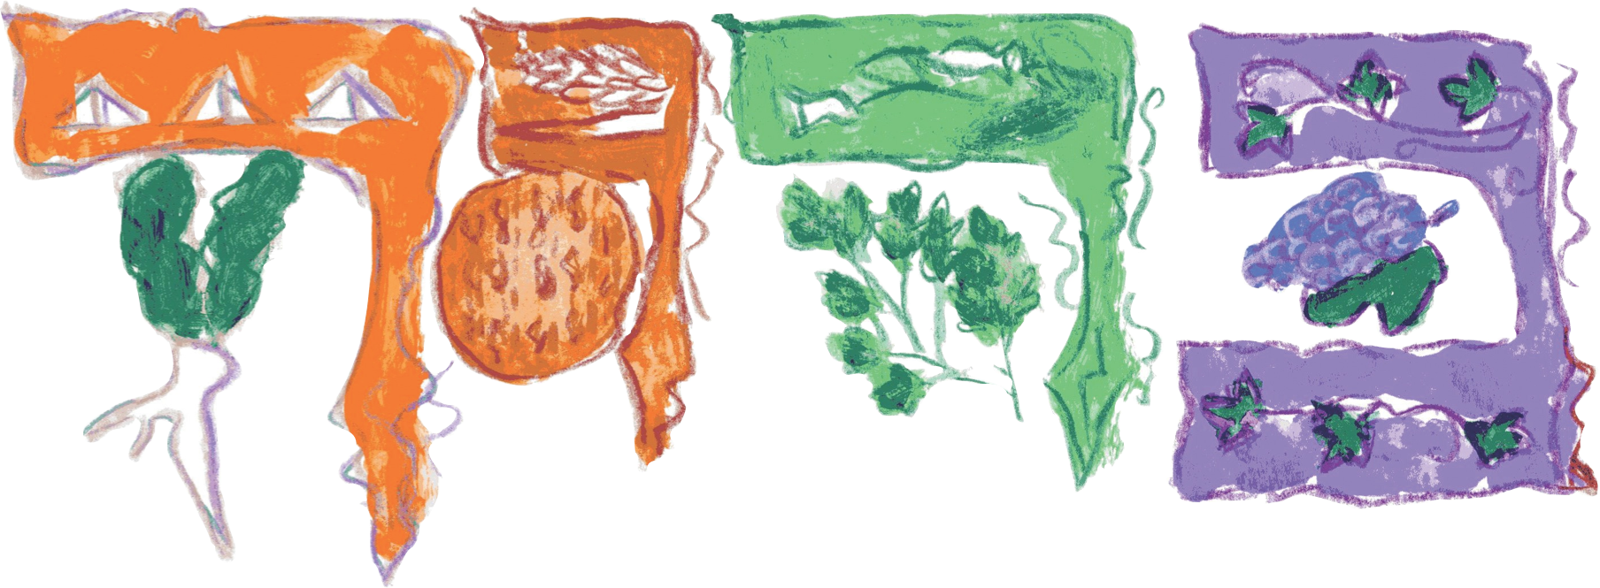
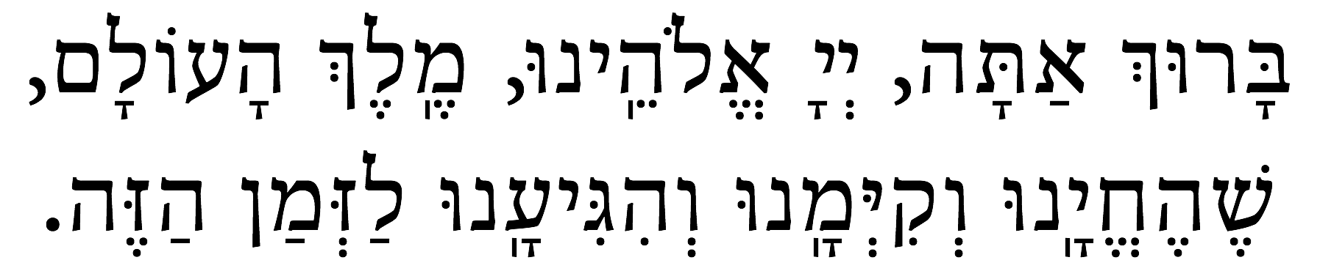
Shehecheyanu: A Prayer to Give Thanks
Baruch atah, Adonai Eloheinu, Melech haolam,
shehecheyanu v’kiy’manu, v’higianu laz’man hazeh.
SAMPLE
Copyright by the Central Conference of American Rabbis.
Blessed are You, Eternal our God, Sovereign of the universe,
for giving us life, sustaining us,
and for enabling us to reach this season.
Drink the first cup of wine and refill the wine cups.
23

