Slide 1



Visual T’filah
Pro vs. Basic

Slide 2



What’s the difference between Pro and Basic Visual T’filah?
BASIC: Each slide is one image.
PRO: Each element on the slide is editable.
Visual T’filah files are standard PowerPoint files.
(Keynote versions available upon request.)
 | Remove slides | Reorder slides | Add new content | Powerpoint Features | Add Images (visual iyyunim) | Edit text
BASIC |  |  | Blank slides are included to make this easy. | Object animations cannot be used, but transitions can. | Images can be placed on top of the slide (using transparency). | Each slide is a “flat” image.
PRO |  |  |  |  | Images can be used as slide backgrounds. | Hebrew text boxes are images, which can be cropped, etc.

Slide 3
Candle Blessing
Kiddush, Evening
Welcome
Shabbat Songs
Examples of
Pro
The following slides are from Mishkan T’filah Visual T’filah Pro,
but the features are consistent for all “Pro” Visual T’filah offerings.

Slide 4
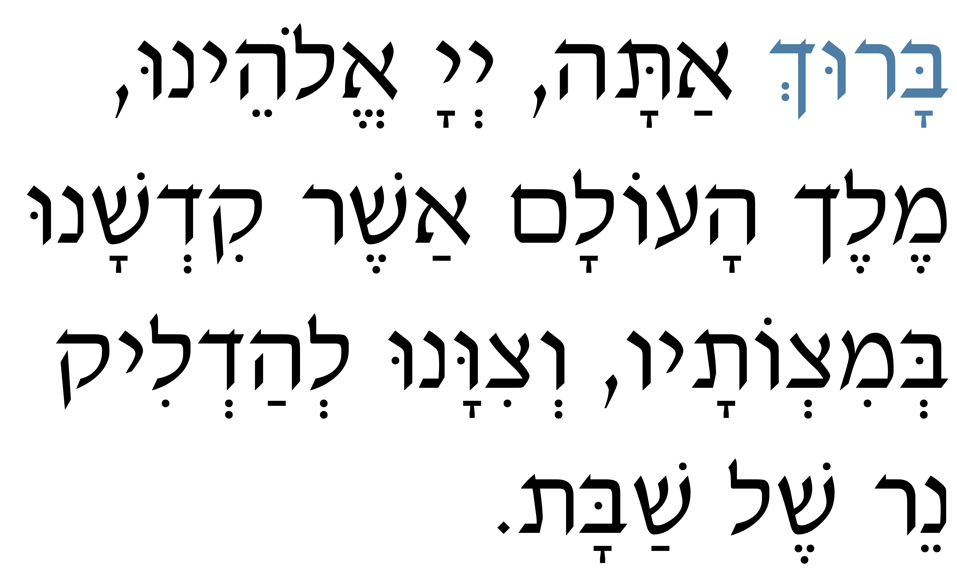
Kabbalat Panim for Shabbat
2 [120]
Candle Blessing
Kiddush, Evening
Welcome
Shabbat Songs
BARUCH atah, Adonai Eloheinu,
Melech haolam, asher kid’shanu
b’mitzvotav, v’tzivanu l’hadlik
ner shel Shabbat.
BLESSED ARE YOU, Adonai our God,
Sovereign of the universe, who hallows us
with mitzvot, commanding us to kindle
the light of Shabbat.
Shabbat Candle Blessing — The mitzvah of kindling Shabbat lights in the home is an early rabbinic practice (M. Shabbat 2:1ff.) The Shabbat candle blessing is first recorded in the ninth-century prayerbook, Seder Rav Amram. Lighting Shabbat candles as part of the synagogue service is an innovation of Reform Judaism.

Slide 5
Kabbalat Panim for Shabbat
3 [121]
Candle Blessing
Kiddush, Evening
Welcome
Shabbat Songs
AS THESE SHABBAT CANDLES give light
to all who behold them,
so may we, by our lives, give light to all who behold us.
As their brightness reminds us
of the generations of Israel who have kindled light,
so may we, in our own day, be among those who kindle light.
As these Shabbat candles . . . Chaim Stern

Slide 6
Candle Blessing
Kiddush, Evening
Welcome
Shabbat Songs
Examples of
BASIC
The following slides are from Mishkan T’filah Visual T’filah Basic,
but the features are consistent for all “Basic” Visual T’filah offerings.

Slide 7
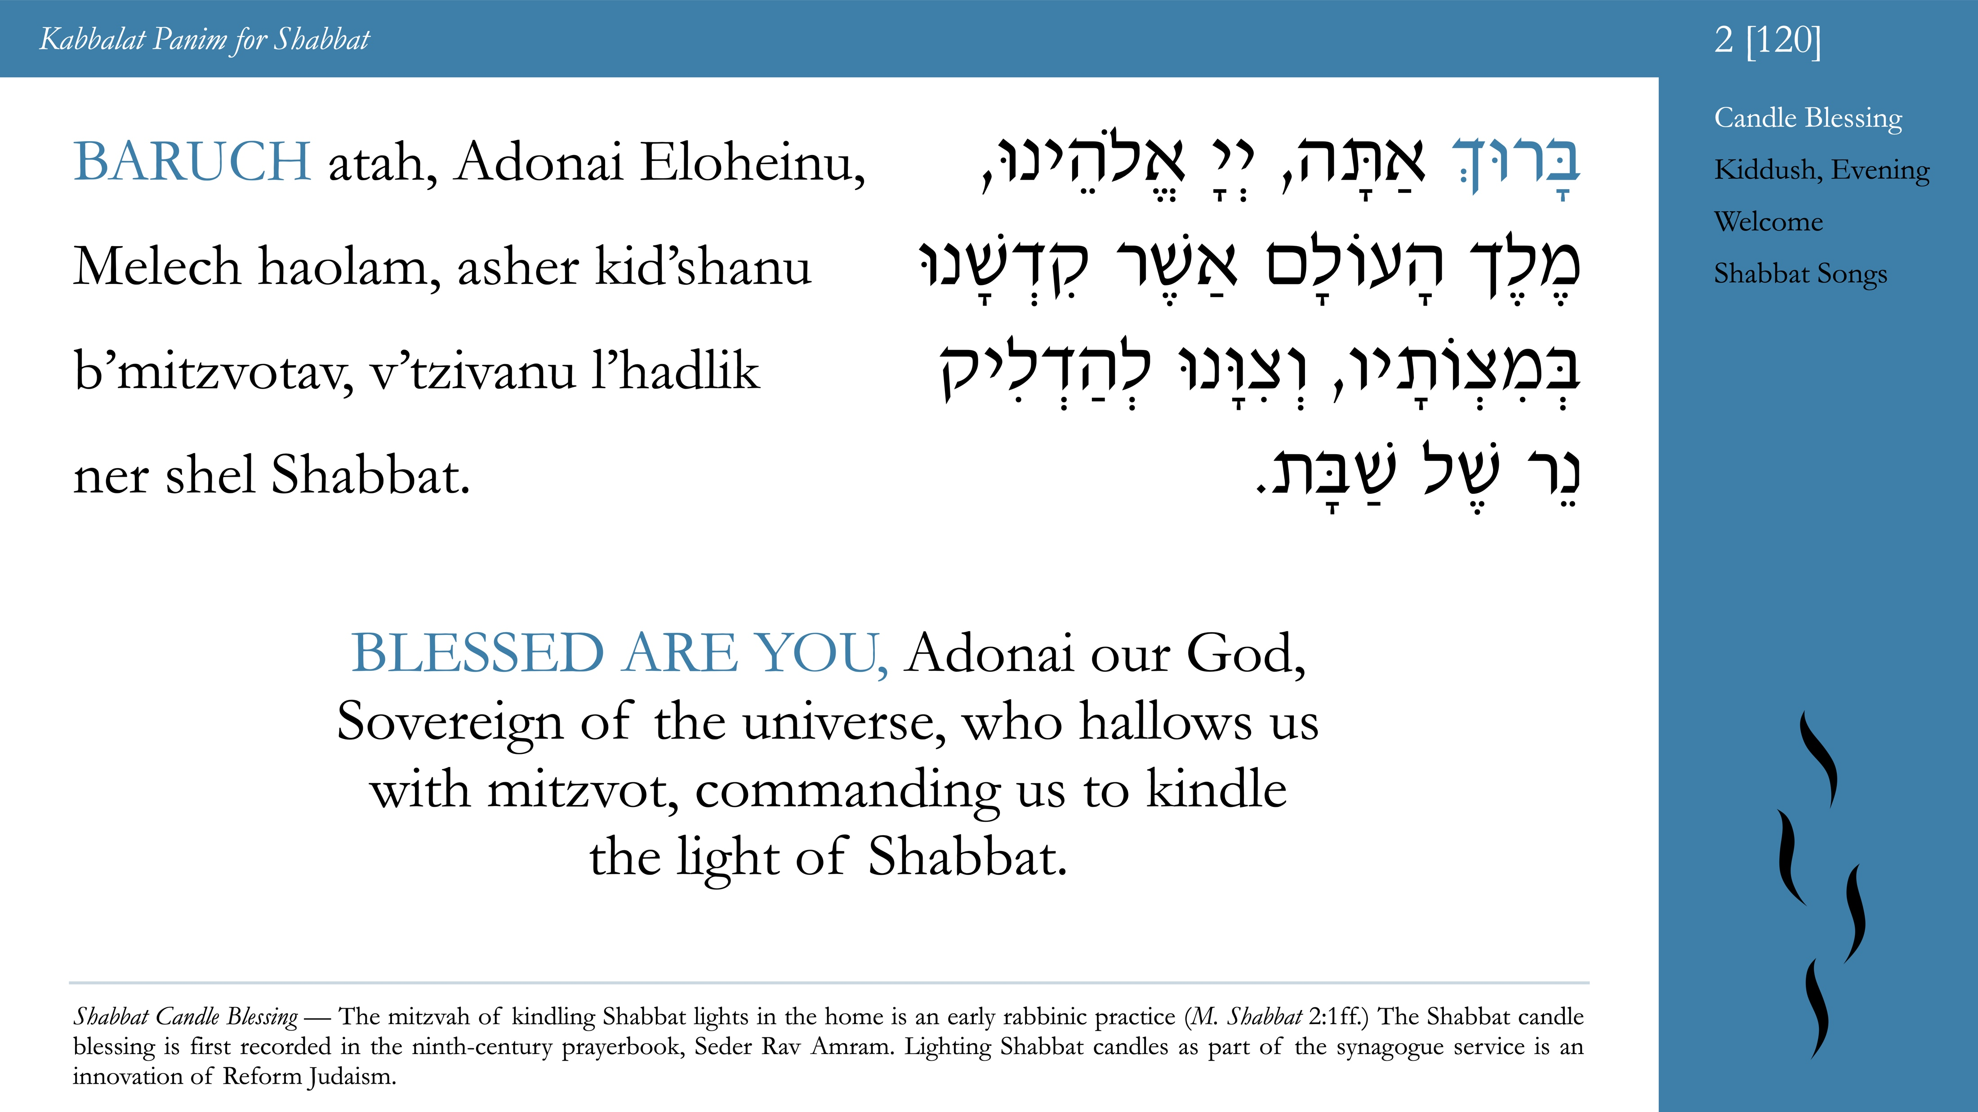

Slide 8
